Slide 1

CHEMISTRY-X
CHAPTER-3
METALS AND NONMETALS
SUB TOPIC- REACTIONS OF METALS WITH BASES AND DISPLACEMENT REACTIONS

Slide 2
REACTION WITH STRONG ALKALIS
Certain metals which are amphoteric in nature (can both react with acids as well as bases) can react with strong alkalis like NaOH and KOH to form corresponding complex salts releasing H2 gas as follows :
  [Zn, Al, Sn and Pb…]
  Zn + NaOH -> Na2ZnO2 + H2 (g) [here Zn is acting like an acid ]
          Sodium Zincate
  Again Zn +HCl -> ZnCl2 + H2 (g) [here Zn is acting like a base]
  Similarly Al, Pb also react to form so.
      Showing its Amphoteric nature.

Slide 3
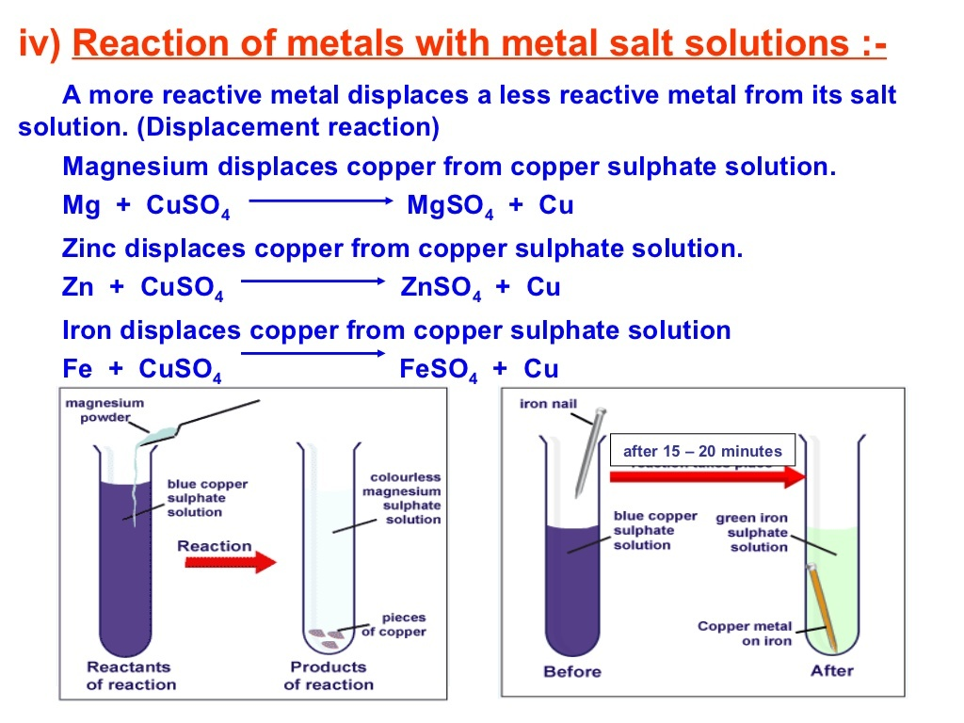
DISPLACEMENT REACTIONS

Slide 4
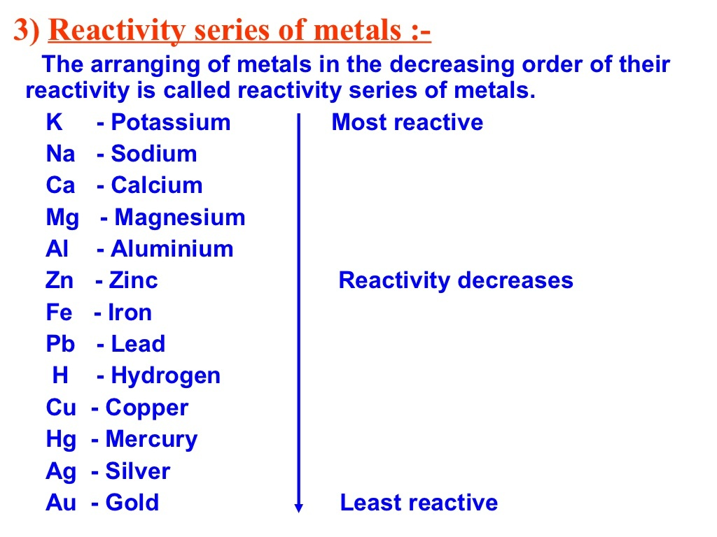
MRS [METAL REACTIVITY SERIES]

Slide 5
THANK YOU
  ODM EDUCATIONAL GROUP

