Slide 1

CLASS-X CH-3 METALS AND NONMETALS
SUB TOPIC- CHEMICAL PROPERTIES OF METALS

Slide 2
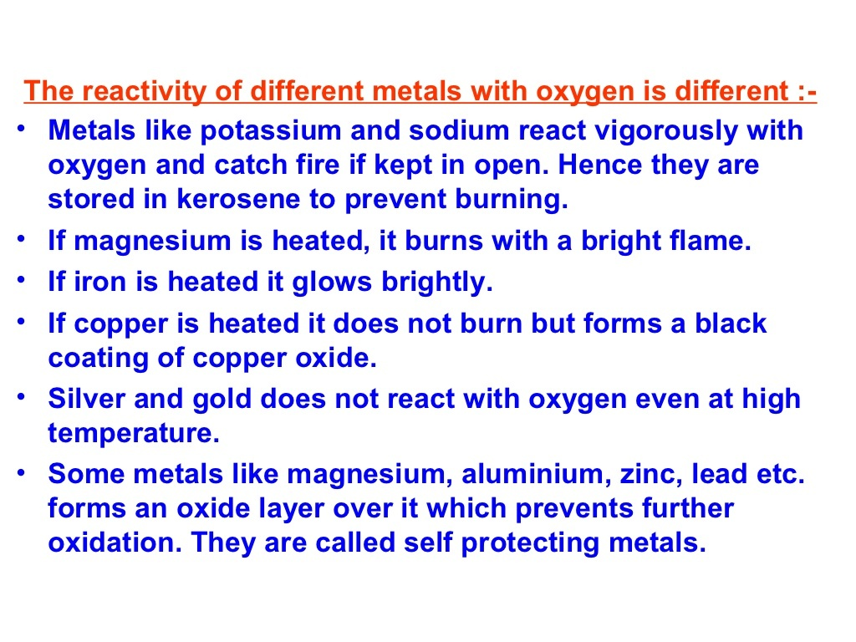
REACTION OF METALS WITH OXYGEN (O2)AND WATER (H2O)

Slide 3
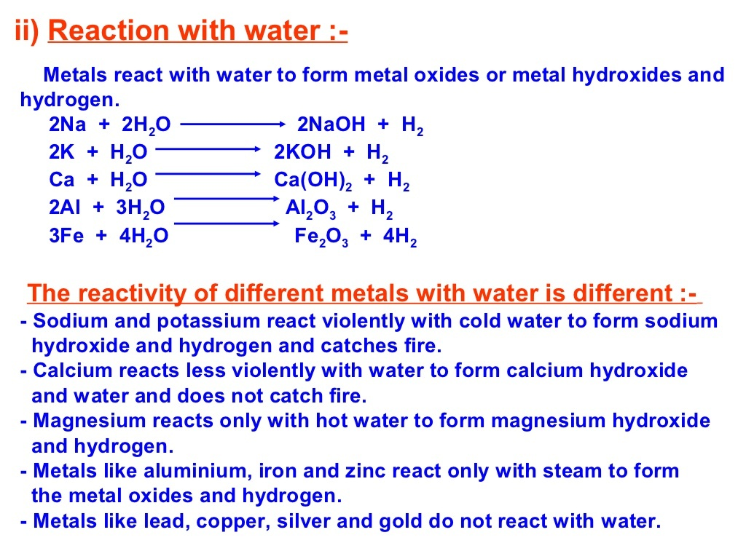
REACTION WITH WATER

Slide 4
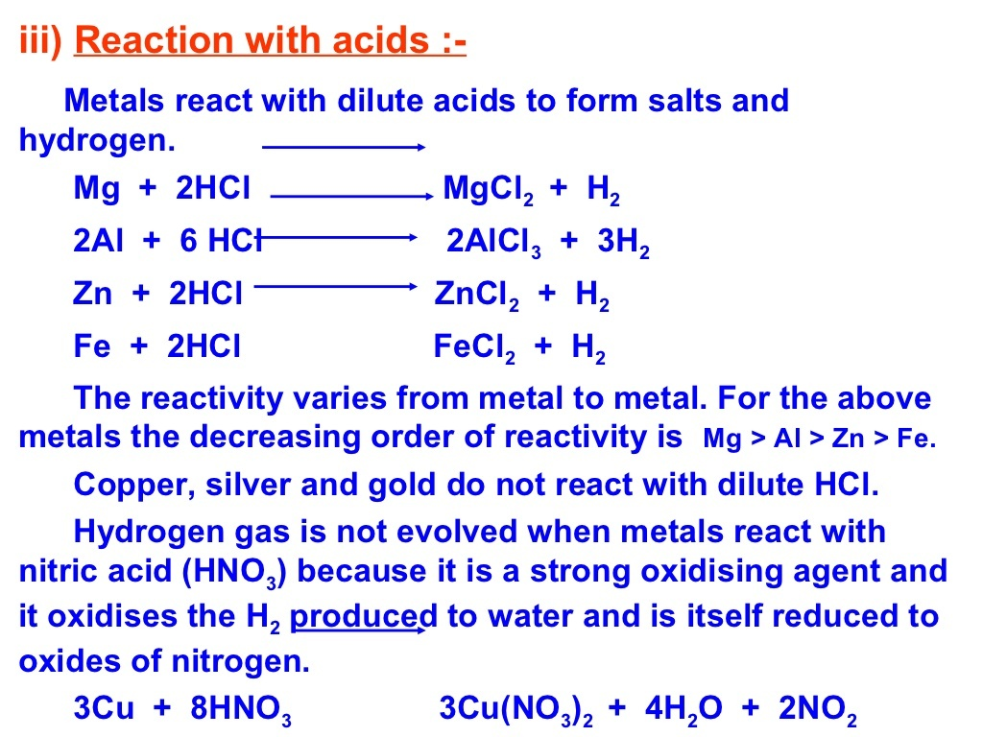
REACTION WITH ACIDS

Slide 5
THANK YOU
ODM PUBLIC SCHOOL

