Slide 1

CHEMISTRY-X
CH-3
METALS AND NONMETALS
SUB TOPIC- PHYSICAL PROPERTIES OF METALS AND NONMETALS

Slide 2
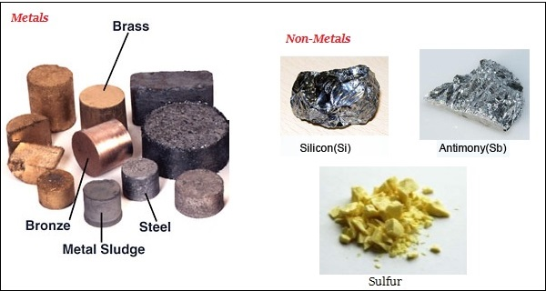
KNOWING SOME METALS AND NONMETALS

Slide 3
PHYSICAL PROPERTIES OF METALS
STATE
DENSITY
BRITTLENESS
RIGIDITY
MALLEABILITY
DUCTILITY
LUSTRE
SONORITY
CONDUCTIVITY (BOTH ELECTRICITY AND HEAT)

Slide 4
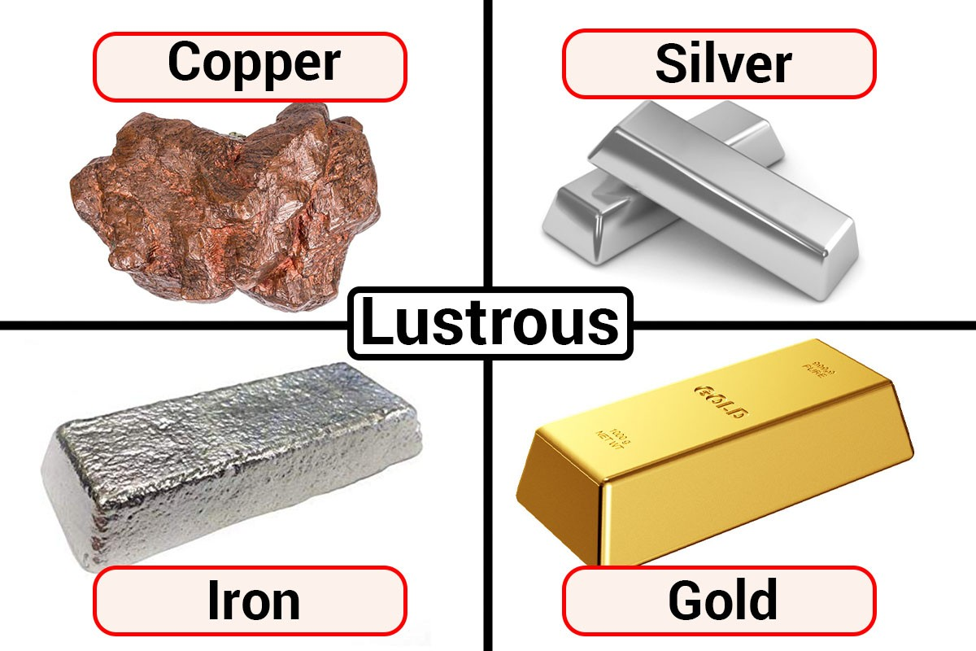
SHOWING LUSTROUS PROPERTY

Slide 5
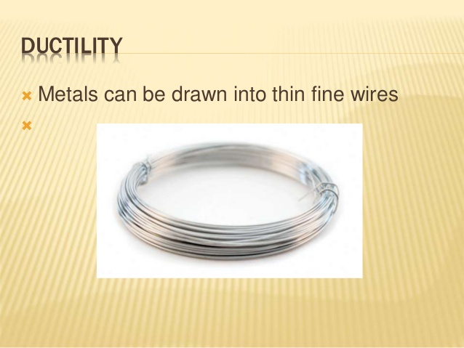
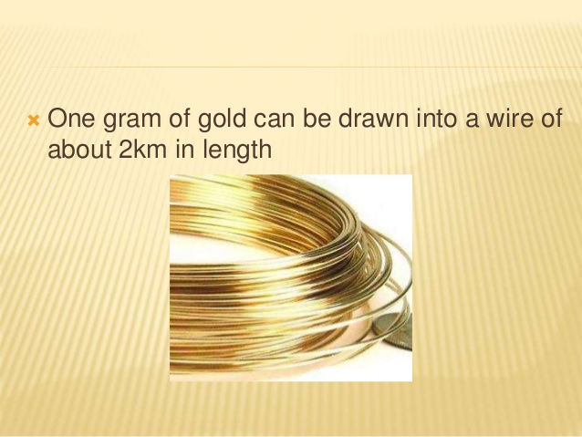
SHOWING DUCTILITY

Slide 6
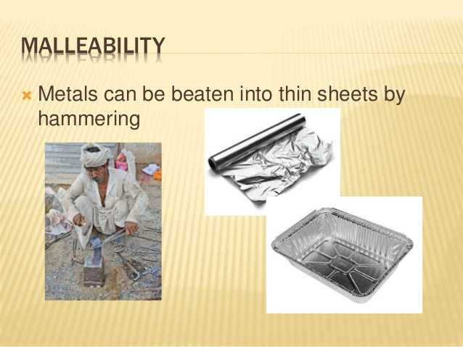
SHOWING MALLEABILITY AND DUCTILITY

Slide 7
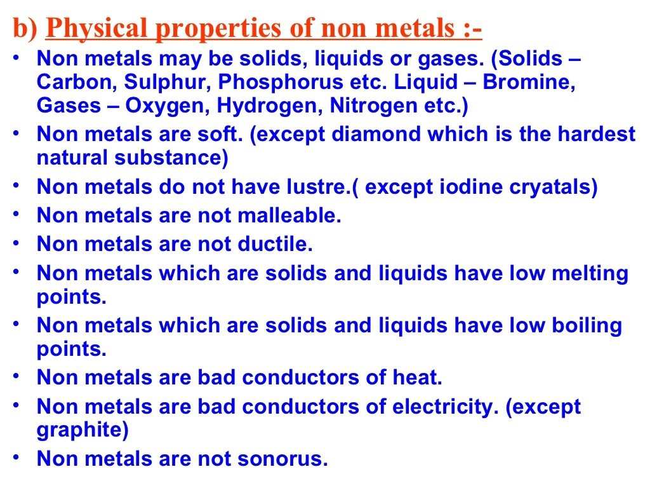
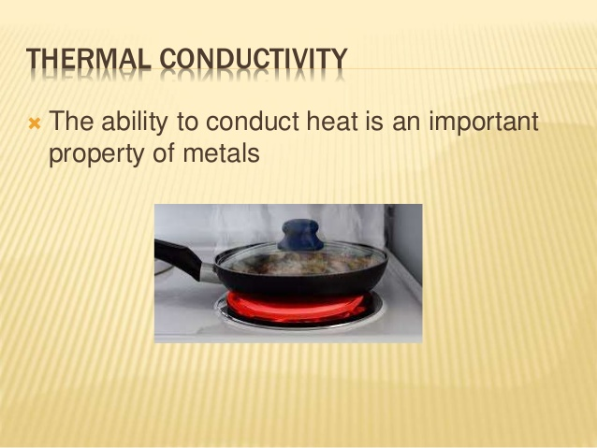
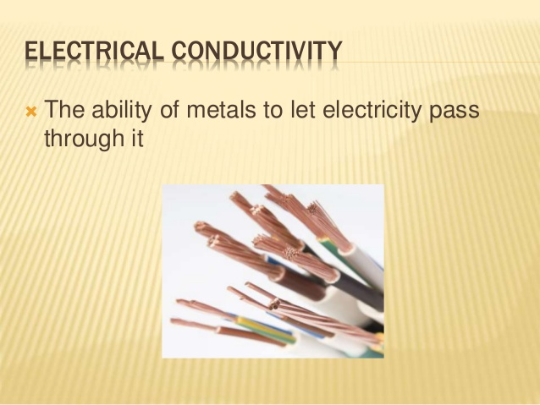
SHOWING CONDUCTIVITY

Slide 8
PHYSICAL PROPERTIES OF METALS

Slide 9
MORE PHYSICAL PROPERTIES

Slide 10
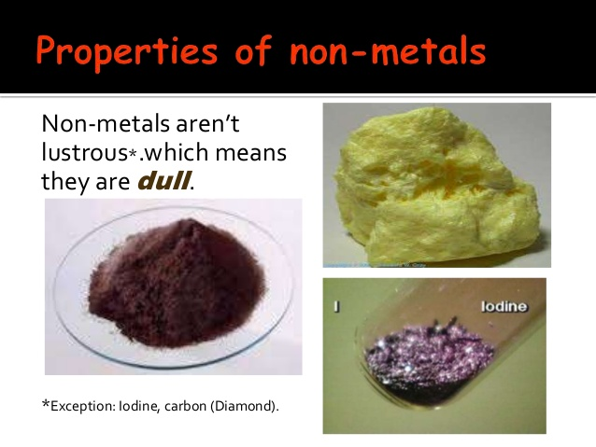
PHYSICAL PROPERTIES OF NONMETALS

Slide 11
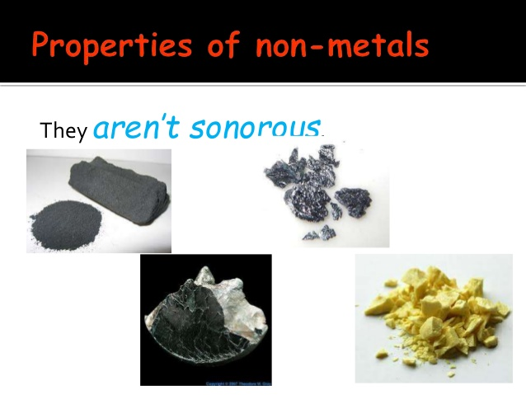
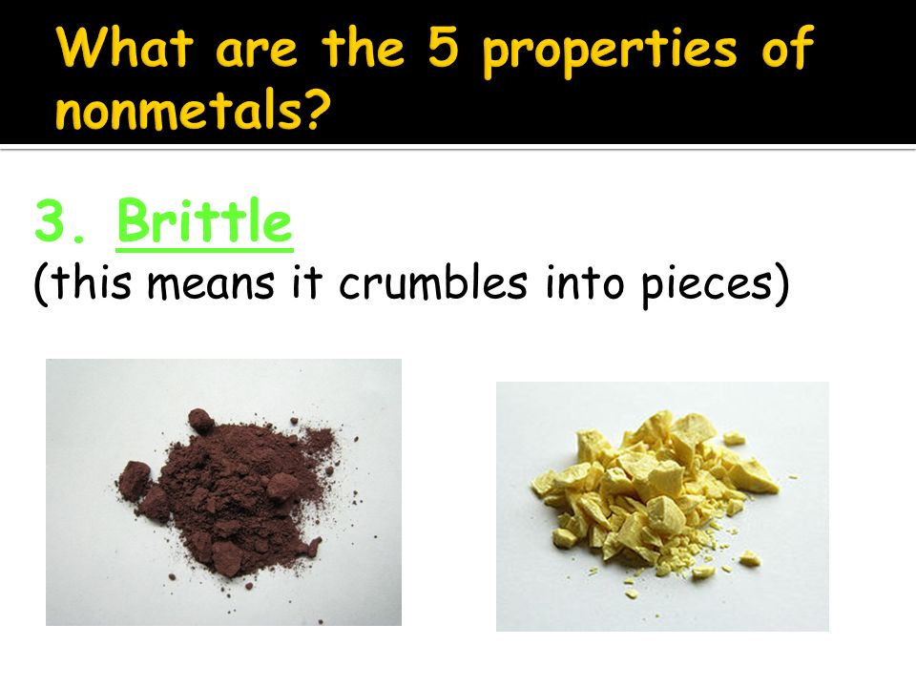
BRITTLE AND SONOROUS NATURE RITTLE

Slide 12
THANK YOU
    ODM EDUCATIONAL GROUP

