Slide 1


DRUGS : OPIOIDS, CANNABINOIDS & COCAINE
SUBJECT : BIOLOGY
CHAPTER NUMBER: 08
CHAPTER NAME : HUMAN HEALTH AND DISEASES

Slide 2
DRUGS :
Drugs are technically medicines or substances used internally or externally for the purpose of relief or cure the diseases.
Informally it is narcotics, stimulant, sedative or hallucinogenic substance that is commonly addictive and is taken as otherwise than medicine.
Surveys and statistics show that use of drugs and alcohol has been on the rise especially among the youth.
This is really a cause of concern as it could result in many harmful effects.
Proper education and guidance would enable youth to safeguard themselves against these dangerous behaviour patterns and follow healthy lifestyles.
The drugs, which are commonly abused are opioids, cannabinoids and coca alkaloids. Majority of these are obtained from flowering plants. Some are obtained from fungi.

Slide 3
OPIOIDS :
Source: Acetylation of morphine extracted from the latex of poppy plants (Papaver somniferum)
Consumed by: Snorting or injection ,orally.
Properties: White, bitter and odourless.
Mode of action: Binds to opioid receptors present in the CNS and GI tract.
Effect: It is a depressant; slows down body functions.
Opioids has sedative and analgesic (pain killer) effect.

Slide 4
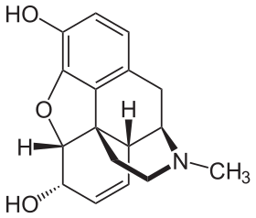
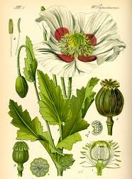
CHEMICAL STRUCTURE OF OPIOIDS AND PAPAVER PLANT:

Slide 5
CANNABINOIDS:
Source: Inflorescences, leaves, resins of the plant Cannabis sativa.
Consumed by: Inhalation, smoking or oral ingestion.
Mode of action: Binds to cannabinoid receptors present in the brain.
Effect: Affects the cardiovascular system, quickly absorbed by lungs and then converted into sedative ones.
Cannabinoids have hallucinogenic effect. These days cannabinoids are also being abused by some sportspersons.

Slide 6
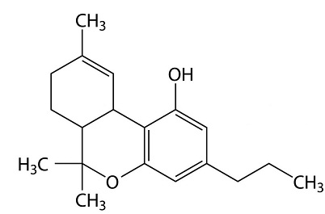
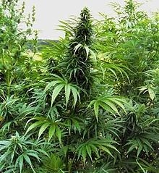
CHEMICALS STRUCTURES OF CANNABINOIDS AND CANNABIS PLANT :

Slide 7
COCAINE :
Source: Coca plant Erythroxylum coca, found in South America.
Consumed by: Snorting, leaves are chewed , sniffed in powder form and taken as drink
Commonly called as crack which is prepared by heating the baking powder into hard rods.
Mode of action: Interference with transfer of neurotransmitter, dopamine.
Effect: Stimulates the CNS, producing a sense of euphoria and increased energy; excessive dosages cause hallucination

Slide 8
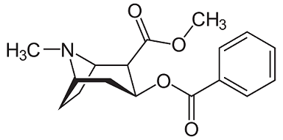
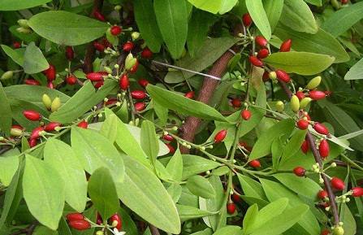
CHEMICAL STRUCTURE OF COCAINE AND ERYTHROXYLUM PLANT :

Slide 9
DRUGS USED AS MEDICINES:
Drugs like barbiturates, amphetamines, benzodiazepines, LSD (Lysergic acid diethyl amides) are used as medicines to help patients with mental illness and insomnia.
Datura and Belladona : seeds and aerial parts are misused for their hallucinogenic properties.
Morphine: It is a pain killer which is used for patients who have undergone surgery, but it is also abused.
Amphetamines are known as anti-sleep pills which brings about sleeplessness and depression.
Barbiturates are tranquillizer depresses brain activity and produce feelings of calmness , relaxation.
Benzodiazepines taken as antianxiety drug which produces deep sleep and drowsiness.
LSDs are hallucinogens which brings emotional outburst .

Slide 10
THANKING YOU
ODM EDUCATIONAL GROUP

