Slide 1


AIDS
CAUSE, TRANSMISSION,STRUCTURE OF HIV,LIFE CYCLE OF HIV,DIAGNOSIS,TREATMENT & PREVENTION
SUBJECT : BIOLOGY
CHAPTER NUMBER: 08
CHAPTER NAME : HUMAN HEALTH AND DISEASES

Slide 2
AIDS :
AIDS (Acquired Immuno Deficiency Syndrome) was first reported in 1981 from USA.
This means deficiency of immune system, acquired during the lifetime of an individual indicating that it is not a congenital disease.
'Syndrome' means a group and in the last twenty-five years or so, it has spread all over the world killing more than 25 million persons.
CAUSE :
It is caused by HIV (human Immuno deficiency virus), a retrovirus.
It was named as HIV in 1986 by international committee on taxonomy of viruses.
In India AIDS was reported from Chennai in 1986.

Slide 3
AIDS :
TRANSMISSION :
Transmission of HIV occurs through:
Sexual contact with infected person.
Sharing infected needles (as in case of intravenous drug abusers).
Transfusion of contaminated blood.
Infected mother to child through placenta.
Time lag between infection and appearance of symptoms − Few months to many years (5-10 years).
Initial 2-6weeks are window period where infection cannot be detected. People can therefore transmit the virus to other during window period.

Slide 4
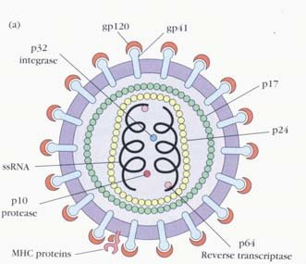
STRUCTURE OF HIV
HIV is a RNA virus which composed of two copies single-stranded RNA enclosed by a conical capsid composed of the viral protein.
Its innermost region consists of a cone-shaped core. that includes of the ssRNA genome, the enzymes reverse transcriptase, integrase and protease,
This is surrounded by an envelope of host-cell origin.
The envelope is formed when the capsid buds from the host cell, taking some of the host-cell membrane with it.
The envelope includes the glycoproteins , which are responsible for binding to and entering the host cell.

Slide 5
LIFE CYCLE OF HIV :
After getting into the body after person the virus enters into macrophages where RNA genome of the virus replicates to form viral DNA with the help of the enzyme reverse transcriptase.
Reverse transcriptase enzyme synthesizes DNA from RNA of viruses.
This viral DNA gets incorporated into host cell's DNA with the help of integrase and directs the infected cells to produce virus particles .
The macrophages continue to produce virus and in this way acts like HIV factory as they do not kill macrophages but bud out of it in the process exocytosis.
As the envelope glycoprotein changes simultaneously HIV enters into helper T –lymphocytes , replicates and produce progeny viruses.
The progeny viruses released in the blood attack other helper T -lymphocytes.

Slide 6
LIFE CYCLE OF HIV :
In the same way like macrophages it multiples in helper T-cells .
But the helper T-cells are killed as the virion ruptures the cell membrane and comes out.
This is repeated leading to a progressive decrease in the number of helper T-lymphocytes in the body of the infected person.
During this period the person suffers from bouts of fever, diarrhea and weight loss.
Due to decrease in the number of helper T lymphocytes the person starts suffering from infections that could have been otherwise overcome such as those due to bacteria specially Mycobacterium, viruses, fungi and even parasites like Toxoplasma .
The patient becomes so immune-deficient that he/she is unable to protect himself/herself against these infections.

Slide 7
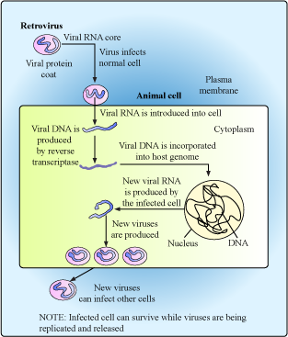
SCHEME SHOWING LIFE CYCLE OF HIV :

Slide 8
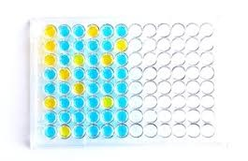
HIV : DIAGNOSIS AND TREATMENT:
Diagnosis of AIDS :
By ELISA (Enzyme Linked Immuno Sorbent Assay).
Western blot is also a confirmatory test which detects antiviral antibodies.
Treatment :
No permanent cure; antiretroviral therapies (ART) can prolong the life of patient.
The treatment includes a reverse transcriptase inhibitor like AZT (azidothymidine)
vaccine for preventing HIV is also under preparation .

Slide 9
PREVENTION OF AIDS :
Ensuring use of disposable syringes
Screening blood from blood banks
Advocating safe sex.
Sex education ,awareness created by media and newspaper.
NACO (National AIDS Control Organization) and many NGOs are doing a lot to create awareness among people.
Free distribution of condoms
Controlling drug abuse.
Promoting regular check-ups and no social boycott .

Slide 10
THANKING YOU
ODM EDUCATIONAL GROUP

