Slide 1


HEALTH AND CATEGORIES OF COMMON DISEASE TO HUMAN
PROTOZOAN , FUNGAL & HELMINTHIC DISEASES
SUBJECT : BIOLOGY
CHAPTER NUMBER: 08
CHAPTER NAME : HUMAN HEALTH AND DISEASES

Slide 2
PROTOZOAN DISEASES :
MALARIA
  Pathogen − Plasmodium sps. (P.vivax, P. falciparum, P. malaria)
  Vector − Female Anopheles mosquito
  Symptoms − High grade fever, chills
LIFE CYCLE OF PLASMODIUM :
Plasmodium requires two hosts to complete its life cycle.
When female Anopheles mosquito bites a healthy human being, it releases Plasmodium, which lives in its body as sporozoite (infectious form).
The parasites multiply (asexual reproduction) in the liver cells and finally burst the liver cells. Sporozoites are released in blood.

Slide 3
PROTOZOAN DISEASES :
LIFE CYCLE OF PLASMODIUM :
Parasites enter RBCs and further multiply (asexual reproduction) here and finally burst RBCs also.
Bursting of RBCs is accompanied by release of a toxic substance called haemozoin (associated with fever and chills).
In the RBCs, only sporozoites change into gametocytes (sexual stage). Gametocytes multiply.
When the diseased person is bitten by a female Anopheles mosquito, gametocytes are introduced into the mosquito.
Gametocytes fertilise and develop inside the intestine of mosquito to form sporozoites.
Sporozoites are stored in the salivary glands of mosquito and are released into the healthy person who is bitten by this mosquito.

Slide 4
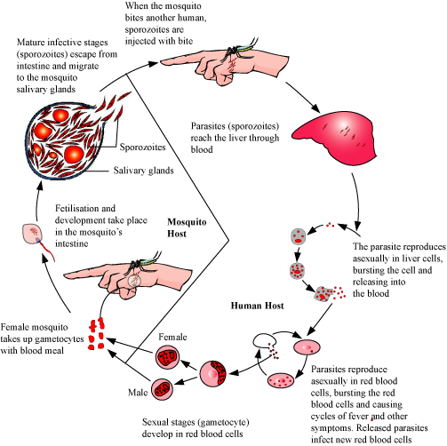
SCHEME SHOWING LIFE CYCLE OF PLASMODIUM :

Slide 5
PROTOZOAN DISEASES :
AMOEBIASIS :
  Pathogen − Entamoeba histolytica.
  Vector − Housefly.
  Site of infection − Large intestine.
  Symptoms − Constipation, abdominal pain, cramps, stools with mucous, and blood clots.
  It is otherwise known as amoebic dysentery. The cyst of Entamoeba present in the stool of infected person reaches to the drinking water, raw vegetables and fruits ,other edibles by the vector.
  The cyst when reaches inside large intestine ,develops infective stage of the protozoa which secretes a toxin that perforates the wall of intestine.

Slide 6
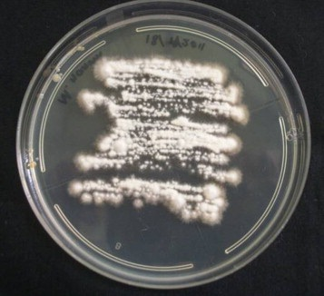
FUNGAL DISEASES :
RINGWORMS :
  Pathogens − Genera Microsporum, Trichophyton, and Epidermophyton .
  Spreads through − Towels, clothes, comb.
  Symptoms − Appearance of dry, scaly lesions on various body parts with intense itching .
  Heat and moisture promote the growth of these fungi especially in skin folds .
  There are dry scaly lesion on skin , nails and scalp that cause intense itching .
CULTURE PLATE OF MICROSPORUM

Slide 7
HELMINTHIC DISEASES:
ASCARIASIS:
Pathogen − Round worm( Ascaris)
  Spreads through − Water, vegetables, fruits contaminated by faeces of infected person
  Symptoms − Internal bleeding, muscular pain, fever, anaemia, blockage of intestinal passage.
  The eggs of the parasite are excreted along with the faeces of infected persons which contaminate soil, water, plants, etc. A healthy person acquires this infection through contaminated water, vegetables, fruits, etc.
ELEPHANTIASIS (FILARIASIS) :
  Pathogen − Wuchereria (W.malayi and W.bancrofti)
  Spreads through − Bite of female mosquito vector.
  Symptom − Chronic inflammation of the organs, usually the lymphatic vessels of lower limb.
  The genital organs are also often affected, resulting in gross deformities. The pathogens are transmitted to a healthy person through the bite by the female mosquito vectors.
.

Slide 8
THANKING YOU
ODM EDUCATIONAL GROUP

