Slide 1


HEALTH AND CATEGORIES OF COMMON DISEASE TO HUMAN
PATHOGENS AND THEIR ADAPTATIONS,
BACTERIAL & VIRAL DISEASES
SUBJECT : BIOLOGY
CHAPTER NUMBER: 08
CHAPTER NAME : HUMAN HEALTH AND DISEASES

Slide 2
HEALTH:
Health does not simply mean absence of disease or physical fitness. Health is the state of complete physical, mental, and social well being.
Health increases productivity and ensures longevity.
When people are healthy. they are more efficient at work. This increases productivity and brings economic prosperity. Health also increases longevity of people and reduces infant and maternal mortality.
The Ways to Ensure Good Health :
Balanced diet
Personal hygiene
Exercise
Awareness about prevention and control of diseases
Proper waste disposal and control of vectors
Vaccination
Diseases occur due to the following reasons
Genetic reasons − Innate deficiencies and inheritable defects
Infections
Sedentary life style − Junk food, consumption of alcohols/drugs, lack of exercise

Slide 3
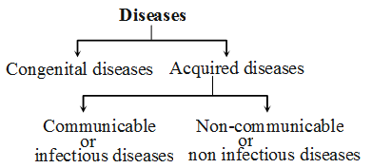
BROAD CATEGORY OF DISEASES :

Slide 4
CATEGORY OF DISEASES
A disease is an abnormal condition affecting a healthy living organism. It is broadly divided into infectious and non-infectious.
Infectious diseases- These diseases are caused by the pathogens, such as bacteria, virus, fungi, parasites and can be easily transmitted from one person to another, hence it is also known as a contagious or communicable disease. Common Cold, Tuberculosis, flu, ringworm, malaria are some examples of infectious diseases.
Non-infectious diseases- Diseases which cannot be transmitted from one person to another are called non-infectious disease, it is also known as a non-communicable disease. These diseases can be either caused by genetic disorders, unhealthy diets, lack of physical activity, excessive use of tobacco, drugs or alcohol and few environmental factors.

Slide 5
PATHOGENS :
In biology, a pathogen in the oldest and broadest sense, is anything that can produce disease. A pathogen may also be referred to as an infectious agent, or simply a germ.
The term pathogen came into use in the 1880s.
Typically, the term is used to describe an infectious microorganism or agent, such as a virus, bacterium, protozoan, prion, viroid or fungus.
Small animals, such as certain kinds of worms and insect larvae, can also produce disease
PATHOGENICITY:
Pathogenicity is the potential disease-causing capacity of pathogens. It is also defined as degree of virulence
Virulence (the tendency of a pathogen to reduce a host's fitness) evolves when a pathogen can spread from a diseased host, despite the host becoming debilitated.

Slide 6
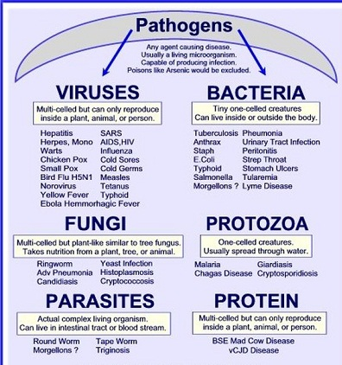
PATHOGENS:

Slide 7
PARASITIC ADAPTATION :
All parasites are pathogens as they cause harm to the host by living in (or on) them.
The pathogens cannot enter our body by various means multiply and interfere with normal vital activities resulting in morphological and functional damage.
Pathogens have to adapt to life within the environment of the host.
For example:
The pathogens that enter the gut must know a way of surviving in the stomach at low pH and resisting the various digestive enzymes.
Loss of digestive organs .
Attachment of adhesive organs.
Excessive multiplication rate .
Well developed and complicated reproductive organs.

Slide 8
COMMUNICABLE (INFECTIOUS) DISEASES :
BACTERIAL DISEASES :
Typhoid
Pathogen − Salmonella typhi .
Spreads through − Contaminated food and water .
Site of infection − Small intestine
Symptoms − High fever (39⁰ c to 40⁰ c), stomach pain, headache, loss of appetite, constipation, and intestinal perforations in severe cases .
Confirmatory test − Widal test.
Mary Mallon nick named Typhoid Mary is worth mentioning here. She was a cook by profession was a typhoid carrier who continued to spread typhoid for several years through the food she prepared.
Pneumonia
Pathogens − Streptococcus pneumoniae and Haemophilus influenzae
Spreads through − Droplets/aerosols released from infected person, sharing of glasses or utensils
Site of infection − Alveoli (gets filled with fluid, difficulty in breathing)
Symptoms − Fever, chills, cough, headache, lips and nails become grey in severe cases.
Dysentery, plague, diphtheria, etc .. are some of the other bacterial diseases in man.

Slide 9
COMMUNICABLE (INFECTIOUS) DISEASES :
VIRAL DISEASES
Common cold:
Many viruses also cause diseases in human beings. They infect the nose and respiratory passage but not the lungs.. Droplets resulting from cough or sneezes of an infected person are either inhaled directly or transmitted through contaminated objects such as pens, books, cups, doorknobs. computer keyboard or mouse etc ….and cause infection in a healthy person.
Pathogen − Rhino viruses
Site of infection − Nose and respiratory passage
Spreads through − Droplets released from coughing or sneezing, or contaminated objects
Symptoms − Nasal congestion and discharge, sore throat, cough, headache, tiredness , which usually last for 3-7 days

Slide 10
THANKING YOU
ODM EDUCATIONAL GROUP

