Slide 1


MICROBES IN SEWAGE TREATMENT,
MICROBES IN PRODUCTION OF BIOGAS
SUBJECT : BIOLOGY
CHAPTER NUMBER: 10
CHAPTER NAME : MICROBES IN HUMAN WELFARE

Slide 2
MICROBES IN SEWAGE TREATMENT :
Sewage basically consists of human excreta. It may contain many microbes, which may be pathogenic also.
Sewage disposal is a huge problem. It cannot be directly disposed into rivers and streams.
Hence, it has to be treated first in sewage treatment plants (STPs).
The heterotrophic microbes present in the sewage itself aid in its treatment.
Treatment of sewage includes two stages − primary treatment and secondary treatment.
Primary Treatment − Involves physical removal of particles by filtration and sedimentation.
Initially, sequential filtration is used to remove floating debris.
Then, grit (soil + small pebbles) are removed by sedimentation.
Solids that settle down form the sludge while the supernatant forms the effluent.
Effluent is taken for secondary treatment. The effluent from the primary settling tank is taken for secondary treatment.

Slide 3
MICROBES IN SEWAGE TREATMENT :
Secondary Treatment:
Effluent is passed to aeration tank → Constant agitation → Air pumped → Vigorous growth of bacteria → Floc formation → Consumption of organic matter by bacteria → Decrease in BOD.
BOD is the amount of oxygen that would be consumed if all the organic matter in one litre of water were oxidized by bacteria. It measures the amount of organic matter present in the water.
BOD is the amount of oxygen required by bacteria to oxidize all the organic matter present in the effluent.
Greater the BOD of water more it is polluted.
Naturally, if organic matter decreases → BOD decreases → Pollution decreases
FLOCS : Floc = Bacteria + Fungal filaments (in a mesh-like structure)
When BOD and hence pollution is reduced, effluent is passed into a settling tank.
Here, flocs settle down and it is known as Activated Sludge.

Slide 4

MICROBES IN SEWAGE TREATMENT :
A small part of the activated sludge is pumped back into the aeration tank to serve as the inoculum.
The remaining major part of the sludge is pumped into large tanks called anaerobic sludge digesters.

Slide 5
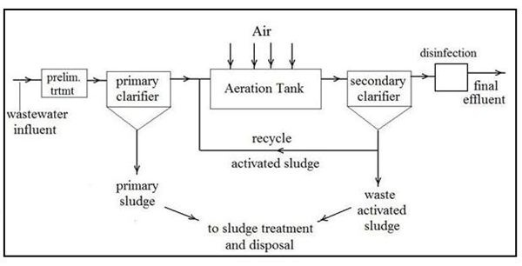
MICROBES IN SEWAGE TREATMENT :

Slide 6
MICROBES IN PRODUCTION OF BIOGAS :
Microbes produce many gases during their metabolism. Biogas is a mixture of gases produced by the microbial activity that can be used as fuel.
Certain bacteria that grows anaerobically on cellulosic material produce large amount of methane along with CO₂ and H₂.
These bacteria are collectively called methanogens (Methanobacterium).
The type of gas produced depends upon the substrate they grow on and the type of microbe.
Methanogens are commonly found in anaerobic sludge (as in sewage treatment) and in the rumen of cattle.
In the rumen of cattle, these bacteria help in cellulose digestion.
Hence, excreta of cattle (gobar) are rich in methanogens. Biogas is also called gobar gas.

Slide 7
MICROBES IN PRODUCTION OF BIOGAS :
Biogas Plant − Components of biogas plant:
Concrete tank− Here, slurry of dung is fed. It is a 10 − 15 feet deep tank.
Floating cover− Placed on slurry; rises as the gas is produced
Outlet − It is connected to the pipe.
Pipe − It supplies the biogas to nearby houses.
Outlet for spent slurry − Spent slurry can be used as a fertilizer.
Biogas plant is usually set up in rural areas since cow dung is available in abundance there.
Biogas is used for cooking and lighting.
Biogas technology in India is due to the efforts of:
IARI - (Indian Agricultural Research Institute).
KVCI - (Khadi and Village Industries Commission).

Slide 8
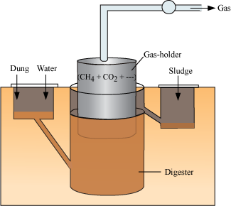
MICROBES IN PRODUCTION OF BIOGAS :

Slide 9
THANKING YOU
ODM EDUCATIONAL GROUP

