Slide 1


SESSION : 9
CLASS :V
SUBJECT : (SOCIAL SCIENCE)
CHAPTER NUMBER: 5
CHAPTER NAME : DRC - The Land of Dense Forest
SUBTOPIC : Class Test & Map Work

Slide 2
LEARNING OBJECTIVES:
Children will :
1.Enhance their talent
2.Sharpen their mind.

Slide 3
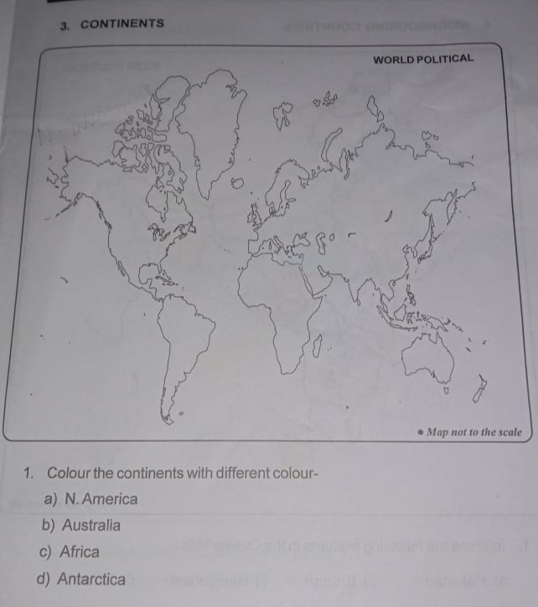
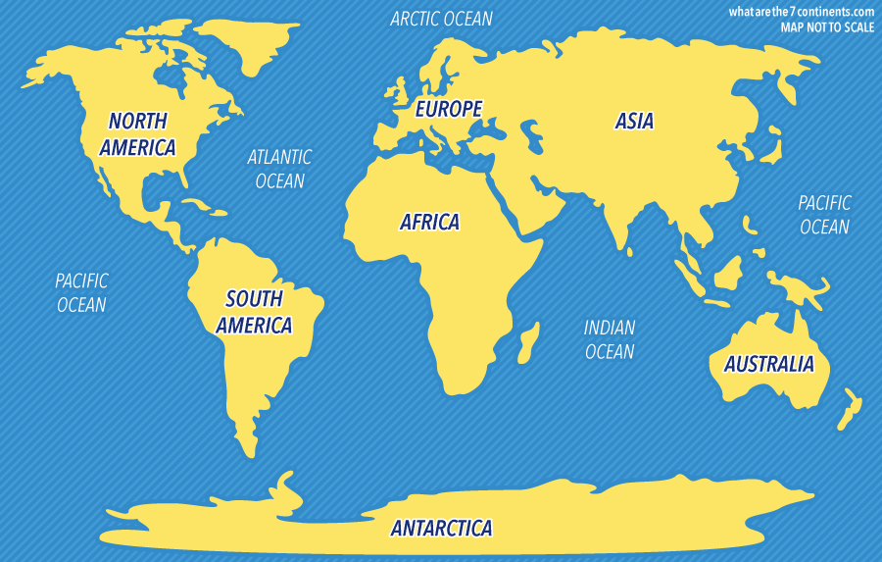
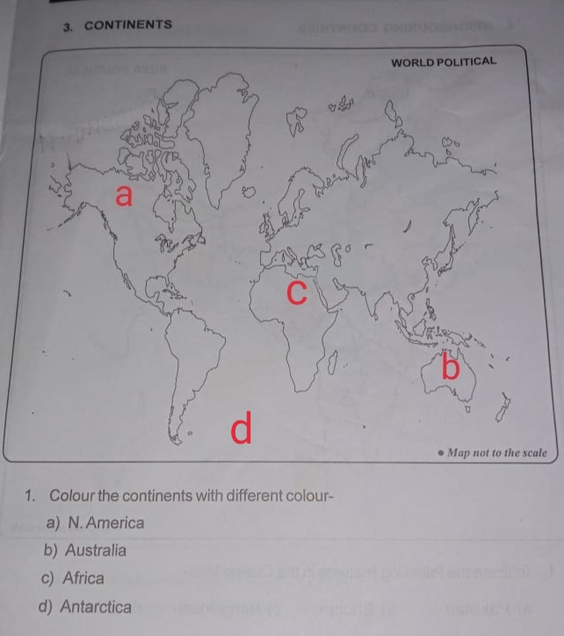

Slide 4
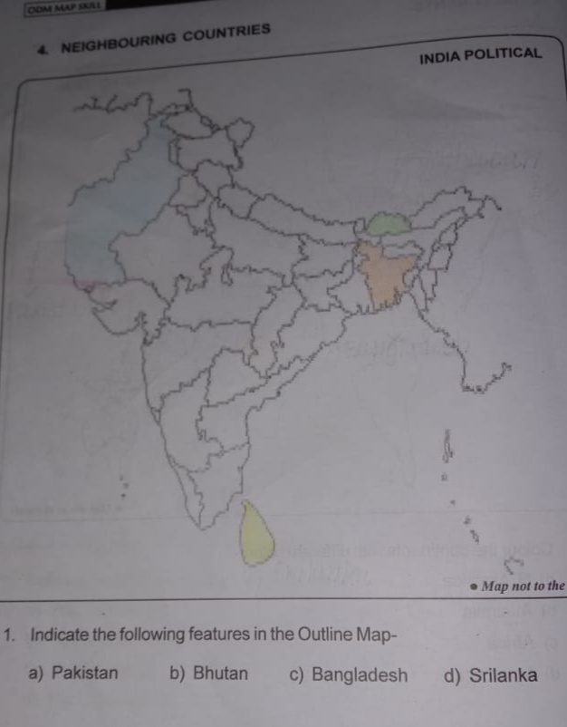
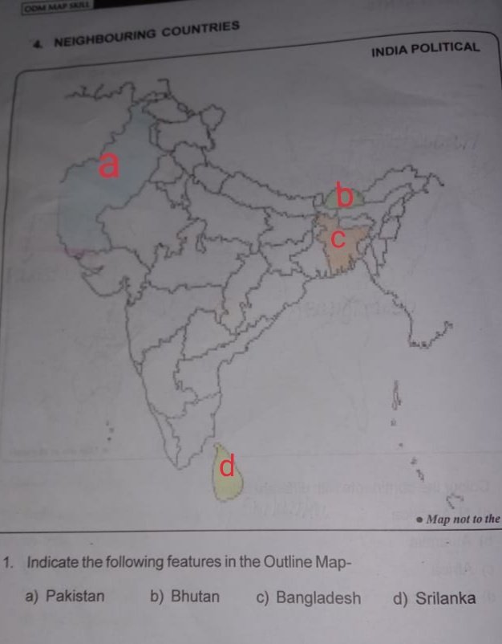
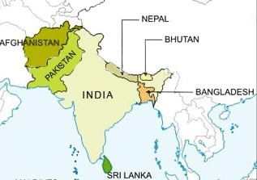

Slide 5
CLASS TEST:
A. Define the following words:
1. Savannah
2. Canopy
3. Pygmies
4. Tribe
( 1X4=4 )
( 1X6=6 )
B. Write in one word:
1.The trees of the forest are covered with leaves throughout the year.
2.The only country in the world in which bonobos are found in the wild.
3.The dwarf chimpanzees found in DRC.
4.An insect found in the forest of DRC that causes the dreaded sleeping sickness.
5.The capital of DRC.
6.Sent to another country for sale.

Slide 6
C. Answer the following questions:
1. Write the location and extent of the DRC.
2. Why is the climate of the DRC hot and humid?
3. Describe the way pygmies live.
4. Name any four common trees grown in the DRC.
5. Name any two countries with which DRC shares its boundaries.
( 2X5=10 )

Slide 7
CLASS TEST:
A. Define the following words:
1. Savanna-
Ans. A large area of grassland with scattered trees, found in southern part of DRC.
2. Canopy-
Ans. Branches of trees that spread over an area like a roof.
3. Pygmies-
Ans. People of less than average height who mainly live in Central Africa and South-east Asia in Negritos.
4. Tribe-
Ans. A large group of people who live in the same area and share a common language, religion and customs.
( 1X4=4 )

Slide 8
( 1X6=6 )
B. Write in one word:
1.The trees of the forest are covered with leaves throughout the year - EVERGREEN FOREST
2.The only country in the world in which bonobos are found in the wild - DRC
3.The dwarf chimpanzees found in DRC - BONOBOS
4.An insect found in the forest of DRC that causes the dreaded sleeping sickness - TSETSE FLY
5.The capital of DRC - KINSHASA
6.Sent to another country for sale - EXPORT

Slide 9
C. Answer the following questions:
1. Write the location and extent of the DRC.
Ans. The Democratic Republic of Congo (DRC) is a country located deep in the heart of the African continent. It lies in the Torrid Zone.
2. Why is the climate of the DRC hot and humid?
Ans. As DRC is near the Equator, the climate in most parts of the DRC is hot and humid throughout the year.
3. Describe the way pygmies live.
Ans. Life style of pygmies
- They hunt animals and gather plant foods for their food.
- They live in huts made of branches and leaves with thatched roof.
4. Name any four common trees grown in the DRC.
Ans. Ebony, redwood, rubber, mahogany
5. Name any two countries with which DRC shares its boundaries.
Ans. Uganda, Rwanda, Burundi, Tanzania
( 2X5=10 )

Slide 10
HW Do Worksheet no. 1 to 4

Slide 11
LEARNING OUTCOME:
By the end of the class, children will be able to:
1.Know the difference between weather and climate of our area and tropical zone area.
2.Know how location of a place affects the climate of that place.

Slide 12
THANKING YOU
ODM EDUCATIONAL GROUP

