Slide 1

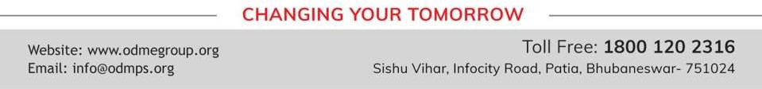
UNDERSTANDING SHAPES
PERIOD 1
SUBJECT : MATHEMATICS
CHAPTER NUMBER: 16
CHAPTER NAME : UNDERSTANDING SHAPES

Slide 2

Learning outcome
Students will be able to understand the concept of Polygons.
.

Slide 3
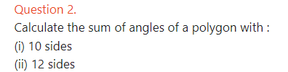
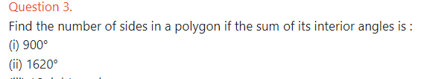

Exercise -16A

Slide 4
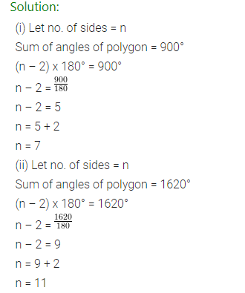
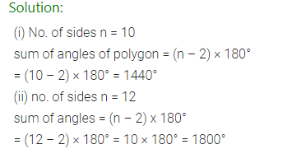

Slide 5
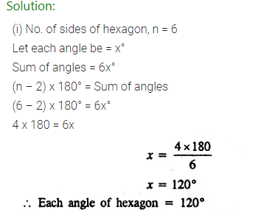
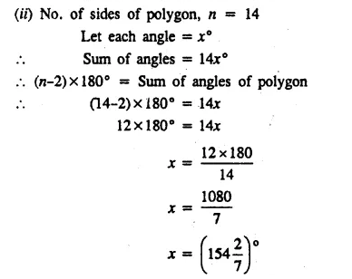

Slide 6
Home assignment
Exercise 16(A)

Slide 7
THANKING YOU
ODM EDUCATIONAL GROUP

