Slide 1


INTRODUCTION TO ACCOUNTING
MEANING & FEATURES OF ACCOUNTING
SUBJECT : ACCOUNTANCY
CHAPTER NUMBER:1
CHAPTER NAME :INTRODUCTION TO ACCOUNTING
CLASS-1

Slide 2
Meaning of Accounting
Accounting is the process of identifying, measuring, recording and communicating the required information relating to the economic events of an organisation to the interested users of such information. Accounting plays important role in providing quantitative information, primarily financial in nature, about economic entities, that is intended to be useful in making economic decisions.
Definition of Accounting
“Accounting is the process of identifying, measuring and communicating economic information to permit informed judgments and decisions by users of the information.”
-- (Year 1966) American Accounting Association (AAA)
“Accounting is a service activity. Its function is to provide quantitative information, primarily financial in nature, about economic entities that is intended to be useful in making economic decisions.”
-- (Year 1970) Accounting Principles Board of AICPA (U.S.A)

Slide 3
Book Keeping
Recording of business transactions in a systematic manner in the books of account is called book- keeping. It is mainly concerned with the maintenance of books of accounts. It includes identification of financial transactions, measuring these transaction in terms of money, recording these transactions and classifying them into ledger.
According to A.J. Favell “Book–keeping is the art of recording the financial transactions of a business in a methodical manner so that information on any point in relation to them may be quickly obtained”.

Slide 4
FEATURES of Accounting
Identification : The first step in accounting is to determine what to record, i.e., to idenfity
the financial events which are to be recorded in the books of accounts. It involves observing all business activities and selecting those events or transactions which can be considered as financial transactions.
Measurement : In Accounting we record only
terms of money or which are of financial nature. If a transactions or event cannot be
measured in monetary terms, it is not considered for recording in financial accounts.
There are few events directly or indirectly make affect on the working of a business firm but cannot be recorded in the books of accounts because they cannot be measured in terms of money. For example : appointment of a new managing director, signing of contracts, strikes, death of an employee etc are not shown in the books of accounts.
Recording : A transaction will be recorded in the books of accounts only if it is considered as an economic event and can be measured in terms of money. Once the economic events are identified and measured in financial terms, these are recorded in books of account in monetary terms and in a chronological order. Recording should be done in a systematic manner so that the information can be made available when required.

Slide 5
Classifying : Once the financial transactions are recorded in journal or subsidiary books, all the financial transactions are classified by grouping the transactions of one nature at one place in a separate account. This is known as preparation of Ledger.
Summarising : It is concerned with presentation of data and it begins with balance of ledger accounts and the preparation of trial balance with the help of such balances. Trial balance is required to prepare the financial statements i.e. Trading Account, Profit & Loss Account and Balance Sheet.
Communication : The main purpose of accounting is to communicate the financial information the users who analyse them as per their individual requirements. Providing financial information to its users is a regular process.

Slide 6
INTRODUCTION TO ACCOUNTING
MEANING OF BOOK KEEPING & ACCOUNTING
SUBJECT : ACCOUNTANCY
CHAPTER NUMBER:1
CHAPTER NAME :INTRODUCTION TO ACCOUNTING
CLASS-2

Slide 7
Book-Keeping | Accounting
Book-Keeping is maintained by Junior staff Book-Keeping is the Primary stage It is concerned with recording of day to day transactions | Accounting is maintained by Senior Staff Accounting is the secondary stage It is based on book keeping

Slide 8
Objectives of Accounting
The main objective of the accounting is to keep systematic record of business transactions. That is why, all financial transactions are first recorded in journal and then posted into ledger.
Accounting is helpful in preventing and detecting the errors and frauds.
Accounting plays important role in calculating the profit or loss during a particular period by preparing Trading account and Profit and Loss Account.
Accounting is helpful in ascertaining the financial position of the business.
Accounting provides useful information to its users.

Slide 9
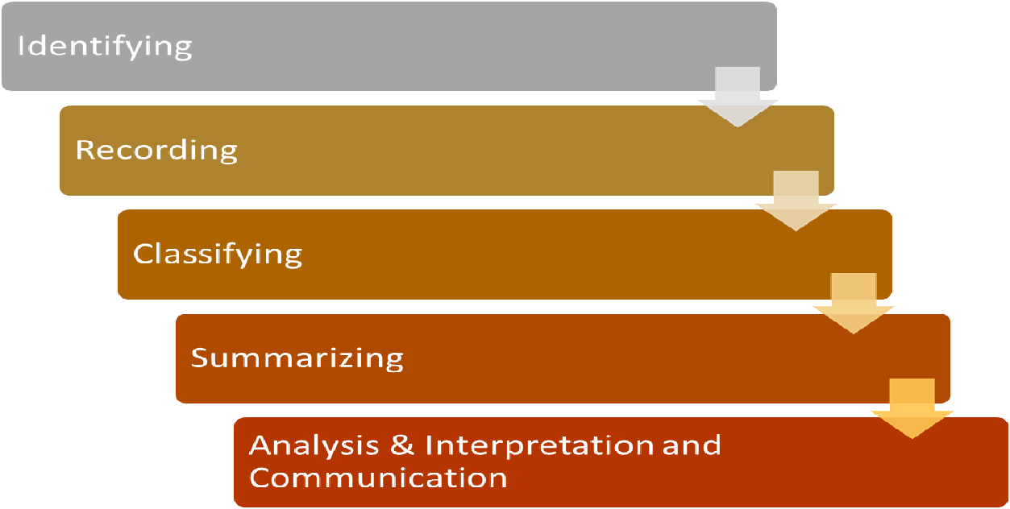
Functions of Accounting

Slide 10
THANKING YOU
ODM EDUCATIONAL GROUP

Slide 11
INTRODUCTION TO ACCOUNTING
ADVANTAGES OF ACCOUNTING
SUBJECT : ACCOUNTANCY
CHAPTER NUMBER:1
CHAPTER NAME :INTRODUCTION TO ACCOUNTING
CLASS-3

Slide 12
ADVANTAGES OF DOUBLE ENTRY SYSTEM OF ACCOUNTING:
It helps to keep a complete and systematic record of all business transactions ;
Since both the aspects of a transaction are recorded under this system, it facilitates a check on the arithmetical accuracy of the accounting books ;
It reveals the results of business activities. By preparing trading and profit and loss account, profit earned or loss suffered by the business is ascertained ;
By preparing position statement (Balance sheet), the financial position of the business is correctly estimated.

Slide 13
ROLE OR BRANCHES OF ACCOUNTING
Financial accounting (Book Keeping + preparation of financial statement).
Cost accounting (Determines the unit cost at different level of production).
Management accounting (It blends financial and cost accounting to get maximum profit at maximum cost).
Tax accounting (Sales tax and income tax).
Social responsibility (Focus on social benefits)

Slide 14
THANKING YOU
ODM EDUCATIONAL GROUP

Slide 15
INTRODUCTION TO ACCOUNTING
LIMITATION OF ACCOUNTING
SUBJECT : ACCOUNTANCY
CHAPTER NUMBER:1
CHAPTER NAME :INTRODUCTION TO ACCOUNTING
CLASS-4

Slide 16
DISADVANTAGES OF DOUBLE ENTRY SYSTEM :
  This system fails to ascertain actual profits if there are errors of principle in the records;
  A mistake committed at the time of journalizing or an omission of a transaction from journalising cannot be disclosed under this system ;
  There is possibility of fraud and misappropriations in the system.

Slide 17
Qualitative Characteristics of Accounting
  Reliability : Accounting information should be reliable, verifiable and based on facts.
  Relevance : Only Relevant information should be disclosed. Information which is irrelevant and useless should be not be the part of financial statements.
  Understandability : Accounting information should be presented in a very simple way so that it is easy to understood by its users.
  Comparability : Financial Statements should contains the figures of current year as well as figures of previous year so that the current performance of the business can be compared with the performance of previous year.

Slide 18
SYSTEM OF RECORDING
    Single entry system : This system ignores the two fold aspect of each transaction as done in double entry system. In this only cash and personal accounts are maintained.
    Double entry system : This is that system of book–keeping under which every business transaction is recorded at two places. This system is based on dual concept, which states, “For every debit there is a credit”.
ADVANTAGES OF DOUBLE ENTRY SYSTEM OF ACCOUNTING:
It helps to keep a complete and systematic record of all business transactions ;
Since both the aspects of a transaction are recorded under this system, it facilitates a check on the arithmetical accuracy of the accounting books ;
It reveals the results of business activities. By preparing trading and profit and loss account, profit earned or loss suffered by the business is ascertained ;
By preparing position statement (Balance sheet), the financial position of the business is correctly estimated.

Slide 19
DISADVANTAGES OF DOUBLE ENTRY SYSTEM :
  This system fails to ascertain actual profits if there are errors of principle in the records;
  A mistake committed at the time of journalizing or an omission of a transaction from journalising cannot be disclosed under this system ;
  There is possibility of fraud and misappropriations in the system.

Slide 20
THANKING YOU
ODM EDUCATIONAL GROUP

Slide 21
INTRODUCTION TO ACCOUNTING
BASIC ACCOUNTING TERMS
SUBJECT : ACCOUNTANCY
CHAPTER NUMBER:1
CHAPTER NAME :INTRODUCTION TO ACCOUNTING
CLASS-5

Slide 22
Business Transactions
An exchange of goods or services for cash or on credit by the business with outsiders is called a transaction.
In the words of L. C. Copper, “ A person’s dealings in money or money’s worth are termed as transactions.”
Entity:- Business entity means a specific identifiable business enterprise like Tata, Reliance, Amul, Sony etc.
Transactions: - Exchange of goods and services for consideration.
Assets:- These are properties or economic resources of an enterprises which can be expressed in monetary terms it can be divided in two parts

Slide 23
Non Current Assets : Fixed assets : Tangible & Intangible ( more than 1 year period)
Tangible Assets | Intangible Assets
Land and Building | Goodwill
Plant and Machinery | Patents
Furniture | Trademarks
Office Equipments | Copyright Computer software

Slide 24
Current assets (less than 1 year period)
  Examples of Current Assets are :
      Debtors
Bills Receivable
      Cash in hand
      Cash at bank
      Cheques in hand
      Drafts in hand
      Stock
      Prepaid Expenses

Slide 25
Liabilities:-These are certain obligations or dues which firm has to pay. Liabilities can be divided into two categories i.e. Non Current Liabilities and Current Liabilities.
Non Current Liabilities | Current Liabilities
Bank Loan | Creditors
Mortgage | Bills Payable
Loan from other financial institutions | Outstanding Expenses
Other long term liabilities | Bank overdraft

Slide 26
THANKING YOU
ODM EDUCATIONAL GROUP

Slide 27
INTRODUCTION TO ACCOUNTING
BASIC ACCOUNTING TERMS
SUBJECT : ACCOUNTANCY
CHAPTER NUMBER:1
CHAPTER NAME :INTRODUCTION TO ACCOUNTING
CLASS-6

Slide 28
Trade Receivables : Debtors + Bills Receivables
Debtors: - There are persons who owe to an enterprise an amount for buying goods and services on credit.
Bills Receivables : Amount to be received againt B/R (from debtors).
Trade Payable : Creditors + Bills Payable
Creditors: - These are persons who have to be paid by an enterprise an amount for providing the enterprise goods and services on credit.
Bills Payable : Amount payable against the bills (to the creditors).
Capital: It is an essential investment for commencement of every business.
Sales: It can be credit or cash, in which goods are delivered to customers.
  Cash Sales (b) Credit Sales

Slide 29
Revenues:-It is the amount which is earned by selling of products.
Expense:-It is known as cost of assets consumed or services which used.
Expenditure:-It means spending money for some benefit.
Profit: - Excess of revenues over expenses is called profit.
Gain: - It generates from incidental transaction such as sales of fixed asset, winning of court case.
Loss: - Excess of expenses over income is termed as loss.
Discount:-It is defined as concession or deduction in price of goods sold.
Voucher:-It is known as evidence in support of a transaction.
Goods: - It refers all the tangible goods (Raw material, work in progress, finished goods.) Drawings: - Amount of goods or cash which is withdrawn from business for personal use. Purchases: - It means of procurement of goods on credit or cash.

Slide 30
Stock: - It is a part of unsold goods. It can be divided into two categories. 1.Opening stock
Closing stock.
Balance Sheet : Balance Sheet is prepared at the end of each accounting period to ascertain the financial position of the business.
Proforma of Balance Sheet
Liabilities | Amount | Assets | Amount
Capital | … | Land | ….
Creditors | …. | Building | ….
Bills Payable | …. | Furniture | ….
Outstanding Expense | … | Machinery | ….
Loans | … | Stock | ….
 |  | Bills Receivable | ….
 |  | Debtors | ….
 | …. |  | ….

Slide 31
THANKING YOU
ODM EDUCATIONAL GROUP

Slide 32
INTRODUCTION TO ACCOUNTING
BASIC ACCOUNTING TERMS
SUBJECT : ACCOUNTANCY
CHAPTER NUMBER:1
CHAPTER NAME :INTRODUCTION TO ACCOUNTING
CLASS-7

Slide 33
Capital expenditure:
“Outlay resulting in the increase or acquisition of an asset or increase in the earning capacity of the business are capital expenses”. William pickles
Benefit of this expenditure we [business] enjoy for a long time. Capital expenditure is incurred for the purpose of enjoying long term advantage for the business.
  This expenditure is mostly incurred for buying assets [tangible or intangible] which can later to be sold and converted into cash.
  This expenditure is incurred to increase the earning capacity of the business.
.

Slide 34
Some examples of capital expenditure:
Expenditure which are only for acquisition of fixed Assets
Expenditure which are used for the extension or improvement in fixed Assets
Legal charges incurred
purchase of land, building,
Purchase of furniture,
Or any fixed asset for permanent use in the business

Slide 35
Revenue expenditure : Mostly benefit of this expenditure we [business] enjoy only within the current year. Expenses of administration, manufacturing, selling expense, Office expense and all day to day expenses of the current year, are example of revenue expenditure.
According to Kohlar, it is “an expenditure charged against operation: a term used to contrast with capital expenditure.”

Slide 36
THANKING YOU
ODM EDUCATIONAL GROUP

