Slide 1

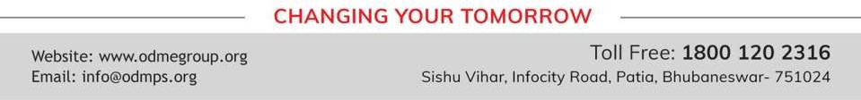
CONSTRUCTIONS
PERIOD 3
SUBJECT : MATHEMATICS
CHAPTER NUMBER: 18
CHAPTER NAME : Constructions

Slide 2


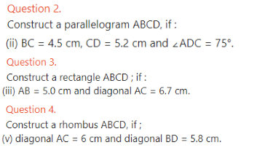
Recapitulation

Slide 3
Home assignment
CHAPTER - 18

Slide 4
THANKING YOU
ODM EDUCATIONAL GROUP

