Slide 1

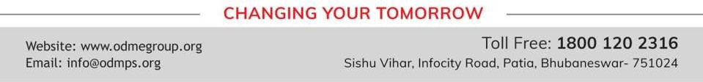
CONSTRUCTIONS
PERIOD 2
SUBJECT : MATHEMATICS
CHAPTER NUMBER: 18
CHAPTER NAME : Constructions

Slide 2

Learning outcome
Students will be able to construct different type of angle , perpendicular bisector , parallel line and different types of quadrilaterals.
.

Slide 3




Exercise - 18 D

Slide 4
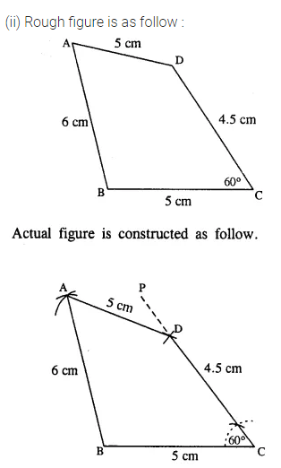
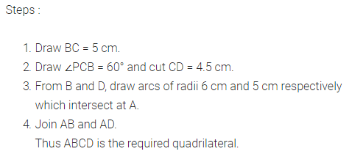

Slide 5
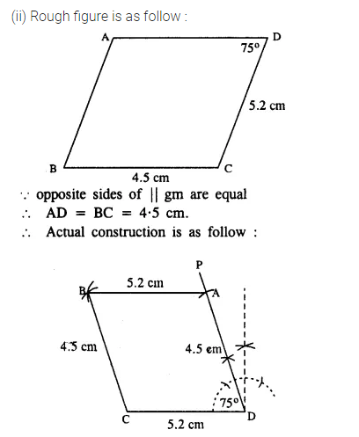
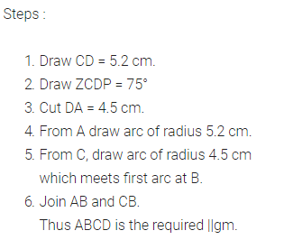

Slide 6
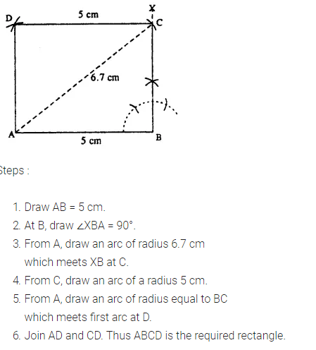

Slide 7
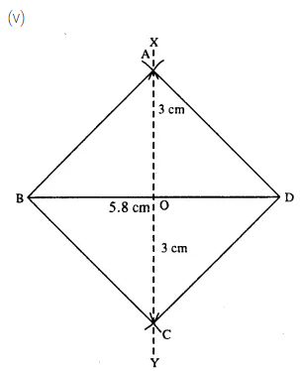
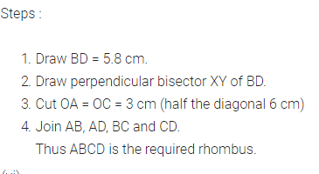

Slide 8
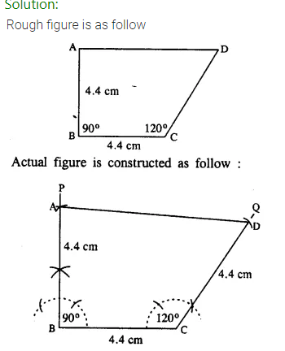
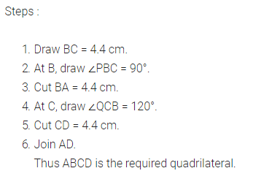

Slide 9
Home assignment
Exercise 18-D

Slide 10
THANKING YOU
ODM EDUCATIONAL GROUP

