Slide 1

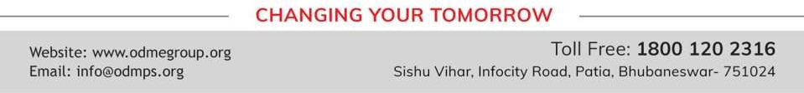
CONSTRUCTIONS
PERIOD 1
SUBJECT : MATHEMATICS
CHAPTER NUMBER: 18
CHAPTER NAME : Constructions

Slide 2

Learning outcome
Students will be able to construct different type of angle , perpendicular bisector , parallel line and different types of quadrilaterals.
.

Slide 3


Exercise - 18 A,B,C

Slide 4
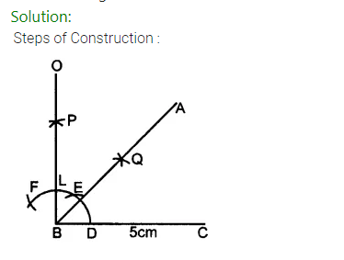
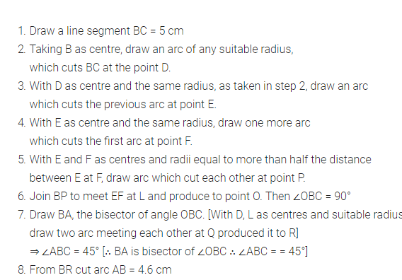

Slide 5
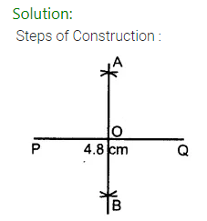
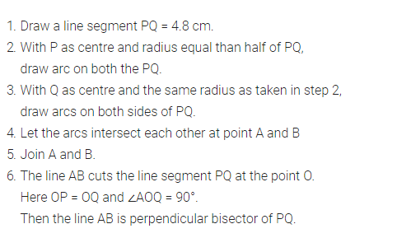

Slide 6
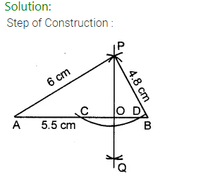
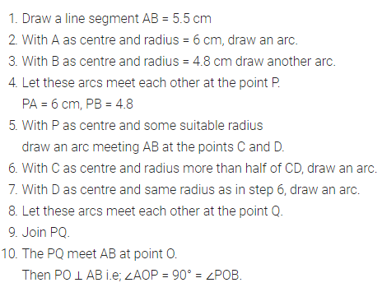

Slide 7
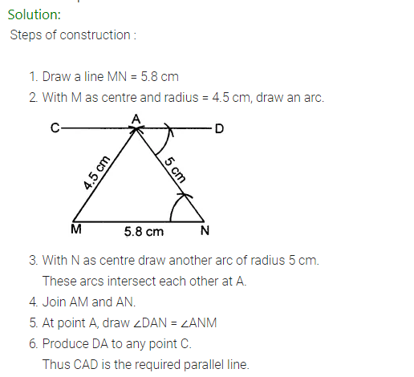

Slide 8
Home assignment
Exercise 18-C

Slide 9
THANKING YOU
ODM EDUCATIONAL GROUP

