Slide 1


SPECIAL TYPES OF QUADRILATERALS
PERIOD 1
SUBJECT : MATHEMATICS
CHAPTER NUMBER: 17
CHAPTER NAME : Special Types of Quadrilaterals

Slide 2
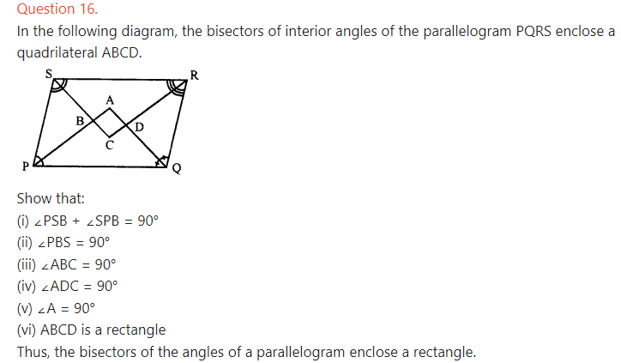
recapitulation

Slide 3

THANKING YOU
ODM EDUCATIONAL GROUP

