Slide 1


SPECIAL TYPES OF QUADRILATERALS
PERIOD 1
SUBJECT : MATHEMATICS
CHAPTER NUMBER: 17
CHAPTER NAME : Special Types of Quadrilaterals

Slide 2

Learning outcome
Students will be able to understand the Properties of special type of quadrilaterals.
.

Slide 3

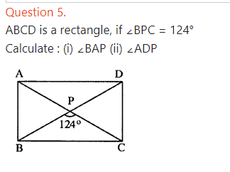

Exercise -17

Slide 4

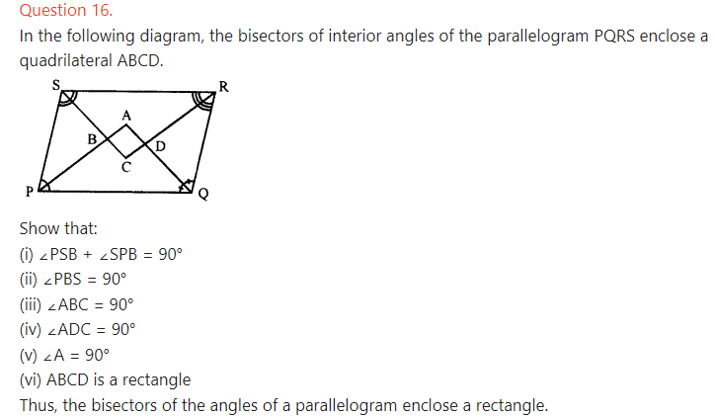

Slide 5
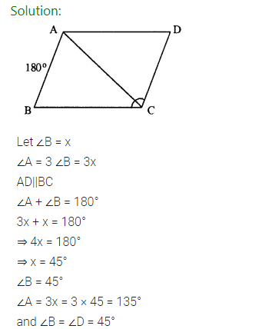
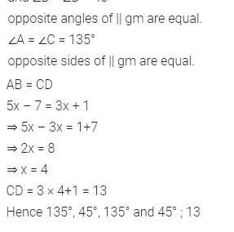

Slide 6
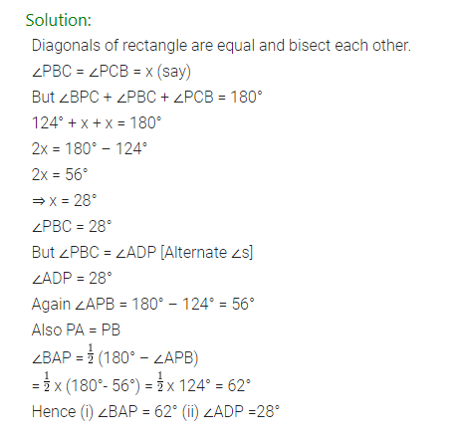

Slide 7
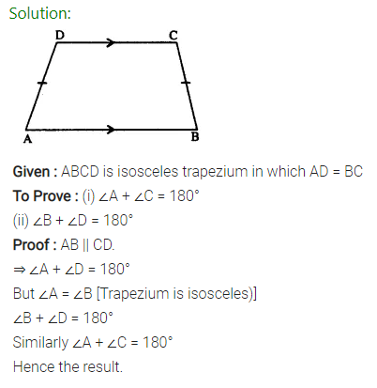

Slide 8
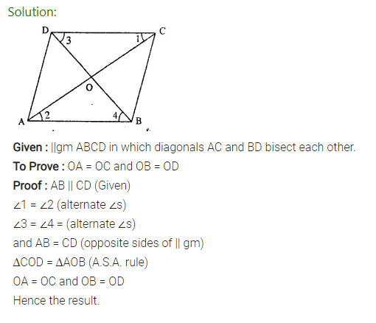

Slide 9
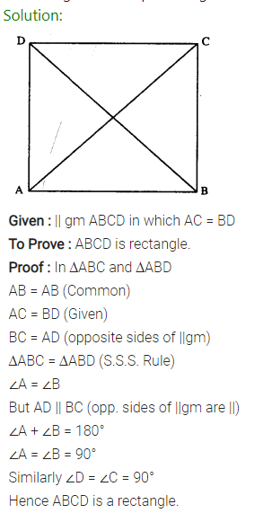

Slide 10
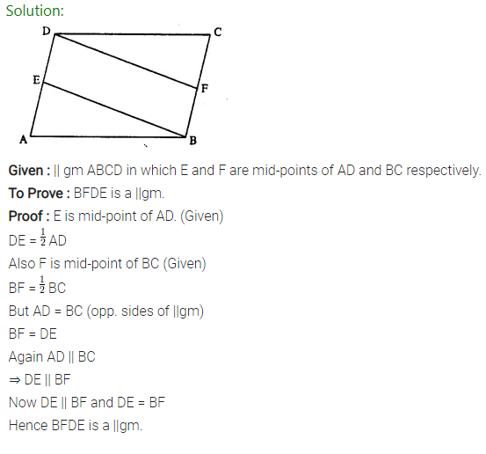

Slide 11
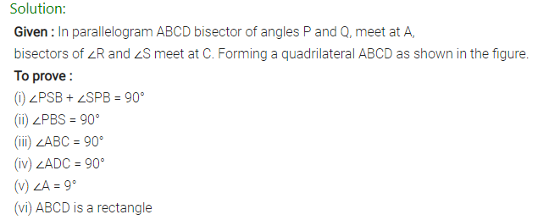
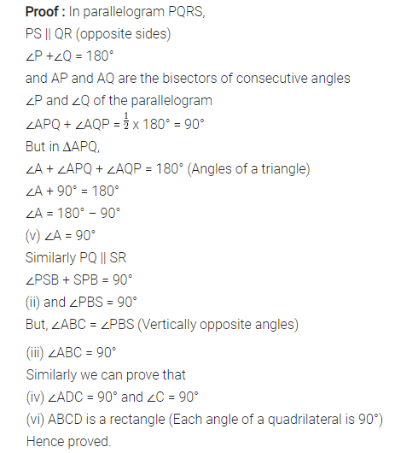

Slide 12
Home assignment
Exercise 17

Slide 13
THANKING YOU
ODM EDUCATIONAL GROUP

