Slide 1

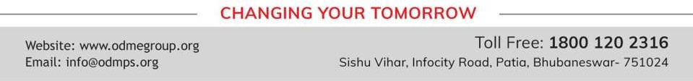
UNDERSTANDING SHAPES
PERIOD 2
SUBJECT : MATHEMATICS
CHAPTER NUMBER: 16
CHAPTER NAME : UNDERSTANDING SHAPES

Slide 2

Learning outcome
Students will be able to understand the concept of Polygons.
.

Slide 3
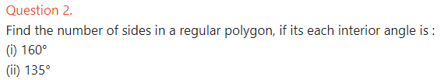


Exercise -16B

Slide 4
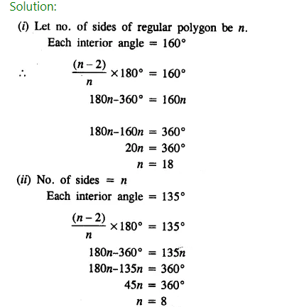

Slide 5
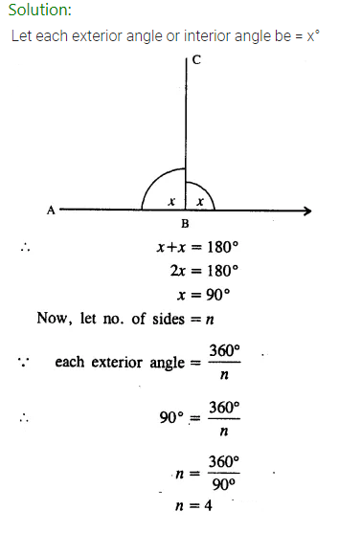

Slide 6
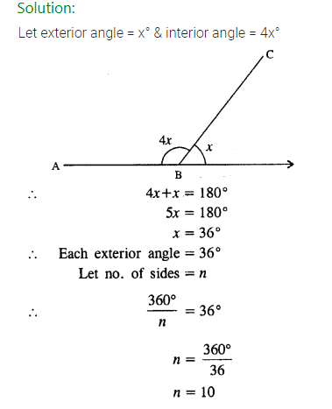

Slide 7
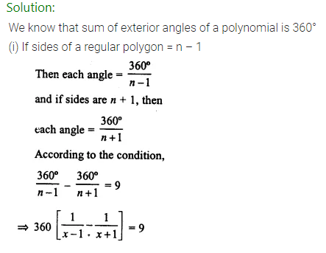
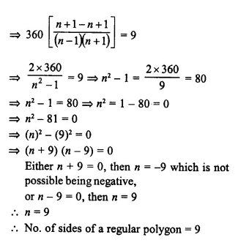

Slide 8
Home assignment
Exercise 16(B)

Slide 9
THANKING YOU
ODM EDUCATIONAL GROUP

