Slide 1


CHAPTER : 10
CHAPTER : HALOALKANES AND HALOARENES

Slide 2
Page-1
LECTURE-1
Introduction:
The Alkyl halides have the general formula CnH2n+1X or RX where X denotes chlorine, Bromine, or Iodine. Fluorine is not included since fluorides do not behave like other halides.
Uses of Halo compounds:
1. The chlorine-containing Antibiotic Chloromycetin (Chloramphenicol) is produced by soil microorganism used in treatments of typhoid fever.;
2. Fully fluorinated compounds are being considered as potential blood substitutes in surgery.
4. Some compounds like DDT, BHC are used as an insecticide,
CLASSIFICATION OF HALO ALKANE AND HALO ARENES:
1. Based on the number of Halogen atoms: The Halo-derivatives can be classified based on the type of halogen atoms present. There are Chloro, Bromo, and iodo derivatives containing chlorine, bromine, and iodine respectively. These can be classified based on the number of halogen atoms and named as mono, di, tri, and tetra halogen derivatives.
a) Mono halogen derivatives:
The mono halogen derivatives of alkane and aromatic hydrocarbons are derived by the replacement of one hydrogen atom by one halogen atom.

Slide 3
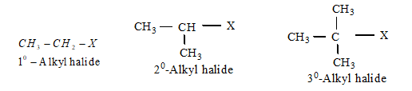
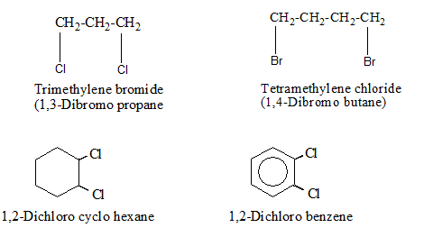
Page-2
b) Dihalogen derivatives:
These halogen derivatives of alkane and aromatic hydrocarbons are derived by the replacement of two hydrogen atoms by two halogen atoms.

Slide 4
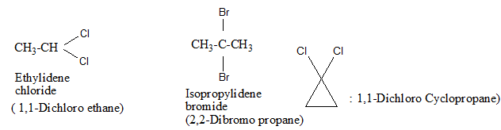
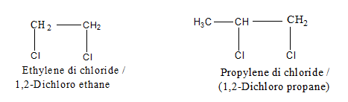
Page-3
Dihalogen derives are further classified as the following types.
i) Gem dihalides: In these compounds both the halogen atoms attached to the same carbon
ii) Vicinal-dihalide: In these compounds the halogen atoms attached to adjacent (vicinal) carbon atoms. These are also called alkylene (di) dihalides.

Slide 5
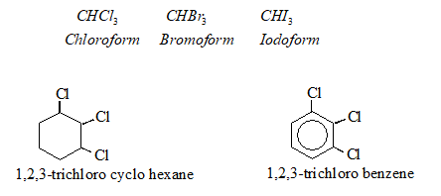

Page-4
c) Tri-halogen derivatives: The trihalogen derivatives are derived by the replacement of three hydrogen atoms by three halogen atoms. They have the general formula:
d) Tetra-halogen derivatives : The tetra halogen derivatives are derived by the replacement of four hydrogen atoms by four halogen atoms.

Slide 6
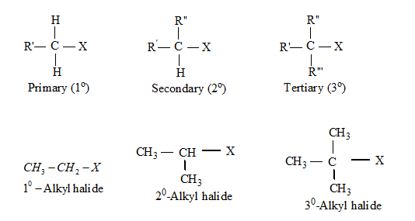
Page-5
Similarly polyhalogen derivative is:
(Hexachloroethane)
2. Halogen atom bonded with sp3-hybridized carbon:
(a) Alkyl Halides or Haloalkanes: These are formed by the replacement of one hydrogen atom from an alkane by one halogen atom. Its general formula is CnH2n+1 X for open-chain alkyl halides and CnH2n-1 X for cyclic alkyl halides. The open-chain alkyl halides are classified as called primary, secondary, or tertiary alkyl halides if the halogen atom is bonded with 1o, 2o, and 3o carbon atom respectively.
For example:

Slide 7
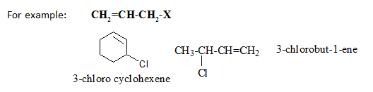
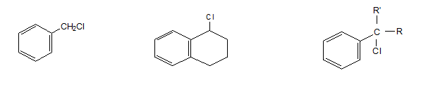
Page-6
(b) Allylic Halides: In this type, the halogen atom is bonded with sp3-hybridized carbon atom next to the carbon-carbon double bond and this carbon atom is called allylic carbon atom.
(c) Benzylic Halides: in these type halides, halogen atom bonded to an sp3-hybridized carbon atom which is attached with a benzene ring.

Slide 8
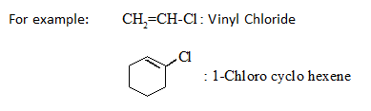

Page-7
3. Halogen atom bonded with sp2-hybridized carbon:
(a) Vinylic Halides: In this type of halide, the halogen atom is bonded to an sp2 -hybridized carbon atom of a C=C.
(b) Aryl Halides: In this type of halide, the halogen atom is bonded to the sp2 hybridized carbon atom of an aromatic ring.

Slide 9
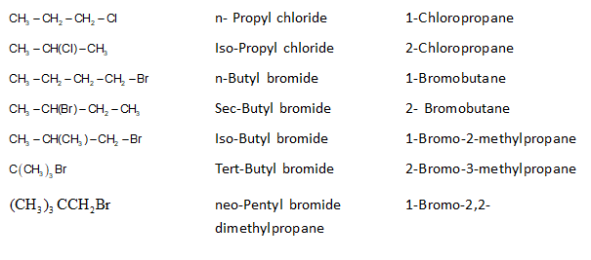
Page-8
NOMENCLATURE:
The halogenated hydrocarbons are commonly called as halo hydrocarbons.
Formula Common name IUPAC Name

Slide 10
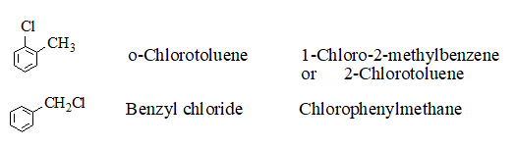
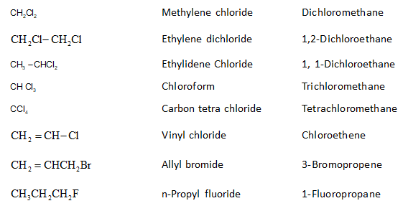
Page-9

Slide 11
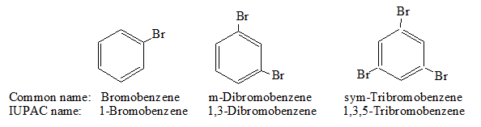
Page-10
Answer the following questions:
1. Draw the structures of all the eight structural isomers that have the molecular formula C5H11Br. Name each isomer according to IUPAC system and classify as primary, secondary or tertiary bromide.
2. Write the structures of the following compounds
i) 2-Chloro-3-methylpentane ii) 1-Chloro-4-ethylcyclohexane iii) 4-tert.Butyl-3-idoheptane
iv) 1,4-Dibromobut-2-ene v) 1-Bromo-4-sec.butyl-2-methylbenzene

Slide 12
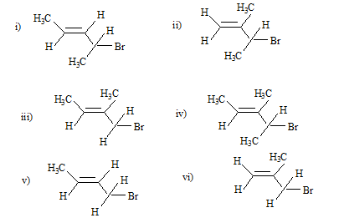
3. Write IUPAC names of the following:

Slide 13

Page-11
LECT-2
Chain Isomerism, Position Isomerism:
Halo alkanes can show chain and position isomerisms. Let haloalkanes of M.F C4H9X . It can show chain and position isomerism as follows:
1-Chloro-2-methylpropane, Tertiarybutyl chloride, 1-Halobutane, 2-halobutane.
Nature of C-X bond: Due to more electronegativity character of halogen atom, the C-X bond in haloalkane is polar. As the electronegativity of halogen atom is greater than that of cabon atom, therefore the shared pair of electron in C-X bond remains closer to the halogen atom. As a result, the halogen atom acquired partial negative charge and the carbon atom acquired partial positive charge.
The polar character of C-X bond decreases as the size of halogen atom increases. Thus the order of polar character is: C-F > C-Cl > C-Br > C-I. Due to increase in size of halogen atom from fluorine to iodine, the C-X bond length increases, bond enthalpies decreases and dipole moment decreases.

Slide 14
Page-12
Preparation of Haloalkanes:
1) From alcohols:
Alcohols can be converted into alkyl halide by using conc. halogen acids, phosphorus halides, or thionyl chloride.
Thionyl chloride is preferred because the other two products are escapable gases.
PBr3, PI3 are generated in situ (produced in the reaction mixture) by the reaction of red phosphorus with bromine and iodine respectively.
The order of reactivity of alcohols with a given halogen acid is 30 > 20 > 10.
Primary and secondary alcohols are treated with HCl in presence of a catalyst ZnCl2 to produce alkyl chlorides.
But in the case of tertiary alcohol, the reaction is carried out by shaking with Conc. HCl at room temperature.
Constant boiling with HBr (48%) is used to prepare alkyl bromide.
R-I is obtained by heating alcohols with NaI or KI in 95% H3PO4.
These methods are not applicable for the preparation of aryl halides. Because
the carbon-oxygen bond in phenols has a partial double bond character which is difficult to break.

Slide 15
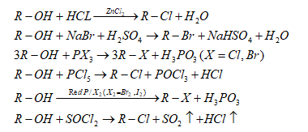
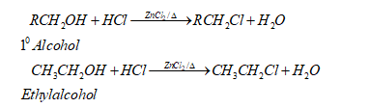
Page-13
The order of reactivity of alcohols is Tertiary > Secondary > Primary. The order of reactivity of halogen acids is HI > HBr > HCl.

Slide 16
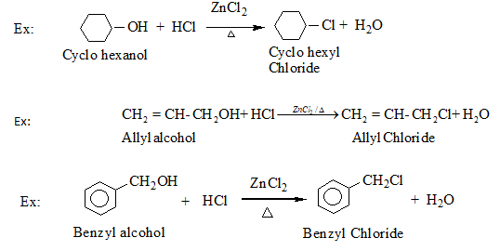
Page-14

Slide 17
Answer the following questions:
1. Draw the structures of all the eight structural isomers that have the molecular formula C5H11Br. Name each isomer according to IUPAC system and write type of isomerism in case.
2. Write the isomers of the following compounds
i) 2-Chloro-3-methylpentane ii) 1-Chloro-4-ethylcyclohexane iii) 4-tert.Butyl-idoheptane
iv) 1,4-Dibromobut-2-ene v) 1-Bromo-4-sec.butyl-2-methylbenzene
3. Write order of bond lengths from R-F to R-I

Slide 18

Page-15
LECTURE-3
2. From hydrocarbons :
a) By free Radical halogenations: Free radical chlorination or bromination of alkanes gives a complex mixture of mono and polyhaloalkanes which is difficult to separate. Hence the yield of any one compound is low.
The halogenation of an alkane appears to be a simple substitution reaction in which a C-H bond is broken and a new C-X bond is formed.
Direct halogenation of alkanes in presence of sunlight, heat, or suitable catalyst gives alkyl halides. Chlorination is faster, bromination is slower while direct iodination is not possible as the reaction is reversible. However, iodination can be done in presence of an oxidizing agent like HNO3 or iodic acid ( HIO3 ).

Slide 19
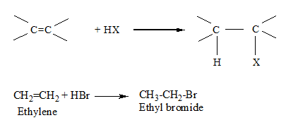
Page-16
3) From Alkenes:
i) Addition of hydrogen halide: When alkenes react with halogen acids (HCl, HBr, or HI), it produces corresponding alkyl halides.
When a halogen acid reacts with asymmetrical alkene only one product is formed, but when it reacts with an unsymmetrical alkene two products are formed i.e. one is the major product and the other is the minor product. The major product is decided as per Markownikoff’s rule.

Slide 20
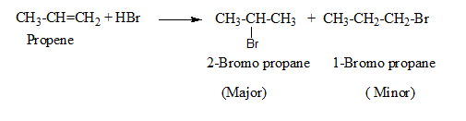
Page-17
Markovnikov’s rule: This rule states that “When addition reaction takes place across an unsymmetrical alkene then the negative part of the addendum is added to the carbon atom of C=C having lesser number of hydrogen atoms”.
Ex: When Propene is added with HBr then 2-Bromo propane is formed as the major product.
If Propene is added with HBr in presence of organic peroxide then 1-Bromo propane is formed as the major product as per Anti markownikoff’s addition or Peroxide effect or Khrasch effect.

Slide 21

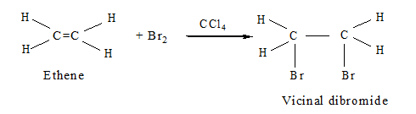
Page-18
AntiMarkovnikov’s addition: When addition reaction takes place across an unsymmetrical alkene in presence of organic peroxide then the negative part of the addendum is added to the carbon atom of C=C having more number of hydrogen atoms”.
ii) Addition of halogens: The addition of bromine in CCl4 to an alkene gives vicinal dibromide. This results in the discharge of the reddish-brown color of the bromine solution. So it is an important method for the detection of the double bond in a molecule.

Slide 22

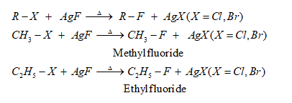
Page-19
4) By Halogen Exchange Reaction:
a) By Finkelstein Reaction: When alkyl chloride or alkyl bromide is treated with NaI, in dry acetone then alkyl iodide is formed. This halogen exchange reaction is known as a Finkel stein reaction.
NaCl or NaBr thus formed gets precipitated(insoluble) in dry acetone. That means the feasibility of this reaction is due to the solubility of NaI in acetone and more nucleophilic character of iodide ion. This facilitates the forward reaction.
b) By Swarts Reaction: When Alkyl chloride or bromide is heated with metal fluorides (AgF, CoF2, Hg2F2) then alkyl fluoride results. This reaction is known as Swart's reaction.

Slide 23
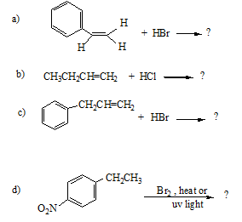
Answer the following questions:
1. Identify all the possible monochloro structural isomers expected to be formed on free radical monochlorination of (CH3)2CHCH2CH3.
2. Write the major products of the following reactions:

Slide 24
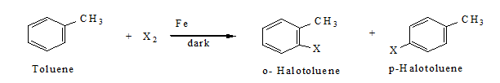
Page-20
LECTURE-4
b) By electrophilic substitution: Aryl chlorides and bromides can be easily prepared by electrophilic substitution of arenes with chlorine and bromine respectively in the presence of Lewis acid as catalyst.
The ortho and para isomers can be easily separated due to a large difference in their melting point. Reaction with iodine is reversible and requires the presence of an oxidizing agent (HNO3, HIO3) to oxidize the HI formed in the reaction. Fluoro compounds cannot be prepared by this method due to its high reactivity.
c) Sandmeyer’s reaction: Primary aromatic amine dissolved in cold aqueous mineral acid followed by the treatment with sodium nitrite gives diazonium salt. When benzene diazonium salt (Freshly prepared by diazotization) is treated with Cu2Cl2/HCl or Cu2Br2/HBr, then Chlorobenzene and bromobenzene are formed respectively.

Slide 25
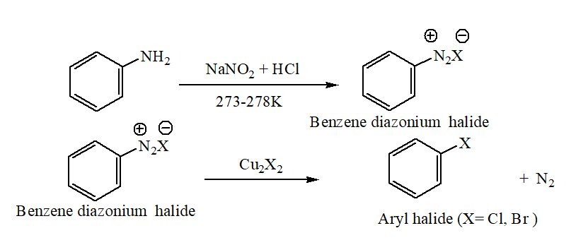
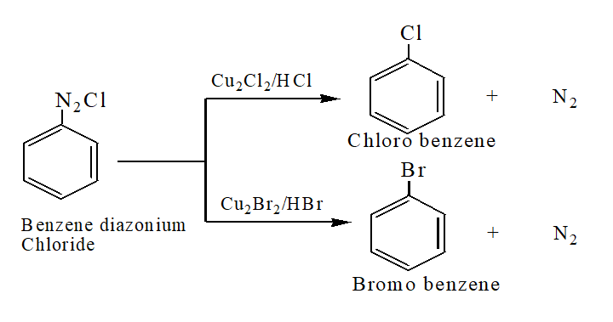
Page-21

Slide 26
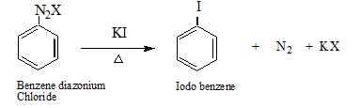

Iodobenzene is formed by shaking the diazonium salt with KI.
PHYSICAL PROPERTIES OF HALO ALKANES:
1. Physical state:
(a) Pure alkyl halides are colorless. But bromides and iodides develop color when exposed to light. Alkyl iodides decompose on exposure to light and therefore they turn brown on standing due to the liberation of iodine.
(b) Lower members like methyl chloride, methyl bromide, ethyl chloride, and some Chlorofluoro methanes are gases at room temperature. Higher members are liquids up to C18 and colorless solids beyond C18. Many volatile halogen compounds have a sweet smell.

Slide 27

Page-22
2. Melting and Boiling points:
The boiling point of alkyl halides is higher than the corresponding hydrocarbons. B.P increases with an increase in molecular mass. Due to greater polarity and higher molecular mass as compared to the parent hydrocarbon, the intermolecular forces of attraction (Dipole-dipole and Vanderwaals) are stronger in the halogen derivatives. Thus B.P of chlorides, bromides, and iodides are higher than hydrocarbons of comparable molecular mass. The attraction gets stronger as the size of the molecule gets bigger.
For the same alkyl group, the boiling point of alkyl halides increases with the size of halogen atoms. It is due to an increase in the magnitude of Vander Waal forces. RI > RBr > RCl > RF
For the same halogen atom, the boiling point increases with an increase in the size of the alkyl group.
(d) In the case of isomeric alkyl halides boiling point decreases with branching. Because with branching the surface area of the alkyl halide decreases and hence the magnitude of the Vander Waal’s forces of attraction decreases.

Slide 28
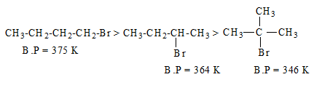

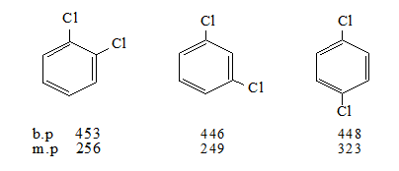
Page-23
d) The boiling point of Chloro, Bromo, and Iodo compounds increases with an increase in the number of halogen atoms.
The boiling point of isomeric dihalobenzenes is nearly the same but para-isomer has a high melting point than ortho and meta isomer. It is due to the symmetry of para-isomer.
.

Slide 29

Page-25
Density:
Alkyl Fluorides and Chlorides are lighter than water, however, alkyl bromides and iodides are heavier than water. The order of density is RI > RBr > RCl. Density increases with an increase in the size of the alkyl group or a halogen atom. Density also increases with an increase in the molecular mass of alkyl halide. Polyhalo alkanes are denser than water.
Solubility:
The haloalkanes are very slightly soluble in water. For a haloalkane to dissolve in water, energy is required to overcome the attraction between the haloalkane molecules and break the hydrogen bonds between water molecules. Less energy is released when the new attraction is set up between the haloalkane and the water molecules as these are not as strong as the original hydrogen bonds in water. As a result, the solubility of haloalkanes in water is low. However, haloalkanes tend to dissolve in organic solvents because the new intermolecular attraction between haloalkanes and solvent molecules have much the same strength as the ones being broken in the separate haloalkane and solvent molecules.
6. Stability:
Stability of alkyl halide decreases as the strength of the C-X bond decreases. Thus the order of stability is R-F > R-Cl > R-Br > R-I. Due to less stability, Alkyl iodides decompose on exposure to light and therefore they become violet or brown on standing due to the liberation of iodine.

Slide 30


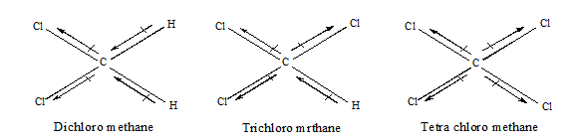
7. Except for Fluorine, the dipole moment of haloalkane increases with increases in electronegativity of a halogen atom from Cl to I. Due to the very small size and highest electronegativity of fluorine, alkyl fluorides have lower dipole moment than chlorine. Thus the order of dipole moment is
In the case of polyhalogen compounds, dipole moment depends upon the structure. Ex: Among the chloro derivatives of methane, dichloromethane has the highest dipole moment. the order of dipole moment is
The three-dimensional structure and the direction of the dipole moment of the compounds are given as

Slide 31
Answer the following questions:
1. Name the Lewis acids used in halogenations of aromatic hydrocarbon.
2. Write the Chlorination of Benzene with Mechanism.
3. Why iodination of Benzene requires oxidising agents like HNO3 or HIO4?
4. Why is Fluorobenzene difficult to prepare by direct fluorination of benzene?
5. How will you prepare Chlorobenzene and Bromobenzene starting from Aniline?
6. Convert Aniline to iodobenzene.

Slide 32
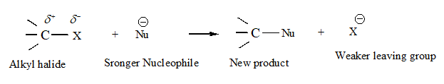

LECTURE-5
CHEMICAL PROPERTIES OF HALOALKANES:
2. Nucleophilic Substitution (SN): Due to the polarity of the C-X bond, alkyl halides are highly reactive. As C-X bond length increases, from C-F to C-I, therefore bond enthalpies decreases from C-F to C-I. So that the C-X bond is easily broken to release halide ion. Hence alkyl halides undergo a nucleophilic substitution reaction. A stronger nucleophile can replace weaker nucleophiles in such types of reactions.
Groups like cyanides and nitriles possess two nucleophilic centers and are called ambient nucleophiles. The cyanide group is the hybrid of two contributing structures and therefore acts as the nucleophile in two ways.

Slide 33


Similarly, nitrate ion also represents an ambient nucleophile with two linking sites
According to the number of reacting species, involved in the rate-determining step, Nucleophilic substitution reaction may be classified as SN1 and SN2 i.e unimolecular and bimolecular respectively.
Table: Nucleophilic Substitution of Alkyl Halides (R–X)
Reagent Nucleophile (Nu) Substitution product( R–Nu) main product
NaOH /KOH) HO– ROH Alcohol
H2O H2O ROH Alcohol
NaOR' R'O– ROR' Ether

Slide 34
NaI I– R—I Alkyl iodide
NH3 NH3 RNH2 Primary amine
R'NH2 R'NH2 RNHR' Sec. amine
R'R''NH R'R''NH RNR'R'' Tert. amine
KCN CN– RCN Nitrile(cyanide)
AgCN CN: RNC Isonitrile (isocyanide)
KNO2 O=N—O– R—O—N=O Alkyl nitrite
AgNO2 Ag—Ö—N=O R—NO2 Nitroalkane
R'COOAg R'COO– R'COOR Ester
LiAlH4 H RH Hydrocarbon
R'– M+ R'– RR' Alkane

Slide 35

SN2 Reaction:
SN2 stands for nucleophilic substitution bimolecular. In this reaction, both alkyl halide and nucleophile are involved in the rate-determining step and follow a concerted mechanism. That means the rate depends upon the concentration of both the reactants.
In the SN2 mechanism, the nucleophile attacks the substrate from a position of 1800 away from the leaving group. Thus the reaction proceeds with complete stereochemical inversion called Walden inversion. The mechanism of the reaction is involved in a single step. The breaking of the C-X bond and making of the C-Nu bond takes place simultaneously. The nucleophile approaches the carbon atom from the opposite side of the halogen atom because the attack of the nucleophile from the side of the halogen atom is hindered due to repulsion with a negatively charged halogen. Here simultaneous attack of the nucleophile and leaving of halide ion occurs through the Penta-coordinated transition state. The rate of substitution is directly proportional to the concentration of the nucleophile, that’s why a high concentration of strong nucleophiles is favorable for this reaction. The polar aprotic solvent is favorable for the hydrolysis of alkyl halide but the Protic solvent slows down the reaction.
Ex: The hydrolysis of Methyl Chloride is an example of the SN2 path.

Slide 36

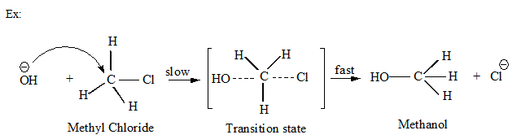
Mechanism: The strong nucleophile OH- attack from the opposite side of the chlorine atom to form a Penta-coordinated transition state in which both OH- and Cl- are partially bonded to the carbon atom. So the carbon center becomes highly overcrowded. Due to this overcrowding, the transition state contains maximum potential energy and minimum stability. In the transition state, the formation of the C-OH bond and breaking of the C-Cl bond takes place simultaneously.

Slide 37
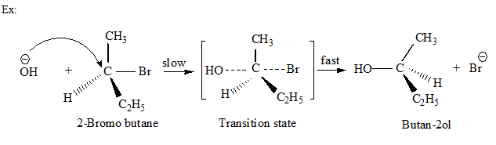

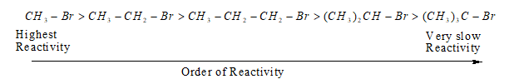
SN2 reaction of optically active alkyl halide is always accompanied by inversion of configuration. The order of reactivity of alkyl halides towards SN2 reaction is,

Slide 38

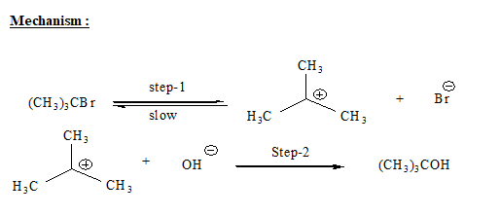
SN1 Reaction: It stands for nucleophilic substitution unimolecular. In this reaction, only alkyl halide is involved in the rate-determining step and follows a non-concerted mechanism. That means the rate depends upon the concentration of alkyl halide only.

Slide 39
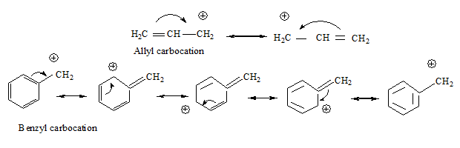
Here the rate of reaction is independent of the concentration of nucleophile. The mechanism of the SN1 reaction is involved in two steps. The step-1 is the slow ionization of the substrate and is the rate-determining step while step-2 is faster and not a rate-determining step. In this reaction, the alkyl halide undergoes heterolytic fission to form a carbocation which is a slow process and hence rate determining. The carbocation which is formed is planar. The central positively charged carbon atom of the carbocation is SP2 hybridized. The nucleophile can attack the planar carbocation from either side to form a mixture of two compounds that are inverted to each other. This mixture is called a racemic mixture. The greater the stability of carbocation greater will be its ease of formation from an alkyl halide and faster will be the rate of reaction. Thus the order of reactivity of alkyl halide towards SN1 reaction is 3⁰ > 2⁰ > 1⁰. Allyl and benzyl halide show high reactivity towards SN1 reaction. Because the carbocation formed gets stabilized through resonance.

Slide 40
For the given alkyl group the order of reactivity of alkyl halides is R-I > R-Br > R-Cl > R-F
Answer the following questions:
1. Why alkyl halides undergo Nucleophilic substitution reaction?
2. What are ambident nucleophiles? Give examples.
3. Haloalkanes react with KCN to form alkyl cyanides as main product while AgCN forms isocyanides as the chief product. Explain.
4. Explain the order of reactivity of haloalkanes towards nucleophilic substitution reaction.

Slide 41
LECTURE-6
Stereochemical Aspects of Nucleophilic substitution reaction:
An SN2 reaction proceeds with complete stereochemical inversion while an SN1 reaction proceeds with racemization.
Optical activity, Chirality, Retention, Inversion, Racemisation:
Optical activity: Certain compounds rotate the plane-polarized light when it is passed through their solutions. Such compounds are called optically active compounds. The angle by which the plane polarised light is rotated is measured by an instrument called polarimeter.
If the compound rotates the plane-polarized light to the right, i.e., clockwise direction, it is called dextrorotatory (Greek for right rotating) or the d-form and is indicated by placing a positive (+) sign before the degree of rotation. If the light is rotated towards left (anticlockwise direction), the compound is said to be laevorotatory or the l-form, and a negative (–) sign is placed before the degree of rotation. Such (+) and (–) isomers of a compound are called optical isomers and the phenomenon is termed as optical isomerism.

Slide 42
Molecular asymmetry, chirality, and enantiomers:
the optical activity was associated with the three-dimensional arrangements of atoms. The spatial arrangement of four groups (valencies) around a central carbon is tetrahedral and if all the substituents attached to that carbon are different, such carbon is called asymmetric carbon or stereocentre. The resulting molecule is referred to as an asymmetric molecule. The asymmetry of the molecule is responsible for the optical activity of the organic compound.
The objects which are non- superimposable on their mirror image (like a pair of hands) are said to be chiral and this property is known as chirality. While the objects, which are, superimposable on their mirror images are called achiral. Let us consider two simple molecules propane-2-ol and butan-2-ol and their mirror images.
propan-2-ol does not contain an asymmetric carbon, as all the four groups attached to the tetrahedral carbon are not different. Thus it is an achiral molecule.
Bhutan-2-ol has four different groups attached to the tetrahedral carbon thus it is chiral. The stereoisomers related to each other as nonsuperimposable mirror images are called enantiomers Enantiomers possess identical physical properties namely, melting point, boiling point, refractive index, etc. They only differ concerning the rotation of plane polarised light. If one of the enantiomers is dextrorotatory, the other will be laevorotatory.

Slide 43
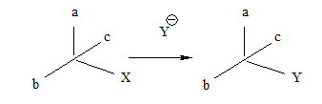
A mixture containing two enantiomers in equal proportions will have zero optical rotation, as the rotation due to one isomer will be cancelled by the rotation due to the other isomer. Such a mixture is known as a racemic mixture or racemic modification. A racemic mixture is represented by prefixing dl or (±) before the name, for example (±) butan-2-ol. The process of conversion of enantiomer into a racemic mixture is known as racemization.
Retention: Retention of configuration is the preservation of the integrity of the spatial arrangement of bonds to an asymmetric center during a chemical reaction or transformation.
If during a reaction, no bond to the stereocentre is broken, the product will have the same general configuration of groups around the stereocentre as that of reactant. Such a reaction is said to proceed with retention of the configuration.
Inversion, retention, and racemization are three outcomes for a reaction at an asymmetric carbon atom. Consider the replacement of a group X by Y in the following reaction.

Slide 44
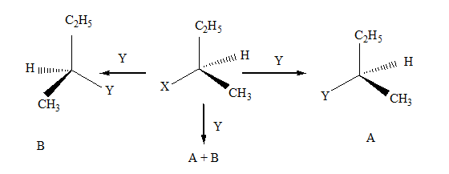
If (A) is the only compound obtained, the process is called retention of configuration. If (B) is the only compound obtained, the process is called inversion of configuration. If a 50:50 mixture of the above two is obtained then the process is called racemization and the product is optically inactive, as one isomer will rotate light in the direction opposite to another.

Slide 45
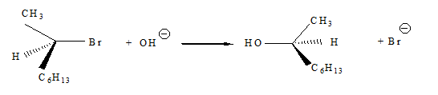
SN 1 and SN 2 mechanisms by taking examples of optically active alkyl halides.
In the case of optically active alkyl halides, the product formed as a result of the SN2 mechanism has an inverted configuration as compared to the reactant. This is because the nucleophile attaches itself to the side opposite to the one where the halogen atom is present. When (–)-2-bromooctane is allowed to react with sodium hydroxide, (+)-Octan-2-ol is formed with the –OH group occupying the position opposite to what bromide had occupied. Thus, SN2 reactions of optically active halides are accompanied by inversion of configuration.

Slide 46
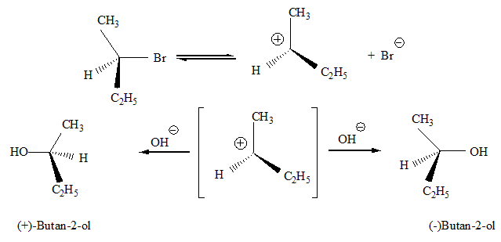
In the case of optically active alkyl halides, SN1 reactions are accompanied by racemization. The carbocation formed in the slow step being sp2 hybridized is planar (achiral). The attack of the nucleophile may be accomplished from either side resulting in a mixture of products, one having the same configuration (the –OH attaching on the same position as halide ion) and the other having opposite configuration (the –OH attaching on the side opposite to halide ion).

Slide 47
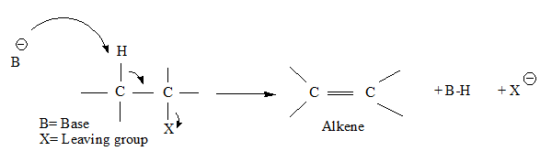

Elimination Reaction: When a haloalkane with a ß-hydrogen atom is heated with an alcoholic solution of potassium hydroxide, there is an elimination of hydrogen atom from ß-carbon and a halogen atom from the -carbon atom. As a result, an alkene is formed as a product. Since the ß-hydrogen atom is involved in elimination, it is often called ß-elimination.
If there is a possibility of formation of more than one alkene due to the availability of more than one ß-hydrogen atoms, usually one alkene is formed as the major product which is formulated by Saytzeff in 1875. It is summarised as “in dehydrohalogenation reactions, the preferred product is that alkene which has the greater number of alkyl groups attached to the doubly bonded carbon atoms.” Thus, 2-bromopentane gives pent-2-ene as the major product.

Slide 48



Reaction with metals: Most organic chlorides, bromides, and iodides react with certain metals to give compounds containing carbon-metal bonds. Such compounds are known as organometallic compounds. An important class of organometallic compounds discovered by Victor Grignard in 1900 is alkyl magnesium halide, RMgX, referred to as Grignard Reagents. These reagents are obtained by the reaction of haloalkanes with magnesium metal in dry ether.
In the Grignard reagent, the carbon-magnesium bond is covalent but highly polar, with carbon pulling electrons from electropositive magnesium; the magnesium halogen bond is essentially ionic. Grignard reagents are highly reactive.
It reacts with alcohols, amines, water to form hydrocarbons.

Slide 49

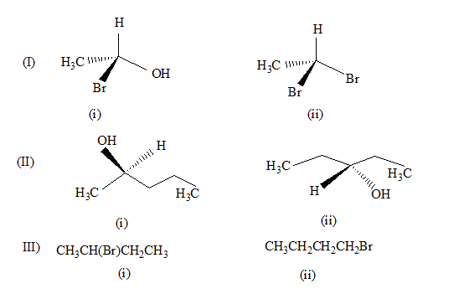
Wurtz reaction: Alkyl halides react with sodium in dry ether to give hydrocarbons containing double the number of carbon atoms present in the halide. This reaction is known as the Wurtz reaction.
Answer the following questions:
1. Identify chiral and achiral molecules in each of the following pair of compounds.

Slide 50
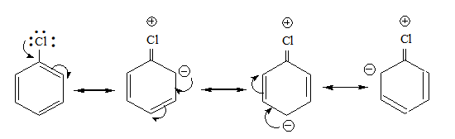
LECTURE-7
Reactions of Haloarenes:
Nucleophilic substitution:
Aryl halides are extremely less reactive towards nucleophilic substitution reactions due to the following reasons:
Resonance effect:
In haloarenes, the electron pairs on halogen atom are in conjugation with pi-electrons of the ring and the following resonating structures are possible.
C—Cl bond acquires a partial double bond character due to resonance. As a result, the bond cleavage in haloarene is difficult than haloalkane, and therefore, they are less reactive towards nucleophilic substitution reaction.

Slide 51
(ii) The difference in the hybridization of carbon atom in C—X bond:
In haloalkane, the carbon atom attached to halogen is sp3 hybridized while in the case of haloarene, the carbon atom attached to halogen is sp2-hybridized.
The sp2 hybridized carbon with a greater s-character is more electronegative and can hold the electron pair of C—X bond more tightly than sp3-hybridized carbon in haloalkane with less s-character.
Thus, C—Cl bond length in haloalkane is 177pm while in haloarene is 169 pm.
Since it is difficult to break a shorter bond than a longer bond, therefore, haloarenes are less reactive than haloalkanes towards nucleophilic substitution reaction.
Instability of phenyl cation:
In the case of haloarenes, the phenyl cation formed as a result of self-ionization will not be stabilized by resonance and therefore, the SN1 mechanism is ruled out.
Because of the possible repulsion, it is less likely for the electron-rich nucleophile to approach electron-rich arenes.
Replacement by hydroxyl group:
Chlorobenzene can be converted into phenol by heating in aqueous sodium hydroxide solution at a temperature of 623K and a pressure of 300 atmospheres.

Slide 52
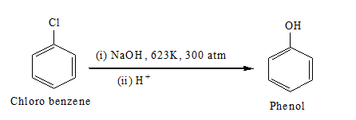
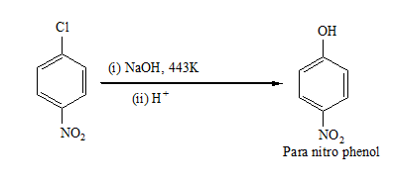
The presence of an electron-withdrawing group (-NO2) at the ortho- and para-positions increases the reactivity of haloarenes.

Slide 53
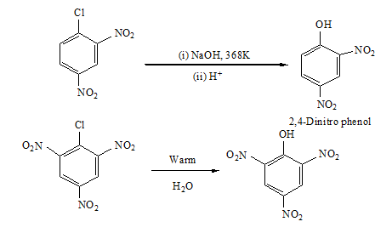
The effect is pronounced when (-NO2) group is introduced at ortho and para- positions. However, no effect on the reactivity of haloarenes is observed by the presence of an electron-withdrawing group at meta-position.

Slide 54
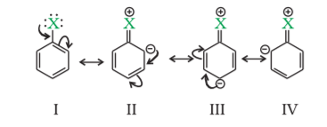
Electrophilic substitution reactions:
Haloarenes undergo the usual electrophilic reactions of the benzene ring such as halogenation, nitration, sulphonation, and Friedel-Crafts reactions.
Halogen atom is slightly deactivating and is o, p-directing, therefore, further substitution occurs at the ortho- and para positions .
The o, p-directing influence of halogen atom can be easily understood if we consider the resonating structures of halobenzene as shown:
Due to resonance, the electron density increases more at the ortho- and para-positions than at meta-positions.
Further, the halogen atom because of its –I effect has some tendency to withdraw electrons from the benzene ring.

Slide 55
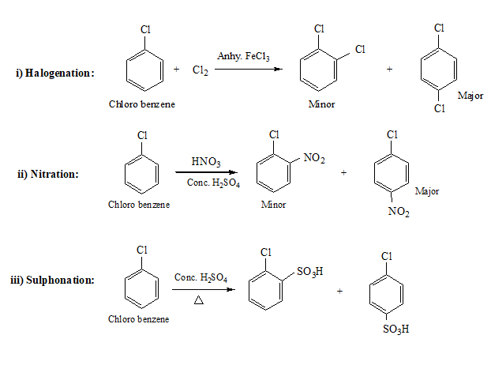
As a result, the ring gets somewhat deactivated as compared to benzene and hence the electrophilic substitution reactions in haloarenes occur slowly and require more drastic conditions as compared to those in benzene.

Slide 56
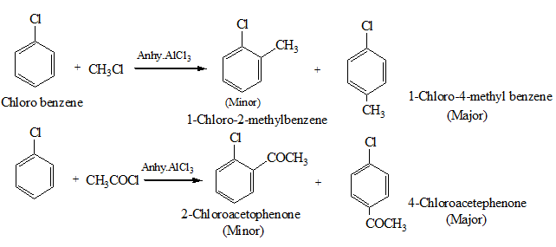
iv) Friedel-Crafts Reaction:

Slide 57
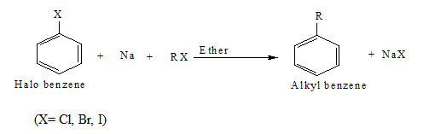
Reaction with metals:
Wurtz-Fittig reaction: A mixture of an alkyl halide and aryl halide gives an alkylarene when treated with sodium in dry ether and is called the Wurtz-Fittig reaction.
Fittig reaction: Aryl halides also give analogous compounds when treated with sodium in dry ether, in which two aryl groups are joined together. It is called the Fittig reaction.

Slide 58
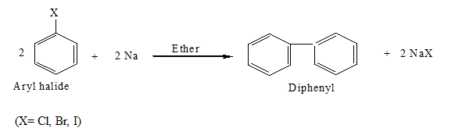
Answer the following questions:
1. Although chlorine is an electron withdrawing group, yet it is ortho-, para- directing in electrophilic aromatic substitution reactions. Why?
2. Can you think why does NO2 group show its effect only at ortho- and para- positions and not at meta- position?
3. Convert (i) Benzene to diphenyl (ii) Chlorobenzene to p-nitrophenol
4. What happens when bromo benzene is treated with Mg in the presence of dry ether?

Slide 59
LECTURE-8
Poly halogen Compounds:
Carbon compounds containing more than one halogen atom are usually referred to as polyhalogen compounds.
Dichloromethane:
It is widely used as a solvent as a paint remover, as a propellant in aerosols, and as a process solvent in the manufacture of drugs.
It is also used as a metal cleaning and finishing solvent. Methylene chloride harms the human central nervous system.
Exposure to lower levels of methylene chloride in the air can lead to slightly impaired hearing and vision. Higher levels of methylene chloride in air cause dizziness, nausea, tingling, and numbness in the fingers and toes.
In humans, direct skin contact with methylene chloride causes intense burning and a mild redness of the skin. Direct contact with the eyes can burn the cornea.
Chloroform:
It is employed as a solvent for fats, alkaloids, iodine, and other substances.
The major use of chloroform today is in the production of the freon refrigerant R-22.
It was once used as a general anesthetic in surgery but has been replaced by less toxic, safer anesthetics, such as ether.

Slide 60

As might be expected from its use as an anesthetic, inhaling chloroform vapors depresses the central nervous system. It can cause dizziness, fatigue, and headache.
Chronic chloroform exposure may cause damage to the liver (where chloroform is metabolized to phosgene) and to the kidneys, and some people develop sores when the skin is immersed in chloroform. Chloroform is slowly oxidized by air in the presence of light to extremely poisonous gas, carbonyl chloride, also known as phosgene. It is therefore stored in closed dark-colored bottles filled so that air is kept out.
Tri iodo methane:
It was used earlier as an antiseptic but the antiseptic properties are due to the liberation of free iodine and not due to iodoform itself. Due to its objectionable smell, it has been replaced by other formulations containing iodine.
Tetra chloromethane(CCl4):
It is produced in large quantities for use in the manufacture of refrigerants and propellants for aerosol cans. It is also used as feedstock in the synthesis of chlorofluorocarbons and other chemicals, pharmaceutical manufacturing, and general solvent use. There is some evidence that exposure to carbon tetrachloride causes liver cancer in humans.

Slide 61
The most common effects are dizziness, lightheadedness, nausea, and vomiting, which can cause permanent damage to nerve cells. In severe cases, these effects can lead rapidly to stupor, coma, unconsciousness, or death.
Exposure to CCl4 can make the heartbeat irregularly or stop. The chemical may irritate the eyes on contact. When carbon tetrachloride is released into the air, it rises to the atmosphere and depletes the ozone layer. The depletion of the ozone layer is believed to increase human exposure to ultraviolet rays, leading to increased skin cancer, eye diseases and disorders, and possible disruption of the immune system.
Freons:
The chlorofluorocarbon compounds of methane and ethane are collectively known as freons. They are extremely stable, unreactive, non-toxic, non-corrosive, and easily liquefiable gases. Freon 12 (CCl2F2) is one of the most common freons in industrial use. It is manufactured from tetrachloromethane by Swarts reaction. These are usually produced for aerosol propellants, refrigeration, and air conditioning purposes. Most freon, even that used in refrigeration, eventually makes its way into the atmosphere where it diffuses unchanged into the stratosphere. In the stratosphere, freon can initiate radical chain reactions that can upset the natural ozone balance.

Slide 62

p, p’-Dichlorodiphenyltrichloroethane:
DDT is used as an insecticide. The use of DDT increased enormously on a worldwide basis after World War II, primarily because of its effectiveness against the mosquito that spreads malaria and lice that carry typhus. Many species of insects developed resistance to DDT, and it was also discovered to have high toxicity towards fish. The chemical stability of DDT and its fat solubility compounded the problem. DDT is not metabolized very rapidly by animals; instead, it is deposited and stored in the fatty tissues.

Slide 63
THANKING YOU
ODM EDUCATIONAL GROUP

Slide 64
Answer the following questions:
1. Write uses and harmful effects of Methylene chloride.
2. Why chloroform stored in closed dark coloured bottle?
3. Write uses and harmful effects of chloroform.
4. Write uses of idoform.
5. Write uses and harmful effects of carbon tetra chloride.
6. What are freons? Give examples.

