Slide 1


HYDROGEN,HYDRIDES & WATER
STRUCTURE, PREPARATIONS,PROPERTIES & CLASSICIFICATION
SUBJECT : (CHEMISTRY)
CHAPTER NUMBER:09
CHAPTER NAME : HYDROGEN

Slide 17
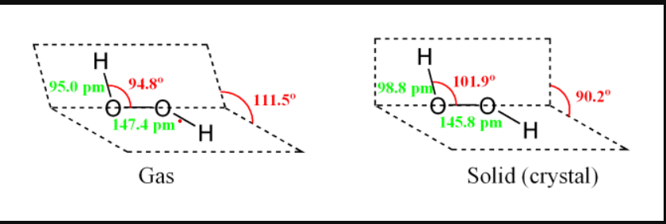

Slide 22
THANKING YOU
ODM EDUCATIONAL GROUP

