Slide 1


STATES OF MATTER
GASES & LIQUIDS
SUBJECT : (CHEMISTRY)
CHAPTER NUMBER:04

Slide 4
Property | Solids | Liquids | Gases
1. Particle arrangement | Molecules occupy fixed position & are packed close together. | Molecules do not occupy fixed position & are less closely packed. | Molecules do not occupy fixed position & are widely separated.
2. Movement | Molecules have very little movement & are associated only with vibratory motion. | Molecules moves freely but slower than gases. Theses have all the three types of motion. | Molecules move very freely & are associated with all three types of motion.
3. Energy | Molecules posses minimum energy. | Molecules posses higher energy. | Molecules posses very high energy.

Slide 6
Diffusion | Solids do not diffuse readily. | Liquids diffuse slowly than gases but move rapidly than solids. | Gases diffuse very rapidly due to the free movement of the molecules.
Compressibility | Solids can only be compressed under extremely high pressure due to the absence of empty spaces. | Liquids can also be compressed only under high pressure. | Gases can be readily due to presence of large empty spaces between the molecules.

Slide 15
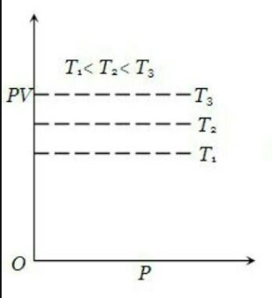

Slide 38
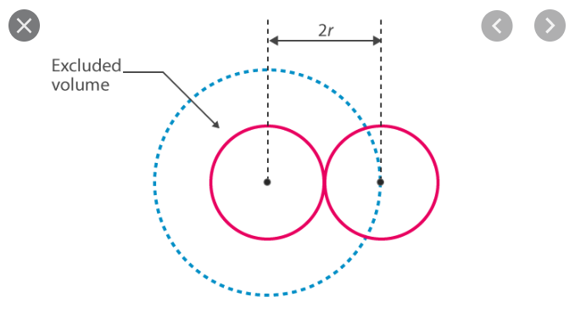

Slide 43
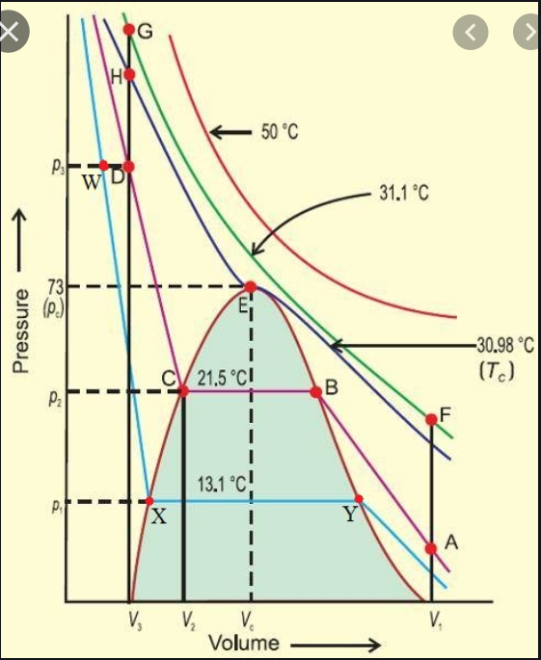
[Isotherms of CO₂ at various temperatures]

Slide 47
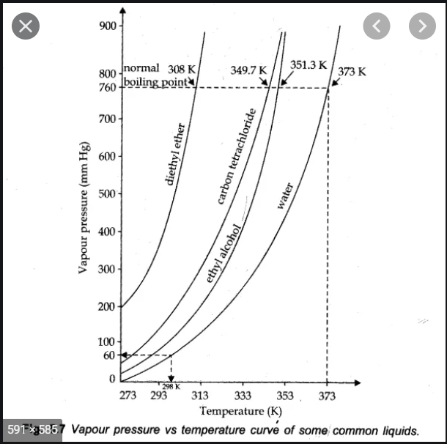
The normal boiling point is the temperature at which the vapor pressure of liquid is the normal atmospheric pressure, i.e., 760mm of Hg.
If pressure is 1bar, then the boiling point is called standard boiling point of the liquid, which is slightly lower than the normal boiling point because 1bar pressure is slightly less than 1atm pressure.
The normal boiling point of water is 100°C (373K) & standard boiling point is 99.6°C (372.6K). At high altitudes, atmospheric pressure is low. Therefore, liquids at high altitudes boil at lower temperature in comparison to that at sea level.

Slide 48
Since water boils at low temperature on hills, the pressure cooker is used for cooking food. Boiling does not occur when liquid is heated in a closed vessel.
On heating, continuously vapor pressure increases. At first, a clear boundary is visible between liquid & vapor phase because liquid is more dense than vapor.
As the temperature increases, more & more molecules to go to vapor phase & density of vapors rise. At the same time, liquid becomes less dense. It expands because molecules move apart.
When density of liquids & vapors becomes the same, the clear boundary between them disappears. This temperature is called critical temperature.
Viscosity:
Viscosity of a liquid is its property by virtue of which it tends to oppose the relative motion between two adjacent layers.
When a liquid is flowing through a cylindrical tube, layers just touching the sides of the tube are stationary, & velocities of the adjacent layers increases towards the centre of the tube. The layer in the centre of the tube will have a maximum velocity.
Thus, there exists a velocity gradient. In order to maintain a uniform velocity gradient, we have to apply force acting along the direction of movement of the layer.

Slide 49
This applied force is measures of internal friction or viscosity of the liquid.
In order to maintain a uniform velocity gradient, we have to apply force acting along the direction of movement of the layer.
This applied force is a measure of internal friction or viscosity of liquid. In case of liquids this, this internal friction arises due to the presence of intermolecular attractive forces.
Let us consider a fluid as being made of parallel layers or planes of molecules. Let the area of each layer be A & the distance between the layers be dx. Further consider between the layers to be moving to the right with velocities v-dv, v, v +dv etc.
Where each succeeding velocity is greater than preceding by an amount dv. This type of flow in which the different layers are parallel to each other is called laminar flow.
In laminar flow, the force ‘F’ required to maintain a steady velocity difference dv between any two parallel layers separated by distance dz will depend upon:
Area of contact A between the two layers.
Velocity gradient, dv/dz.

Slide 50
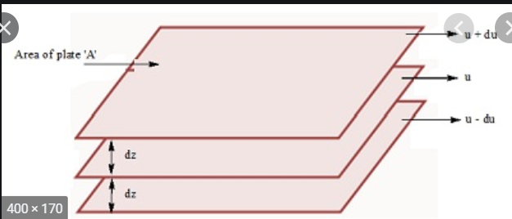
[Graduation of velocity in the laminar flow]

Slide 53
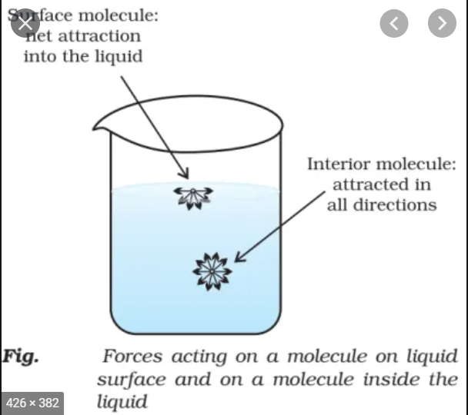
Unit: Nm⁻¹
Surface energy:
Due to surface tension, liquids tend to minimize their surface area. Therefore, in order to increase the surface area. Force must be external to overcome the surface tension.

Slide 56
THANKING YOU
ODM EDUCATIONAL GROUP

