Slide 1
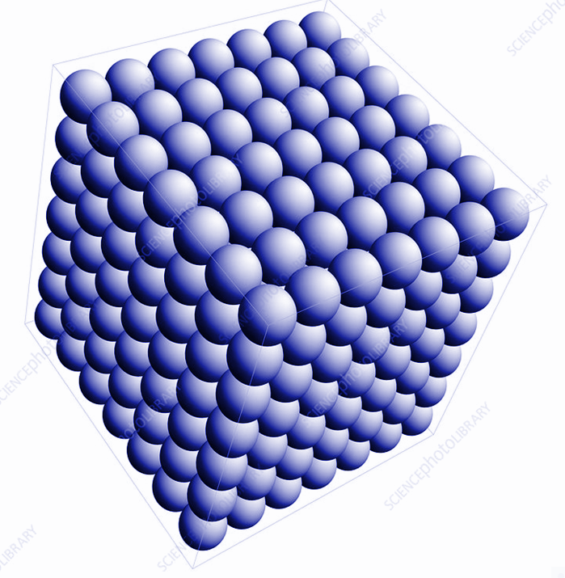



CRYSTAL LATTICE & UNIT CELLS (LECT-02)
SUB-CONCEPTS:
CRYSTAL LATTICES, CRYSTAL SYSTEMS, UNIT CELLS, NUMBER OF ATOMS IN UNIT CELLS
CHAPTER NUMBER: 01
CHAPTER NAME : THE SOLID STATE

Slide 2
LEARNING OUTCOMES
Students will be able to describe lattice points and recite the seven types of Crystal systems with the help of an acronym (HTC MOTR).
Students will be accustomed to the types of unit cells and their 14 types of Bravais lattices.
They can easily figure out the number of atoms in each unit cell and can do problems related to this.

Slide 3
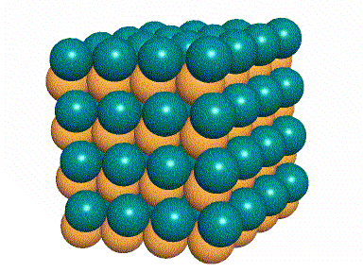
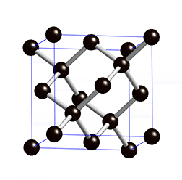
CRYSTAL LATTICE/ SPACE LATTICE
All Crystals have a regular repetition of some constituent particles(Atoms, molecules or ions).
Regular arrangement of lattice points showing how the particles are arranged at different sites in 3D-view.

Slide 4
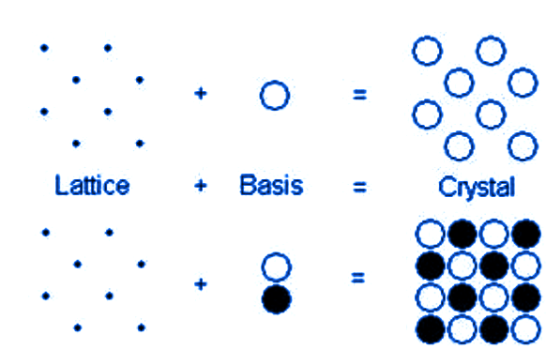
A regular three dimensional arrangement of points in space is called a crystal lattice.
What is basis or motif?
Lattice point + basis or motif = Crystal

Slide 5
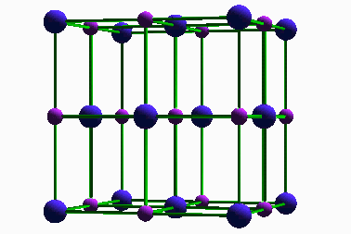
CHARACTERISTICS OF CRYSTAL LATTICE
Each point in a crystal lattice is called a lattice point.
Lattice points are joined by straight lines to bring out the geometry of the lattice.

Slide 6
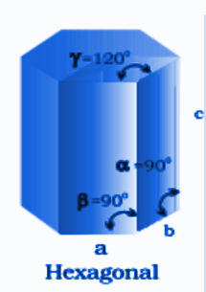
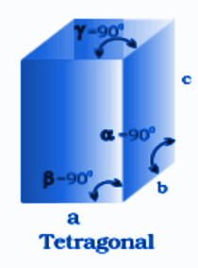
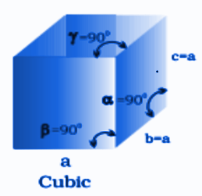
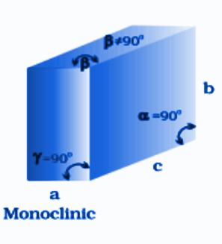
SEVEN CRYSTAL SYSTEMS (HTC MOTR)

Slide 7
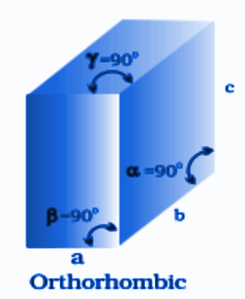
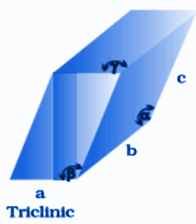
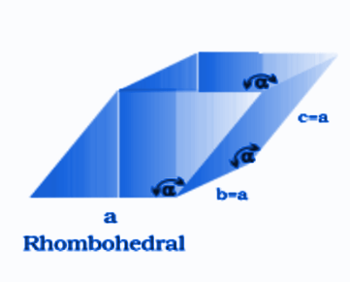
SEVEN CRYSTAL SYSTEMS (HTC MOTR)

Slide 8
SEVEN PRIMITIVE AND CENTRED UNIT CELLS
Crystal System Axial relationships Angles in degree Bravais Lattices
Hexagonal a = b ≠ c α = β = 90, ϒ= 120 P
Tetragonal a = b ≠ c α = β = ϒ = 90 B & P
Cubic a = b = c α = β = ϒ= 90 P, F & B
Monoclinic a ≠ b ≠ c α = ϒ = 90 ≠ β E & P
Orthorhombic a ≠ b ≠ c α = β = ϒ = 90 B, P , F & E
Triclinic a ≠ b ≠ c α ≠ β ≠ ϒ ≠ 90 P
Rhombohedral a = b = c α = β = ϒ ≠ 90 P
P = Primitive B = Body-centred F = Face-centred E = End-centred

Slide 9
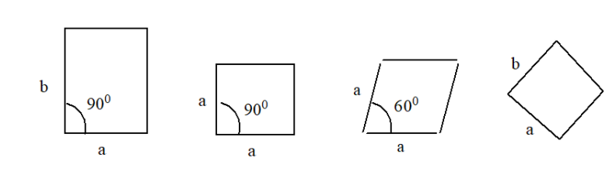
UNIT CELLS
Unit cell is the smallest repeating portion.
Possible unit cells in two dimensions:

Slide 10
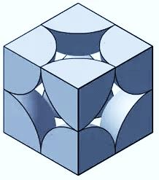

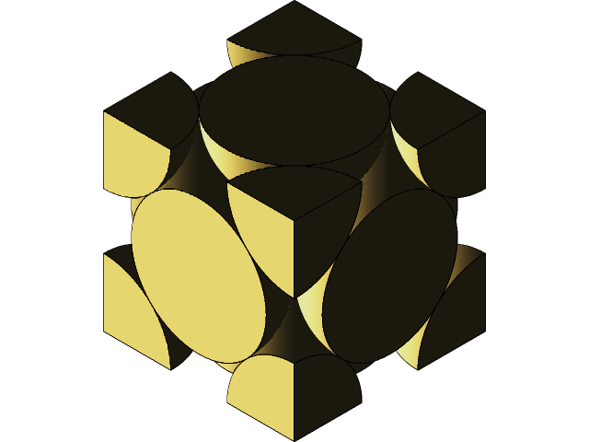
UNIT CELLS IN THREE DIMENSIONS:
(i) Simple Cubic or Primitive Unit Cell
(ii) Body-centred Unit Cell
(iii) Face-centred Unit Cell

Slide 11
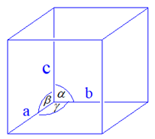
PARAMETERS OF UNIT CELLS:
Unit cell is characterised by
(i) Dimensions along three edges a, b & c.
(ii) Angle between the edges ά, β & γ.

Slide 12
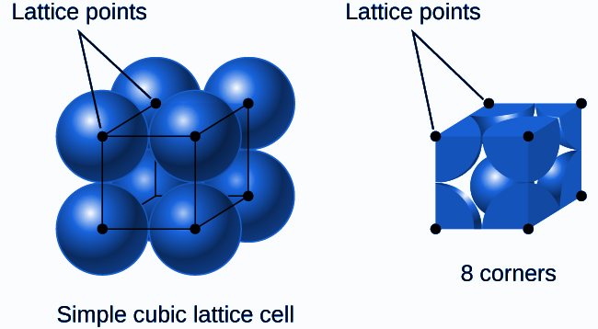
TYPES OF UNIT CELLS:
Primitive Unit Cell (b) Centred Unit Cells
Primitive Unit Cell

Slide 13
CENTRED UNIT CELLS:
(i) Simple Cubic or Primitive Unit Cell
(ii) Body-centred Unit Cell
(iii) Face-centred Unit Cell

Slide 14
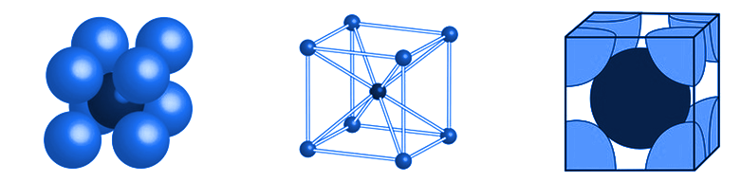
CENTRED UNIT CELLS:
(i) Body-Centred Unit Cell

Slide 15
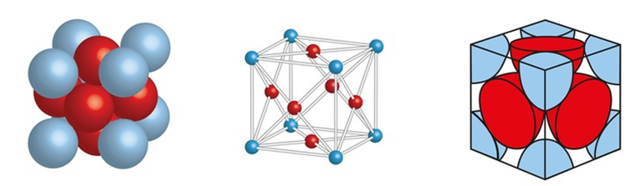
CENTRED UNIT CELLS:
(ii) Face-Centred Unit Cell

Slide 16

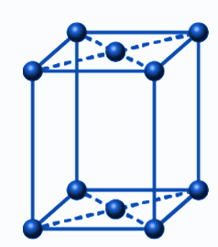
CENTRED UNIT CELLS:
(iii) End-Centred Unit Cell

Slide 17
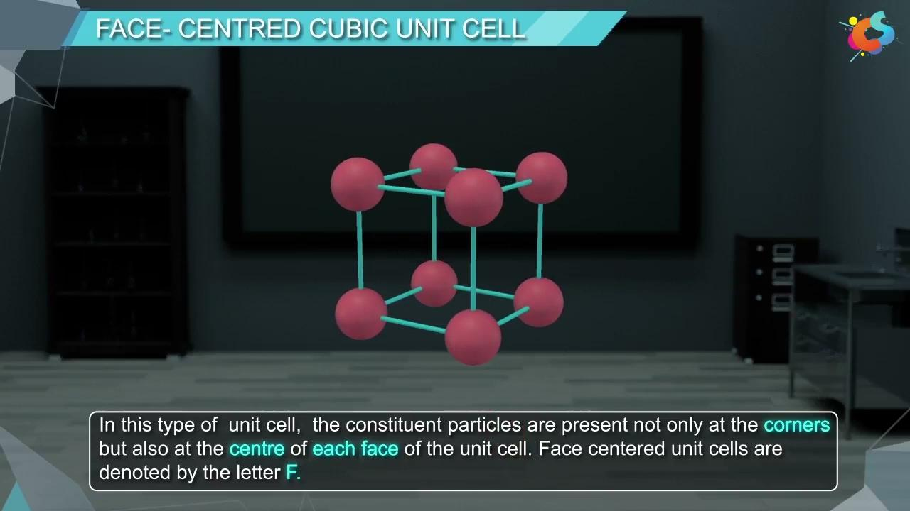

Slide 18
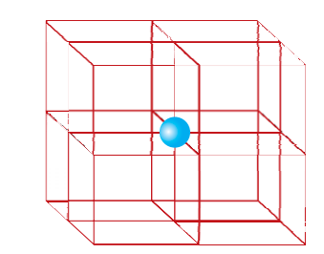
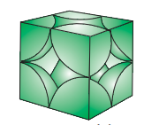
NUMBER OF ATOMS IN UNIT CELLS:
Contribution by each corner atom:
1/8th of an atom

Slide 19
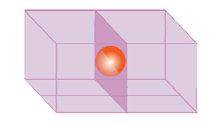
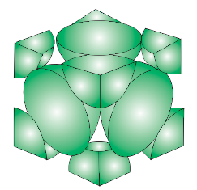
NUMBER OF ATOMS IN UNIT CELLS:
Contribution by each atom at face centers:
½ of an atom

Slide 20
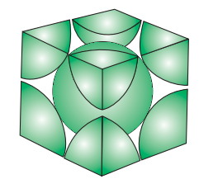
NUMBER OF ATOMS IN UNIT CELLS:
Number of atoms contributed by body centre:
One atom at the body centre

Slide 21
NUMBER OF ATOMS IN UNIT CELLS:
UNIT CELLS Number of atoms per unit cell
Simple Cubic 8 x 1/8 = 8
Body Centred 8 x 1/8 + 1 = 2
Face Centred 8 x 1/8 + 6 x ½ = 4

Slide 22
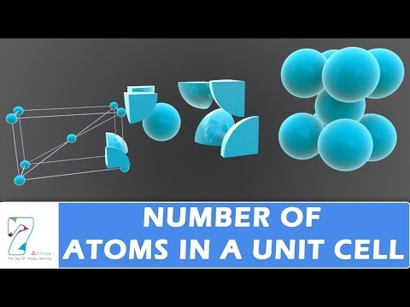

Slide 23
Assignments.
In a simple cubic unit cell, each point on a corner is shared by
2 unit cells (b) 1 unit cell (c) 8 unit cells (d) 4 unit cells
The number of atoms in an end-centered unit cell is
(a) 1 (b) 2 (c) 3 (d) 4 (d) 4
Assertion: A particle present at the corner of the unit cell has 1/8th of its contribution to the unit cell.
Reason: In any space lattice, the corner of the unit cell is always shared by the eight-unit of the cells.
How many atoms constitute one unit cell of a face-centered cubic (fcc) crystal?
Give the significance of a ‘lattice point’.
Name the parameters that characterize a unit cell.
Distinguish between (i) Hexagonal and monoclinic unit cells (ii) Face-centred and end-centered unit cells.
Explain how many portions of an atom are located at (i) corner (ii) the body center of a cubic unit cell is part of its neighboring unit cell.
Distinguish between Crystal lattice and unit cell?

Slide 24
The Refractive index of a solid is observed to have the same value along with all directions. Comment on the nature of this solid. Would it show cleavage property?
How many lattice points are there in one unit cell of each of the following lattices? (i) Face-centred cubic (ii) Face-centred tetragonal (iii) Body-centred.
A cubic solid is made of two elements P and Q. Atoms of Q are at the corners of the cube and P at the body-center. What is the formula of the compound?
A cubic solid is made of two elements X and Y. Atoms of X are at the corners of the cube and Y at the face-centers. What is the formula of the compound?
A cubic solid is made of two elements A and B. Atoms of A are at the corners of the cube and two atoms of B are in each body diagonal. What is the formula of the compound?
In a face-centered cubic arrangement of A and B atoms where A are present at the corner and B at the face centers. An atom is missing from 4 corners in each unit cell. What is the simplest formula of the compound?
In an fcc arrangement of A and B atoms. A is present at the corners of the unit cell and B is present at the face centers. If one atom of A is missing from its position at the corners, what is the formula of the compound?

Slide 25
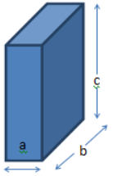
14. Which of the following is regarded as the ‘repeatable entity’ of a 3D crystal structure? a) Unit cell b) Lattice c) Crystal d) Bravais Index
15. Identify the dimensional relation for the unit cell illustrated below.
a) a = b = c b) a = b ≠ c c) a ≠ b ≠ c d) a ≠ b = c
16. A compound is formed by atoms of elements A occupying the corners of the unit cell and an atom of element B present at the center of the unit cell. Deduce the formula of the compound. a) AB₂ b) AB₃ c) AB₄ d) AB
17. How many parameters are used to characterize a unit cell? a) Six b) Three c) Two d) Nine

Slide 26
18. Bravais lattice consists of __________ space lattices. a) Eleven b) Twelve
c) Thirteen d) Fourteen
19. A unit cell that contains lattice points only at the corners is known as _________. a) Primitive unit cell b) Secondary unit cell c) Layered unit cell d) Derived unit cell
20. The axial relationship of a rhombohedral crystal system is given as ___________. a) a = b = c b) a = b ≠ c c) a ≠ b = c d) a ≠ b ≠ c

Slide 27
THANKING YOU
ODM EDUCATIONAL GROUP

