Slide 1


CELL :THE UNIT OF LIFE
PLASTIDS
SUBJECT:BIOLOGY
CHAPTER NUMBER:08
CHAPTER NAME :CELL:THE UNIT OF LIFE

Slide 2
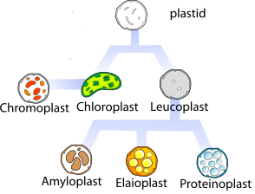
PLASTIDS
Plastids are found in all plant cells and in Euglenoides.
These are easily observed under the microscope as they are large.
They bear some specific pigments, thus imparting specific colours to the plants.
Based on the type of pigments plastids can be classified into chloroplasts,
chromoplasts and leucoplasts.
PLASTID-TYPES
Chloroplasts: green coloured plastids
Chromoplasts : yellow, orange, red coloured plastids
Leucoplasts : colourless plastids

Slide 3
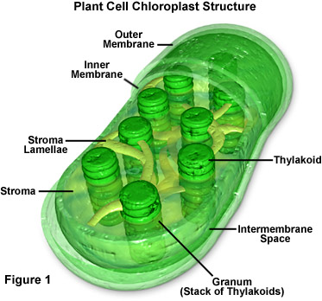
PLASTID-TYPES
The word chloroplast is derived from the Greek word ‘chloros’ which means green and ‘plastes’ which means ‘the one who form’.
The chloroplasts contain chlorophyll and carotenoid pigments which are responsible for trapping light energy essential for photosynthesis
Sectional view of chloroplast

Slide 4
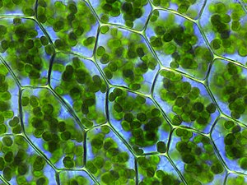
STRUCTURE OF CHLOROPLAST
Stroma Lamellae
CELLS OF Bryum capillare SHOWING CHLOROPLAST
Grana

Slide 5
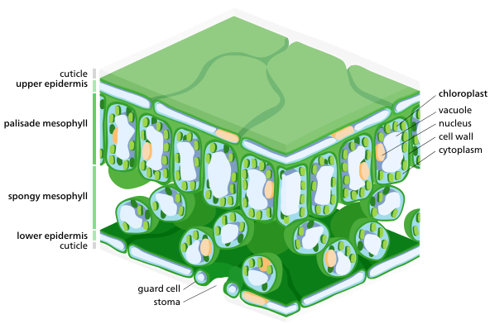
CHLOROPLAST
Majority of the chloroplasts of the green plants are found in the mesophyll cells of the leaves.
These are lens-shaped, oval, spherical, discoid or even ribbon-like organelles having variable length (5-10µm) and width (2-4µm).
The number varies from 1 per cell of the Chlamydomonas, a green alga to 20-40 per cell in the mesophyll and up to 100 in plants like Arabidopsis and wheat.
CROSS SECTION OF LEAF

Slide 6
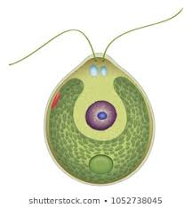
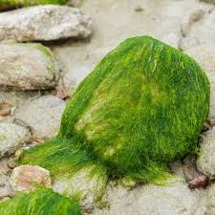
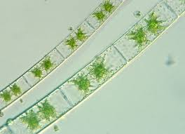
GREEN ALGAE
Cup shaped
Stellate shaped
Chlamydomonas
Zygnema
SPIROGYRA

Slide 7
STRUCTURE OF CHLOROPLAST
Like mitochondria, the chloroplasts are also double membrane bound.
Of the two, the inner chloroplast membrane is relatively less permeable.
The space limited by the inner membrane of the chloroplast is called the stroma.
The inner chloroplast membrane borders the stroma and regulates passage of materials in and out of the chloroplast.
In addition to regulating the passage of materials, the inner Chloroplasts Membrane is where fatty acids, lipids and carotenoids are synthesized.

Slide 8
A number of organised flattened membranous sacs called the thylakoids, are present in the stroma.
Stroma is protein rich alkaline aqueous fluid within the inner chloroplast membrane.
Chloroplast DNA, chloroplast ribosomes, the thylakoid system, starch granules and many proteins can be found floating around in it.

Slide 9
STRUCTURE OF CHLOROPLAST
Thylakoids are arranged in stacks like the piles of coins called grana (singular: granum) or the intergranal thylakoids.
In addition, there are flat membranous tubules called the stroma lamellae connecting the thylakoids of the different grana.
The membrane of the thylakoids enclose a space called a lumen.
Chlorophyll pigments are present in the thylakoids.
Embedded in the thylakoid membranes are important protein complexes which carry out the light reactions of photosynthesis.

Slide 10
The stroma of the chloroplast contains enzymes required for the synthesis of carbohydrates and proteins.
It also contains small, double stranded circular DNA molecules and ribosomes.
Chloroplasts have their own ribosomes which they utilise to synthesize proteins.
The ribosomes of the chloroplasts are smaller (70S) than the cytoplasmic ribosomes (80S).

Slide 11
CHLOROPLAST DNA
Chloroplasts have their own DNA often abbrevaited as ctDNA, or the cpDNA. It is also known as plastome.
Chloroplast genome is a single large circular DNA molecule.
cpDNA codes for various proteins required for photosynthesis.
FUNCTIONS OF CHLOROPLAST
Chloroplasts are organelles that conduct photosynthesis, where the photosynthetic pigment chlorophyll captures the energy from sunlight.
It converts the light energy and stores it in chemical form ATP, during photolysis freeing oxygen from water.
The ATP is used to make organic molecules from CO₂ in the process known as Calvin Cycle.

Slide 12

PLASTID-TYPES
Chromoplasts the fat soluble carotenoid pigments:
like carotene
xanthophylls
This gives the part of the plant a yellow, orange or red colour.
Phycocyanin is responsible for imparting brown algae their
Distinctive brown color.
Kelp
Phycoerythrin is responsible for giving many red algae their
distinctive red color.
Red algae

Slide 13
PHOTOSYNTHETIC PIGMENTS
Chlorophyll a
Chlorophyll b
Chlorophyll c
Chlorophyll d
Chlorophyll f
Xanthophyll
α Carotene
β Carotene

Slide 14
LEUCOPLAST- TYPES
The leucoplasts are the colourless plastids of varied shapes and sizes with stored nutrients:
Amyloplasts store carbohydrates (starch), e.g., potato;
Elaioplasts store oils and fats.
Aleuroplasts store proteins.
Leucoplasts

Slide 15
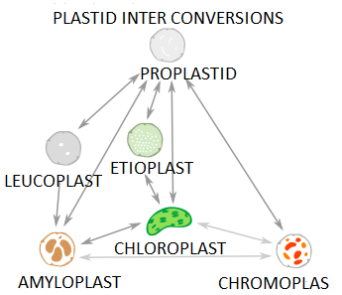
INTER CONVERSION OF PLASTIDS

Slide 16
THANKING YOU
ODM EDUCATIONAL GROUP

