Slide 1


CELL: THE UNIT OF LIFE
MITOCHONDRIA
SUBJECT : BIOLOGY
CHAPTER NUMBER:08
CHAPTER NAME :CELL:THE UNIT OF LIFE

Slide 2
MITOCHONDRIA
Mitochondria (sing.: mitochondrion), is a semi-autonomous double membrane bound organelle, found in most eukaryotic organisms.
The word mitochondrion comes from the Greek word ‘ mitos’ means thread and chondrion means ‘granule’ or ‘grain like’.
The number of mitochondria per cell is variable depending on the physiological activity of the cells.
Electron micrograph of Mitochondria

Slide 3
The number of mitochondria in a cell can vary widely by organism, tissue, and cell type.
For instance, red blood cells have no mitochondria, whereas liver cells can have more than 2000.
The organelle is composed of compartments that carry out specialized functions.
These compartments or regions include the outer membrane, the intermembrane space, the inner membrane, and the cristae and matrix.

Slide 4
Organization and distribution
The population of all the mitochondria of a given cell constitutes the chondriome.
Mitochondria vary in number and location according to cell type.
A single mitochondrion is often found in unicellular organisms.
Conversely, the chondriome size of human liver cells is large, with about 1000–2000 mitochondria per cell, making up 1/5 of the cell volume.
The mitochondrial content of otherwise similar cells can vary substantially in size and membrane potential, with differences arising from sources including uneven partitioning at cell divisions, leading to extrinsic differences in ATP levels and downstream cellular processes.

Slide 5
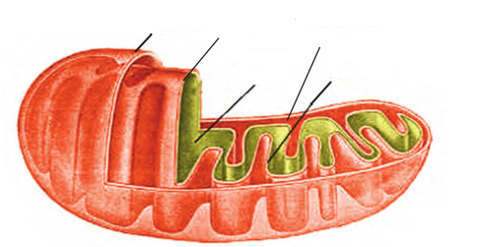
MITOCHONDRIA - STRUCTURE
Outer
membrane
INNER
membrane
Inter-membrane space
Matrix
Crista
Structure of MITOCHONDRIA (Longitudinal section

Slide 6
MITOCHONDRIA - STRUCTURE
Each mitochondrion is a double membrane-bound structure with the outer membrane and the inner membrane dividing its lumen distinctly into two aqueous compartments, i.e., the outer compartment and the inner compartment.
The inner compartment is filled with a dense homogeneous substance called the matrix.
The outer membrane forms the continuous limiting boundary of the organelle.
The inner membrane forms a number of infoldings called the cristae (sing.: crista) towards the matrix.
The cristae increase the surface area

Slide 7
mtDNA
Although most of a cell's DNA is contained in the cell nucleus, the mitochondrion has its own independent genome ("mitogenome") that shows substantial similarity to bacterial genomes.
Mitochondrial proteins (proteins transcribed from mitochondrial DNA) vary depending on the tissue and the species.
In humans, 615 distinct types of proteins have been identified from cardiac mitochondria, whereas in rats, 940 proteins have been reported.

Slide 8
MITOCHONDRIA - FUNCTIONS
Energy conversion
A dominant role for the mitochondria is the production of ATP, as reflected by the large number of proteins in the inner membrane for this task.
This is done by oxidizing the major products of glucose: pyruvate, and NADH, which are produced in the cytosol.
This type of cellular respiration known as aerobic respiration, is dependent on the presence of oxygen, which provides most of the energy released.
The production of ATP from glucose and oxygen has an approximately 13-times higher yield during aerobic respiration compared to fermentation.

Slide 9
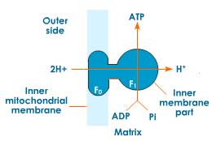
OXYSOMES

Slide 10
MITOCHONDRIA - FUNCTIONS
The two membranes have their own specific enzymes associated with the mitochondrial function.
Mitochondria are the sites of aerobic respiration.
They produce cellular energy in the form of ATP, hence they are called ‘power houses’ of the cell.
The matrix also possesses single circular DNA molecule, a few RNA molecules, ribosomes (70S) and the components required for the synthesis of proteins.
The mitochondria divide by fission.
Storage of calcium ions.
The concentrations of free calcium in the cell can regulate an array of reactions and is important for signal transduction in the cell.
Mitochondria can transiently store calcium, a contributing process for the cell's homeostasis of calcium.

Slide 11
THANKING YOU
ODM EDUCATIONAL GROUP

