Slide 1


CELL:THE UNIT OF LIFE
ENDOMEMBRANE SYSTEMS, Endoplasmic reticulum, GOLGI BODIES, VACUOLES AND Lysosome
SUBJECT : BIOLOGY
CHAPTER NUMBER:08
CHAPTER NAME :CELL:THE UNIT OF LIFE

Slide 2
ENDOMEMBRANE SYSTEM
The endo-membrane system consists of nuclear envelope, Endoplasmic Reticulum (ER), Golgi complex, lysosomes and vacuoles suspended in the cytoplasm.
These are considered together as an endo-membrane system because their functions are coordinated with each other, inspire of this that each membranous organelles is distinct in terms of its structure and functioning.

Slide 3
The Endoplasmic Reticulum (ER)
Electron microscopic studies of eukaryotic cells reveal the presence of a network or reticulum of tiny tubular structures scattered in the cytoplasm that is called the endoplasmic reticulum (ER).
Hence, ER divides the intracellular space into two distinct compartments, i.e., luminal (inside ER) and extra luminal (cytoplasm) compartments.

Slide 4
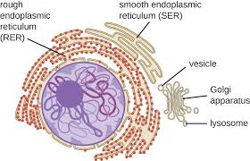
Types of Endoplasmic Reticulum
The ER often shows ribosomes attached to their outer surface.
The endoplasmic reticulun bearing ribosomes on their surface is called rough endoplasmic reticulum (RER).
In the absence of ribosomes they appear smooth and are called smooth endoplasmic reticulum (SER).

Slide 5
Function of Endoplasmic Reticulum
RER is frequently observed in the cells actively involved in protein synthesis and secretion.
They are extensive and continuous with the outer membrane of the nucleus.
The smooth endoplasmic reticulum is the major site for synthesis of lipid. In animal cells lipid-like steroidal hormones are synthesised in SER.

Slide 6
Golgi Apparatus
Camillo Golgi (1898) first observed densely stained Golgi apparatus reticular structures near the nucleus. These were later named Golgi bodies after him.
They consist of many flat, disc-shaped sacs or cisternae of 0.5μm to 1.0μm diameter.
These are stacked parallel to each other. Varied number of cisternae are present in a Golgi complex.
The Golgi cisternae are concentrically arranged near the nucleus with distinct convex cis or the forming face and concave trans or the maturing face.
The cis and the trans faces of the organelle are entirely different, but interconnected.

Slide 7
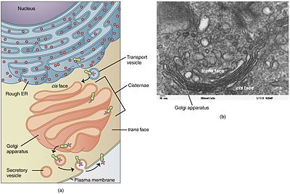

Slide 8
Functions Of Golgi Apparatus
The golgi apparatus principally performs the function of packaging materials, to be delivered either to the intra-cellular targets or secreted outside the cell.
Materials to be packaged in the form of vesicles from the ER fuse with the cis face of the golgi apparatus and move towards the maturing face.
This explains, why the golgi apparatus remains in close association with the endoplasmic reticulum.
A number of proteins synthesised by ribosomes on the endoplasmic reticulum are modified in the cisternae of the golgi apparatus before they are released from its trans face.
Golgi apparatus is the important site of formation of glycoproteins and glycolipids.

Slide 9
These are membrane bound vesicular structures formed by the process of packaging in the golgi apparatus.
The isolated lysosomal vesicles have been found to be very rich in almost all types of hydrolytic enzymes (hydrolases – lipases, proteases, carbohydrases) optimally active at the acidic pH.
These enzymes are capable of digesting carbohydrates, proteins, lipids and nucleic acids.

Slide 10
Vacuoles
The vacuole is the membrane-bound space found in the cytoplasm.
It contains water, sap, excretory product and other materials not useful for the cell.
The vacuole is bound by a single membrane called tonoplast.
In plant cells the vacuoles can occupy up to 90 per cent of the volume of the cell.

Slide 11
Functions Of Vacuoles
In plants, the tonoplast facilitates the transport of a number of ions and other materials against concentration gradients into the vacuole, hence their concentration is significantly higher in the vacuole than in the Cytoplasm.
In Amoeba the contractile vacuole is important for osmoregulation
and excretion.
In many cells, as in protists, food vacuoles are formed by engulfing the food particles.

Slide 12
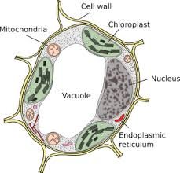
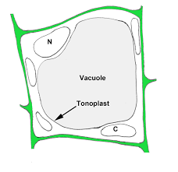

Slide 13
LYSOSOME
Lysosomes are an important cell organelle found within eukaryotic animal cells. Due to their peculiar function, they are also known as the “suicide bags” of the cell.
The term was coined by Christian de Duve, a Belgian biologist, who discovered it and ultimately got a Nobel Prize in Medicine or Physiology in the year 1974.
“Lysosomes are sphere-shaped sacs filled with hydrolytic enzymes that have the capability to break down many types of biomolecules.”

Slide 14
In other words, lysosomes are membranous organelles whose specific function is to breakdown cellular wastes and debris by engulfing it with hydrolytic enzymes.
Lysosomes are membrane-bound organelles and the area within the membrane is called the lumen, which contains the hydrolytic enzymes (lipases, proteases, carbohydrases,), optimally active at the acidic pH and other cellular debris lipids, nucleic acid.
The enzymes are capable of digesting carbohydrate, proteins.
These are formed by the process of packaging in the golgi apparatus.

Slide 15
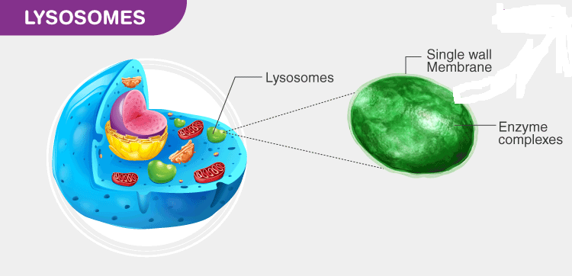

Slide 16
The pH level of the lumen lies between 4.5 and 5.0, which makes it quite acidic. It is almost comparable to the function of acids found in the stomach.
Besides breaking down biological polymers, lysosomes are also involved in various other cell processes such as counting discharged materials, energy metabolism, cell signaling, and restoration of the plasma membrane.
The sizes of lysosomes vary, with the largest ones measuring in more at than 1.2 μm. But they typically range from 0.1 μm to 0.6 μm.

Slide 17
Where are Lysosomal Enzymes made?
Lysosomes comprise of over 50 different enzymes.
They are synthesized in the rough ER.
Once synthesized, the enzymes are brought in from the Golgi apparatus in tiny vesicles or sacs, which then merges with bigger acidic vesicles.
The enzymes produced especially for lysosomes are mixed with the molecule mannose 6-phosphate making them get fixed appropriately up into acidified vesicles.

Slide 18
Lysosome in Plant Cell
Lysosomes are predominantly found in eukaryotic animal cells and are responsible for breaking down cellular debris.
In plants, the role of lysosomes is undertaken by the vacuoles as traditional cell biology dictates.
However, recent discoveries point out that the function of vacuoles is quite similar to the functions of a lysosome in animal cells.
Furthermore, findings suggest that these vacuoles possess hydrolytic enzymes similar to the ones found in animal cells

Slide 19
These are the small sub-spherical granular organelles, not bounded by any membrane.
Ribosomes were first observed by George Palade (1953), as the dense particles under the electron microscope.
Hence, are also called Palade particles.
As they are primarily involved in the synthesis of proteins or polypeptides.
As studied earlier, the prokaryotic ribosomes are 70S type, while the eukaryotic ribosomes are 80S type. Here, ‘S’ (Svedberg’s unit) stands for sedimentation coefficient (measure of density and size).
Both 70S and 80S ribosomes contains two sub-units, i.e., the smaller and the larger sub-unit.
RIBOSOME

Slide 20
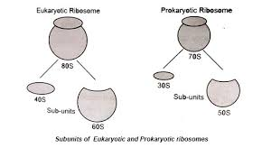
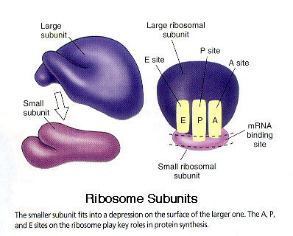

Slide 21
“Ribosomes are complex cell organelles made of RNA and protein that translates genetic code into chains of amino acids.”
The ribosome is a complex molecular machine found inside the living cells that make proteins from amino acids in the process called protein synthesis or translation.
Protein synthesis is a major task performed by living cells.
Ribosomes are special organelles as they are found in both prokaryotes and eukaryotes.

Slide 22
Every cell needs ribosome to manufacture proteins.
It binds to a messenger ribonucleic acid (mRNA) and decodes the information carried by the nucleotide sequence of the mRNA.
The transfer RNAs (tRNAs) containing amino acids enter the ribosome at the acceptor site.
When it binds correctly, it adds amino acid to the growing protein chain on tRNA.
Ribosome of chloroplasts are smaller (70S) than the ribosome of eukaryotic cytoplasm (80S).

Slide 23
Ribosomes Structure
Ribosome are mainly composed of ribonucleoproteins (i. e., RNA-t- proteins) and are also known as protein factories.
A ribosome is a complex of RNA and protein and is, therefore, known as a ribo-nucleoprotein.
It is made up of two subunits. The smaller subunit is where the mRNA binds and is decoded. While the larger subunit is where the amino acids get added.
Both of the subunits are made up of both protein and ribonucleic acid components.
The two subunits are joined to each other by interactions between the rRNAs in one subunit and proteins in the other subunit.
Ribosome are located inside the cytosol found in the plant cell and animal cell.

Slide 24
The ribosome structure includes the following:
It is located in two areas of cytoplasm.
Scattered in the cytoplasm.
Prokaryotes have 70S ribosomes while eukaryotes have 80S ribosomes.
Around 62% of ribosomes are comprised of RNA, while the rest is proteins.
The structure of free and bound ribosomes is similar and is associated with protein synthesis.

Slide 25
Ribosomes Function
The important ribosome function includes:
It assembles amino acid to form proteins that are essential to carry out cellular functions.
The DNA produces mRNA by the process of DNA transcription.
The mRNA is synthesized in the nucleus and transported to the cytoplasm for the process of protein synthesis.
The ribosomal subunits in the cytoplasm are bound around mRNA polymers. The tRNA then synthesizes proteins.
The proteins synthesized in the cytoplasm are utilized in the cytoplasm itself, the proteins synthesized by bound ribosome are transported outside the cell.

Slide 26
THANKING YOU
ODM EDUCATIONAL GROUP

