Slide 1


CELL: THE UNIT OF LIFE
DOMAIN EUKARYOTA,CHARACTERISTIC OF EUKARYOTIC CELL, CELL MEMBRANE, CELLWALL AND CYTOPLASM
SUBJECT : BIOLOGY
CHAPTER NUMBER:08
CHAPTER NAME :CELL:THE UNIT OF LIFE

Slide 2
EUKARYOTIC CELLS
‘Eu’ = WELL/ true Karyon = nucleus
(Eukaryotic cells possess an organised nucleus with a nuclear envelope.)
The eukaryotes include
1. KINGDOM PROTISTA
2. KINGDOM FUNGI
3. KINGDOM PLANTAE
4. KINGDOM ANIMALIA

Slide 3
GENERAL CHARACTERISTICS
There is an extensive compartmentalisation of cytoplasm through the presence of membrane bound organelles.
In addition, eukaryotic cells have a variety of complex locomotory and cytoskeleton structures.
Their genetic material is organised into chromosomes.
All eukaryotic cells are not identical.
Plant and animal cells are different as the former possess cell walls, plastids and a large central vacuole which are absent in animal cells.
On the other hand, animal cells have centrioles which are absent in almost all plant cells.

Slide 4
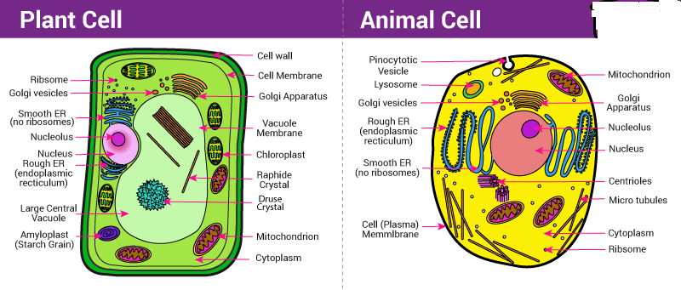
Difference Between Plant Cell and Animal Cell
Diagram showing the Difference between Plant cell and Animal cell

Slide 5
MAJOR DIFFERENCE BETWEEN PLANT CELL & ANIMAL CELL :
Plant Cell | Animal Cell
Cell Shape
Square/rectangular | Irregular/round
Cell Wall
Present | Absent
Plasma Membrane
Present | Present
Endoplasmic Reticulum
Present | Present
Nucleus
Present and lies on one side of the cell | Present and lies in the centre of the cell

Slide 6
MAJOR DIFFERENCE BETWEEN PLANT CELL & ANIMAL CELL
Lysosomes
Present but are very rare | Present
Centrosomes
Absent | Present
Golgi Apparatus
Present | Present
Cytoplasm
Present | Present
Ribosomes
Present | Present
Plastids
Present | Absent

Slide 7
Vacuoles
Few large or a single, centrally positioned vacuole | Usually small and numerous
Cilia
Absent | Present in most of the animal cells
Mitochondria
Present but fewer in number | Present and are numerous
Mode of Nutrition
Primarily autotrophic | Heterotrophic
Both plant and animal cells contain membrane-bound organelles like the nucleus, endoplasmic reticulum, mitochondria, Golgi apparatus, peroxisomes, lysosomes. They also have similar membranes such as cytosol, and cytoskeletal elements. The plant cell can also be larger than the animal cell.
The normal range of the animal cell varies from about 10 – 30 micrometres and that of plant cell range between 10 – 100 micrometres.

Slide 8
CELL MEMBRANE
The detailed structure of the membrane was studied by the help of electron microscope in the 1950s.
Meanwhile, chemical studies on the cell membrane, especially in human red blood cells (RBCs), enabled the scientists to deduce the possible structure of plasma membrane.
These studies showed that the cell membrane is mainly composed of lipids and proteins.

Slide 9
CHEMICAL COMPOSITION OF CELL MEMBRaNE
The major lipids are phospholipids that are arranged in a bilayer.
Also, the lipids are arranged within the membrane with the polar head towards the outer sides and the hydrophobic tails towards the inner part.
This ensures that the nonpolar tail of saturated hydrocarbons is protected from the aqueous environment.
In addition to phospholipids membrane also contains cholesterol.
Biochemical investigation clearly revealed that the cell membranes possess protein and carbohydrate.

Slide 10
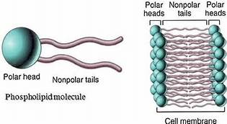
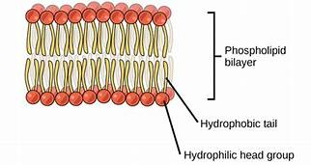
LIPID BILAYER OF THE CELL MEMBRANE
Because of the presence of both hydrophilic and hydrophobic parts phospholipids are called as amphipathic or amphiatic.

Slide 11
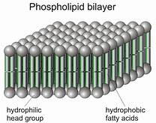
3 D ARRANGEMENT OF PHOSPHOLIPID IN CELL MEMBRANE

Slide 12
CHEMICAL COMPOSITION OF CELL MEMBRANE
The ratio of protein and lipid varies considerably in different cell types.
In human beings, the membrane of the erythrocyte has approximately 52 per cent protein and 40 per cent lipids.
Depending on the ease of extraction, membrane proteins can be classified as integral and peripheral.
Peripheral proteins lie on the surface of membrane while the integral proteins are partially or totally buried in the membrane.

Slide 13
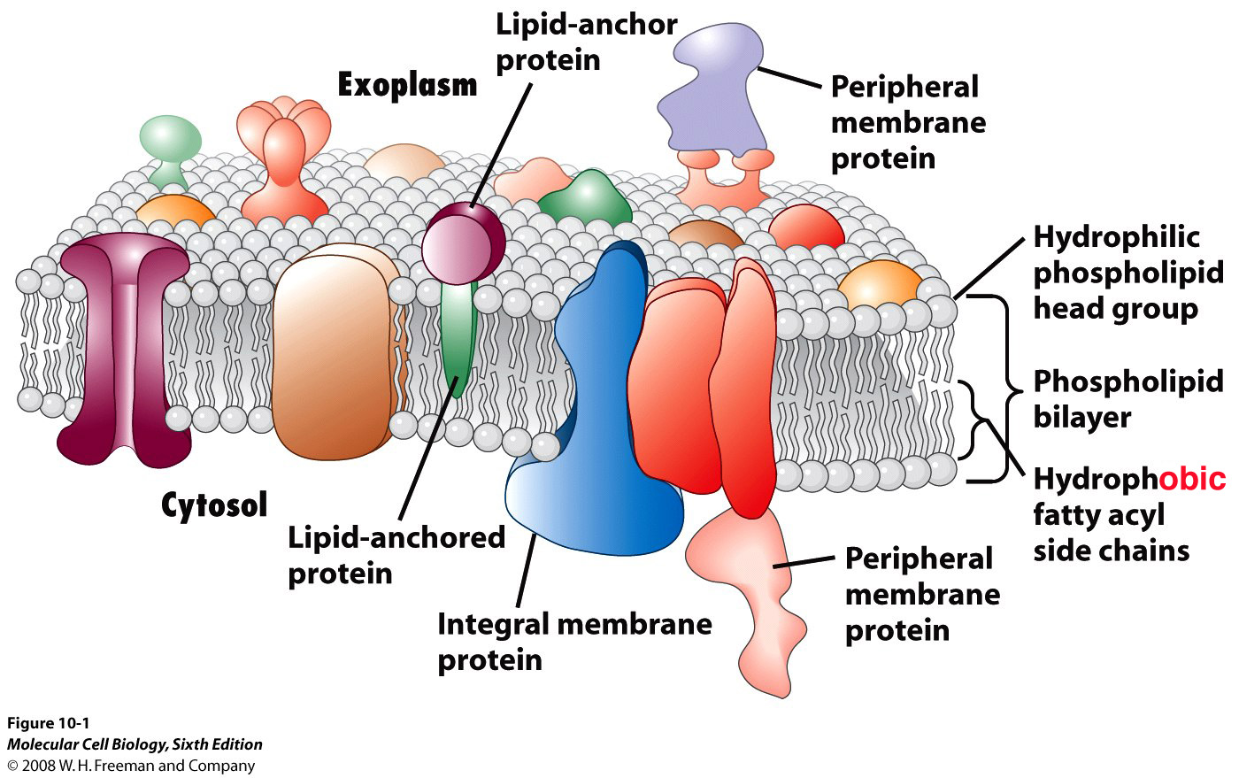
PROTEINS IN THE CELL MEMBRANE

Slide 14
STRUCTURE OF CELL MEMBRANE
Lamellar model or Sandwich model- Danielli and Davson (1935)-P-L-L-P
Unit membrane model- Robertson’s model (1959)-trilaminar structure (outer and inner narrow dense layer and transparent middle layer).
An improved model of the structure of cell membrane was proposed by Singer and Nicolson (1972) widely accepted as fluid mosaic model.
According to this, the quasi-fluid nature of lipid enables lateral movement of proteins within the overall bilayer. This ability to move within the membrane is measured as its fluidity.
The fluid nature of the membrane is also important from the point of view of functions like cell growth, formation of intercellular junctions, secretion, endocytosis, cell division etc.

Slide 15
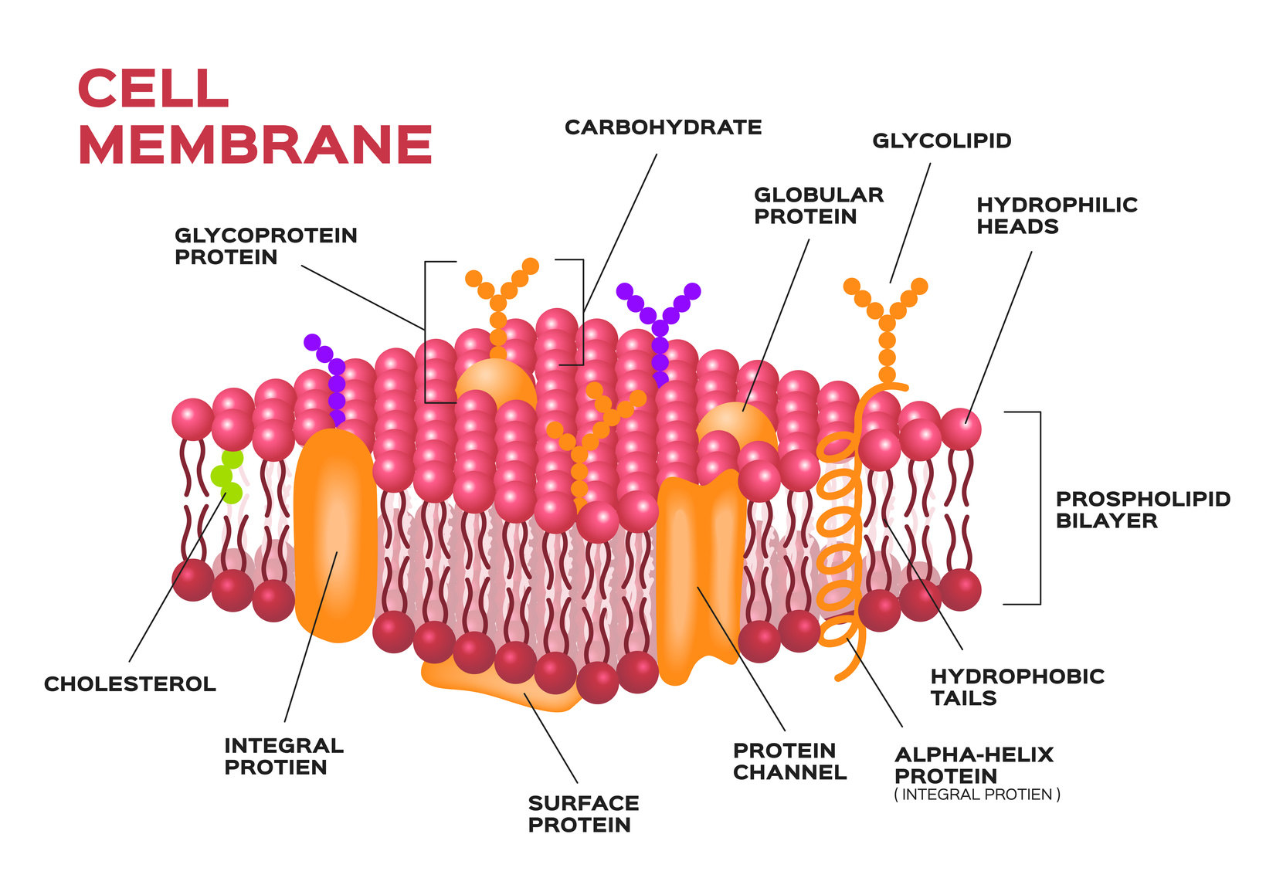
FLUID MOSAIC MODEL- SINGER AND NICOLSON

Slide 16
FUNCTION OF CELL MEMBRANE
The most important functions of the plasma membrane is the transport of the molecules across it.
The membrane is selectively permeable to some molecules present on either side of it.
Molecules can move briefly across the membrane without any requirement of energy and this is called the passive transport.
Neutral solutes may move across the membrane by the process of simple diffusion along the concentration gradient, i.e., from higher concentration to the lower.
Water may also move across this membrane from higher to lower concentration. Movement of water by diffusion is called osmosis.
As the polar molecules cannot pass through the nonpolar lipid bilayer, they require a carrier protein of the membrane to facilitate their transport across the membrane.
A few ions or molecules are transported across the membrane against their concentration gradient, i.e., from lower to the higher concentration.
Such a transport is an energy dependent process, in which ATP is utilised and is called active transport, e.g., Na+/K+ Pump.

Slide 17
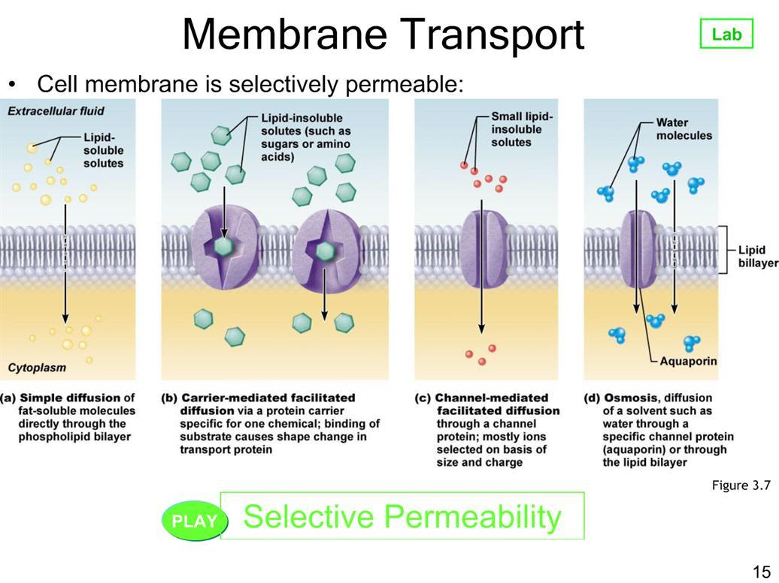
TRANSPORT ACROSS THE MEMBRANE

Slide 18
TRANSPORT ACROSS THE MEMBRANE

Slide 19
Differences between Active and Passive Transport
Active Transport | Passive Transport
The transport involves an expenditure of energy by the cells. It occurs against the concentration gradient. It is a rapid process. | The cells do not spend energy in passive transport. This transport is always along the concentration gradient. It is comparatively slow process.

Slide 20
CELL WALL
As you may recall, a non-living rigid structure called the cell wall forms an outer covering for the plasma membrane of fungi and plants.
Cell wall not only gives shape to the cell and protects the cell from mechanical damage and infection, it also helps in cell-to-cell interaction and provides barrier to undesirable macromolecules.
Algae have cell wall, made of cellulose, galactans, mannans and minerals like calcium carbonate, while in other plants it consists of cellulose, hemicelluloses, pectins and proteins.
The cell wall of a young plant cell, the primary wall is capable of growth, which gradually diminishes as the cell matures and the secondary wall is formed on the inner (towards membrane) side of the cell.
The middle lamella is a layer mainly of calcium pectate which holds or glues the different neighbouring cells together.
The cell wall and middle lamellae may be traversed by plasmodesmata which connect the cytoplasm of neighbouring cells.

Slide 21
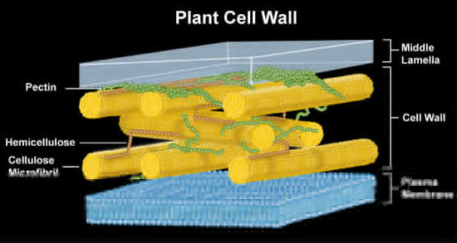

Slide 22
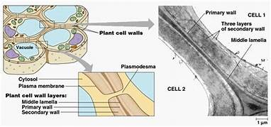
CELL WALL STRUCTURE

Slide 23
Structure of Cell Wall
On the basis of the structure, cell wall is differentiated into the following three parts.
i. Middle Lamella
It is the layer mainly made up of calcium and magnesium pectates.
It cements the cell walls of two adjoining cells together.
It is absent on the outer side of surface cells middle lamella along with a cell wall transverse by plasmodesmata which connects cytoplasm of neighbouring cells.

Slide 24
ii. Primary Cell Wall
It is produced inner to the middle lamella in a young and growing cell.
It is capable of growth and extension. It tends to diminish gradually as the cell attain maturity.
iii. Secondary Cell Wall
The thick secondary wall is formed inner towards membrane to the primary wall.
As the cell gets fully matured.
Its composition is similar to the primary wall.

Slide 25
Functions
Cell wall possess the following Junctions
(i) It helps in providing a definite shape to the cell and also protects protoplasm against any mechanical injury, i.e., damage and infection.
(ii) It also helps in cell-to-cell interaction
(iii) It provides barrier to undesirable macro­molecules and attack of pathogens.

Slide 26
CYTOPLASM
(kytos- cell, plams-form) (Strasburger 1882)
It is semifluid jelly like transluscent part of cell protoplasm that lies inner to plasmalemma, excludes the nucleus but include cytoplasmic matrix, cytoplasmic organelles.
cytoplasmic matrix exists in two interconvertible states, sol and gel
Sol-(plasmasol) liquid state of colloids
Gel- (plasmagel) gel state-lines plasmalemma-ectoplasm and rest part matrix is endoplasm

Slide 27
THANKING YOU
ODM EDUCATIONAL GROUP

