Slide 1


CELL:THE UNIT OF LIFE
PROKARYOTIC CELL, STRUCTURE of PROKARYOTIC
SUBJECT : BIOLOGY
CHAPTER NUMBER:08
CHAPTER NAME :CELL :THE UNIT OF LIFE

Slide 2
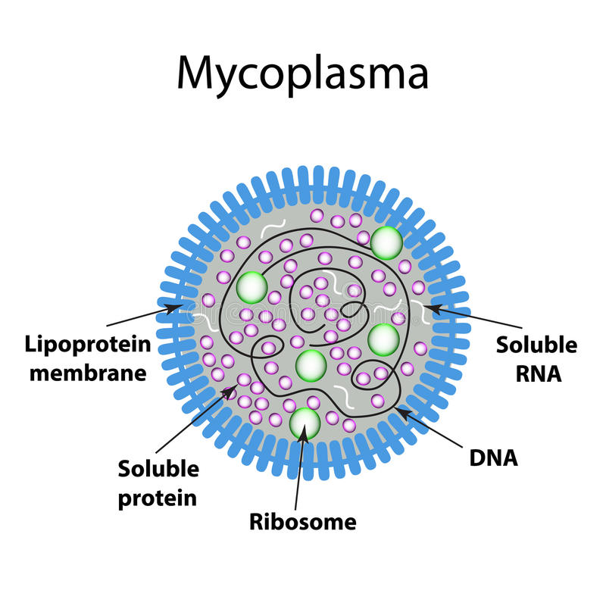
PROKARYOTIC CELLS
The prokaryotic cells are represented by bacteria, blue-green algae, mycoplasma and PPLO (Pleuro Pneumonia Like Organisms).
They are generally smaller and multiply more rapidly than the eukaryotic cells
They may vary greatly in shape and size.
The four basic shapes of bacteria are bacillus (rod like), coccus (spherical), vibrio (comma shaped) and spirillum (spiral).
The organisation of the prokaryotic cell is fundamentally similar even though prokaryotes exhibit a wide variety of shapes andfunctions.

Slide 3
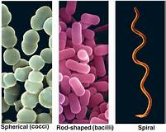
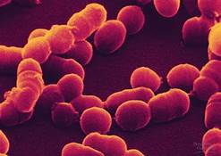
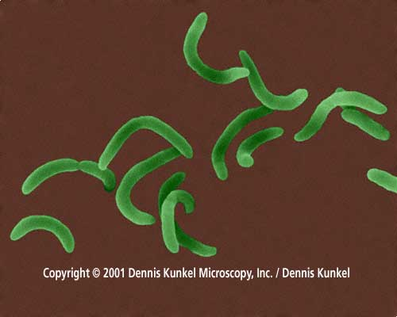
SHAPES OF PROKARYOTIC CELLS

Slide 4
PROKARYOTIC CELLS
Prokaryotes have a cell wall surrounding the cell membrane except in mycoplasma.
The fluid matrix filling the cell is the cytoplasm.
There is no well-defined nucleus. The genetic material is basically naked, not enveloped by a nuclear membrane.
In addition to the genomic DNA (the single chromosome/circular DNA), many bacteria have small circular DNA outside the genomic DNA. These smaller DNA are called plasmids.
The plasmid DNA confers certain unique phenotypic characters to such bacteria. One such character is resistance to antibiotics.

Slide 5
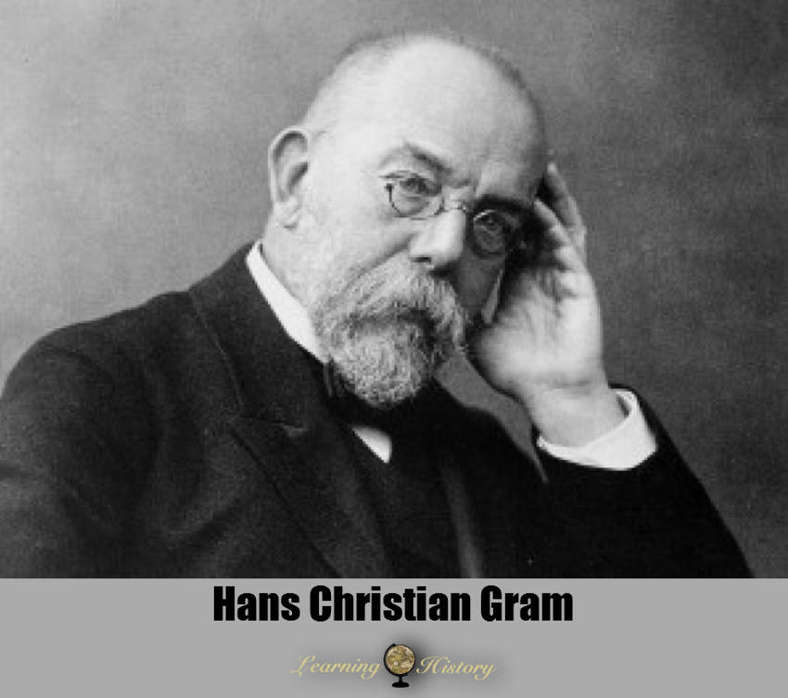
CLASSIFICATION OF PROKARYOTIC CELLS
Bacteria can be classified into two groups on the basis of the differences in the cell envelopes and the manner in which they respond to the staining procedure developed by Gram.
Those that take up the gram stain are Gram positive and the others that do not are called Gram negative bacteria.

Slide 6
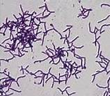
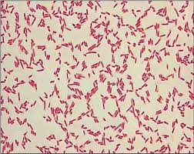
GRAM STAINS
The gram-positive forms include many well-known genera such as Lactobacillus, Bacillus, Listeria, Staphylococcus, Streptococcus, Enterococcus, and Clostridium.
GRAM POSITIVE
Gram-negative bacteria generally possess a thin layer of peptidoglycan between two membranes. Most bacterial phyla are gram-negative, including the cyanobacteria, green sulfur bacteria, and most.
GRAM NEGATIVE

Slide 7
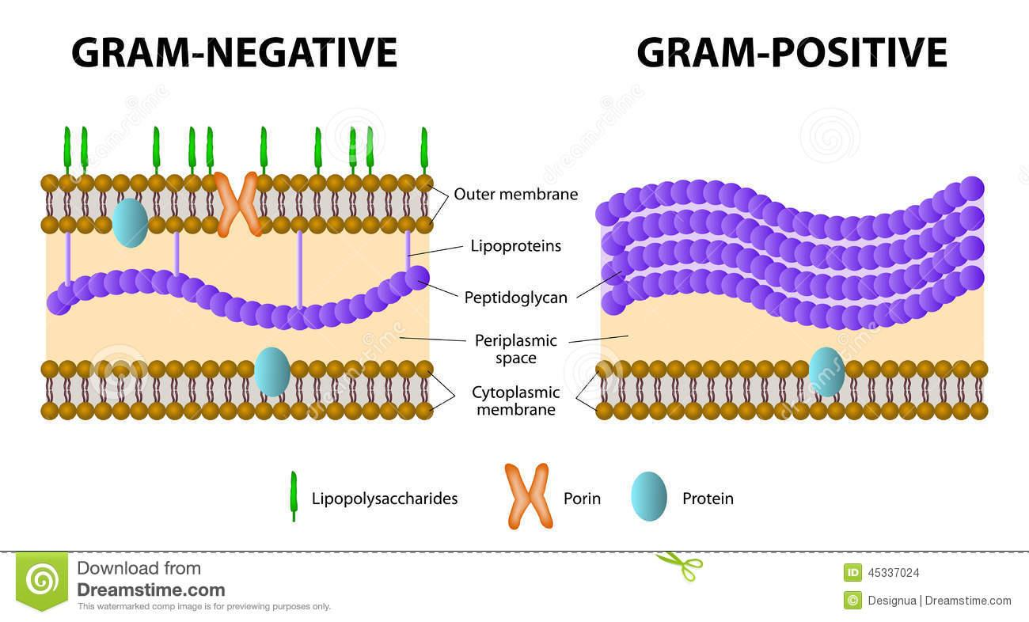
GRAM POSITIVE AND GRAM NEGATIVE BACTERIA

Slide 8
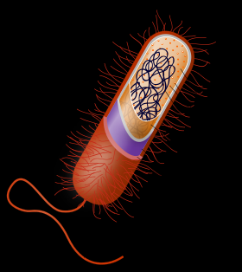
SURFACE STRUCTURES
The motile Bacterial cells have thin filamentous extensions from their cell wall called flagella.
Bacteria show a range in the number and arrangement of flagella.
FLAGELLA

Slide 9
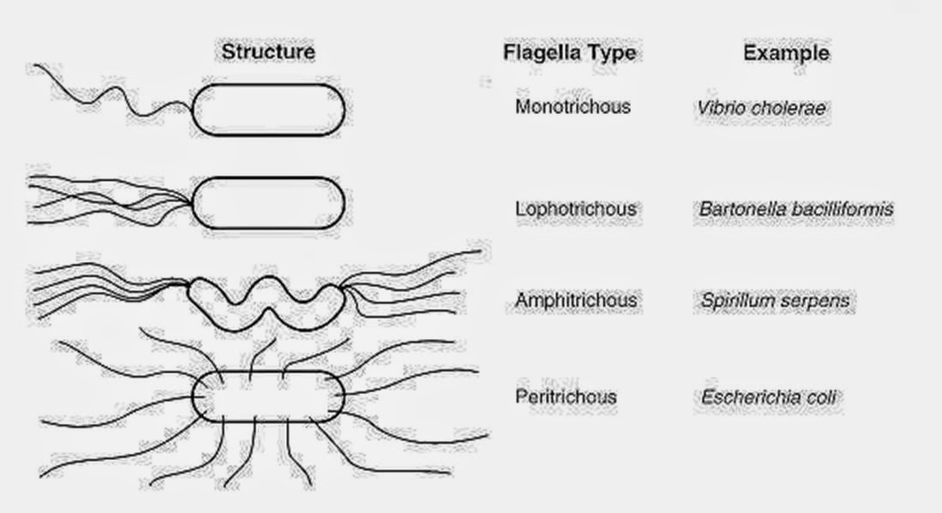
Types of bacteria basing on flagella

Slide 10
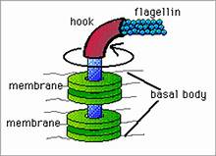
FLAGELLA
Bacterial flagellum is composed of three parts – filament, hook and basal body.
The filament is the longest portion and extends from the cell surface to the outside.

Slide 11
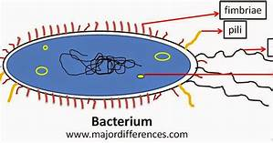
SURFACE STRUCTURES
Besides flagella, Pili and Fimbriae are also surface structures of the bacteria but do not play a role in motility.
The pili are elongated tubular structures made of a special protein.
The fimbriae are small bristle like fibres sprouting out of the cell.
In some bacteria, they are known to help attach the bacteria to rocks in streams and also to the host tissues.

Slide 12
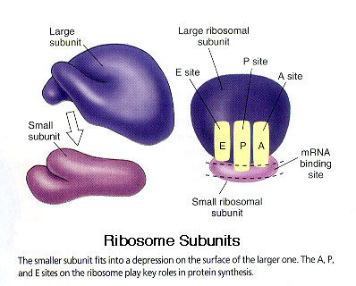
RIBOSOMES
In prokaryotes, ribosomes are associated with the plasma membrane of
the cell.
They are about 15 nm by 20 nm in size and are made of two subunits - 50S and 30S units which when present together form 70S prokaryotic ribosomes.
Ribosomes are the site of protein synthesis. Several ribosomes may attach to a single mRNA and form a chain called polyribosomes or polysome.
The ribosomes of a polysome translate the mRNA into proteins.

Slide 13
INCLUSION BODIES
Reserve material in prokaryotic cells are stored in the cytoplasm in the form of inclusion bodies.
These are not bound by any membrane system and lie free in the cytoplasm, e.g., phosphate granules, cyanophycean granules and glycogen granules.
Gas vacuoles are found in blue green and purple and green photosynthetic bacteria.

Slide 14
PROKARYOTIC CELLS and eukaryotic cells
 | PROKARYOTES | EUKARYOTES
Typical organisms | bacteria, archaea | protists, fungi, plants, animals
Typical size | ~ 1–5 µm[18] | ~ 10–100 µm[18]
Type of nucleus | nucleoid region; no true nucleus | true nucleus with double membrane
DNA | circular | linear molecules (chromosomes) with histone proteins
RNA/protein synthesis | coupled in the cytoplasm | RNA synthesis in the nucleus
 |  | protein synthesis in the cytoplasm
Ribosomes | 50S and 30S | 60S and 40S

Slide 15
 | PROKARYOTES | EUKARYOTES
Cytoplasmic structure | very few structures | highly structured by endomembranes and a cytoskeleton
Cell movement | flagella made of flagellin | Flagella and cilia containing microtubules
Mitochondria | none | one to several thousand
Chloroplasts | none | in algae and plants

Slide 16
 | PROKARYOTES | EUKARYOTES
Organization | usually single cells | single cells, colonies, higher multicellular organisms with specialized cells
Cell division | binary fission (simple division) | mitosis (fission or budding), meiosis
Chromosomes | single chromosome | more than one chromosome
Membranes | cell membrane | Cell membrane and membrane-bound organelles

Slide 17
THANKING YOU
ODM EDUCATIONAL GROUP

