Slide 1


CELL:THE UNIT OF LIFE
HISTORY OF CELL, CELL SHAPE AND SIZE, CELL THEORY, PROKARYOTIC CELL, AND EUKARYOTIC CELL
SUBJECT : BIOLOGY
CHAPTER NUMBER:08
CHAPTER NAME :CELL: THE UNIT OF LIFE

Slide 2
History of cell
The discovery of the cell was made possible through the invention of the microscope. In the first century BC, Romans were able to make glass, discovering that objects appeared to be larger under the glass.
In Italy during the 12th century, Salvino D’Armate made a piece of glass fit over one eye, allowing for a magnification effect to that eye. The expanded use of lenses in eye
glasses in the 13th century probably led to wider spread use of simple microscopes (magnifying glasses) with limited magnification
Compound microscopes, which combine an objective lens with an eyepiece to view a real image achieving much higher magnification, first appeared in Europe around 1620.

Slide 3
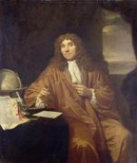
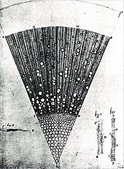
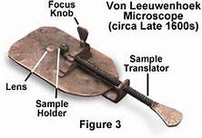
Extensive microscopic study was done by Anton van Leeuwenhoek, a draper who took the interest in microscopes after seeing one while on an apprenticeship in Amsterdam in 1648.
At some point in his life before 1668, he was able to learn how to grind lenses. This eventually led to Leeuwenhoek making his own unique microscope. His was a single lens simple microscope, rather than a compound microscope.
Leeuwenhoek
A Drawing of plant as observed
by Leeuwenhoek

Slide 4
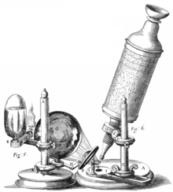
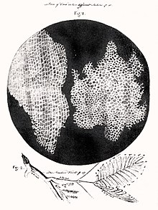

PROKARYOTIC CELLS
In 1665, Robert Hooke used a microscope about six inches long with two convex lenses inside and examined specimens under reflected light for the observations in his book Micrographia.
Hooke also used a simpler microscope with a single lens for examining specimens with directly transmitted light, because this allowed for a clearer image.
HOOKE’S MICROSCOPE
HOOKE’S OBSERVATION
ROBERT HOOKE

Slide 5
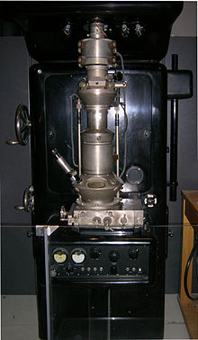
The invention of the microscope and its improvement leading to the electron microscope revealed all the structural details
of the cell.
Optical microscopes can focus on objects the size of a wavelength or larger, giving restrictions still to advancement in discoveries with objects smaller than the wavelengths of visible light.
The development of the electron microscope in the 1920s made it possible to view objects that are smaller than optical wavelengths, once again opening up new possibilities in science.
Electron Microscope

Slide 6
CELL THEORY
Credit for developing cell theory is usually given to two scientists: Theodor Schwann and Matthias Jakob Schleiden.
In 1839, Schleiden suggested that every structural part of a plant was made up of cells or the result of cells.
In 1839, Theodor Schwann states that along with plants, animals are composed of cells or the product of cells in their structures.

Slide 7
From these conclusions about plants and animals, two of the three tenets of cell theory were postulated.
1. All living organisms are composed of one or more cells.
2. The cell is the most basic unit of life.
In 1855, Rudolf Virchow added the third tenet to cell theory. In Latin, this tenet states “Omnis cellula e cellula”.
3. All cells arise only from pre-existing cells.

Slide 8
CELL THEORY: Modern interpretation
The generally accepted parts of modern cell theory include:
All known living things are made up of one or more cells. All living cells arise from pre-existing cells by division.
The cell is the fundamental unit of structure and function in all living organisms.
Energy flow (metabolism and biochemistry) occurs within cells.
Cells contain DNA which is found specifically in the chromosome and RNA found in the cell nucleus and cytoplasm.
All cells are basically the same in chemical composition in organisms of similar species.

Slide 9
The modern version of the cell theory includes the ideas that:
Energy flow occurs within cells.
2. Heredity information (DNA) is passed on from cell to cell.
3. All cells have the same basic chemical composition

Slide 10
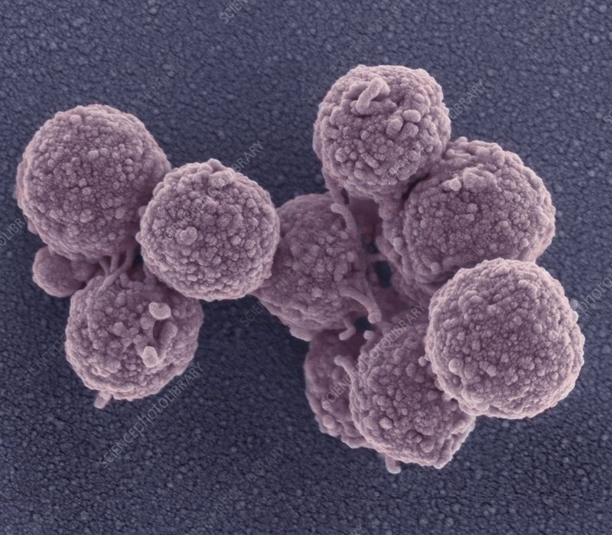
CELL SIZE
Cells differ greatly in size, shape and activities.
For example, Mycoplasmas, the smallest cells, M. pneumoniae is about
(100 x 1000 nm) while bacteria could be (3 to 5 μm).
The largest isolated single cell is the egg of an ostrich (13 cm X 15 cm).
Among multicellular organisms, human red blood cells are about 7μm
in diameter.
Cell size is highly variable among organisms, with some algae such as Caulerpa taxifolia being a single cell several meters in length.
M. pneumoniae

Slide 11
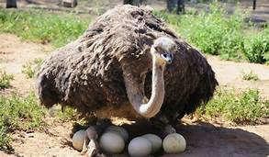
CELL SIZE
Largest bacteria
Thiomargarita namibiensis (100–300 μm) is world’s largest bacteria, a gram-negative m found in the ocean sediments off the coast of Namibia .
Protists such as Paramecium can be 330 μm long, while a typical human cell might be 10 μm.
HUMAN SPERM 5.1 µm by 3.1 µm and a tail 50 µm long.
Nerve cells are some of the longest cells.

Slide 12
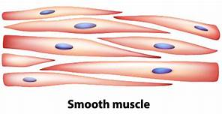
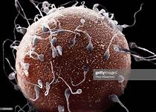
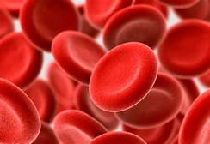
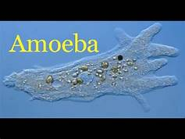
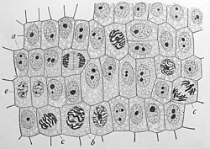
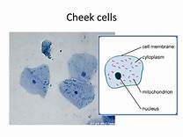
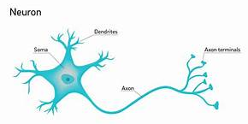
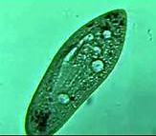
CELL SHAPE
Cells also vary greatly in their shape. They may be disc-like, polygonal, columnar, cuboid, thread like, or even irregular.
The shape of the cell may vary with the function they perform.

Slide 13
MYCOPLASMA
Cell wall is absent and plasma membrane forms the outer boundary of the cell.
Due to the absence of cell wall these organisms can change their shape and are pleomorphic.
Lack of nucleus and other membrane-bound organelles.
Genetic material is a single DNA duplex and is naked.
Ribosomes are 70S type.
Possess a replicating disc at one end which assist replication process and also the separation of the genetic materials.
Heterotrophic nutrition. Some live as saprophytes but the majority are parasites of plants and animals.

Slide 14
PROKARYOTIC CELLS
The prokaryotic cells are represented by bacteria, blue-green algae, mycoplasma and PPLO (Pleuro Pneumonia Like Organisms).
They are generally smaller and multiply more rapidly than the eukaryotic cells
They may vary greatly in shape and size.
The four basic shapes of bacteria are bacillus (rod like), coccus (spherical), vibrio (comma shaped) and spirillum (spiral).
The organisation of the prokaryotic cell is fundamentally similar even though prokaryotes exhibit a wide variety of shapes and functions

Slide 15
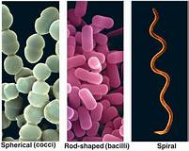
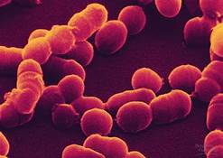
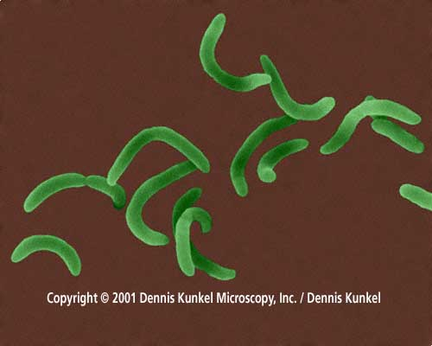
shapes of bacteria
The four basic shapes of bacteria are bacillus (rod like), coccus (spherical), vibrio (comma shaped) and spirillum (spiral).
Bacillus
Coccus
Spirillum
Vibrio

Slide 16
Prokaryotes have a cell wall surrounding the cell membrane except in mycoplasma. The fluid matrix filling the cell is the cytoplasm.
There is no well-defined nucleus. The genetic material is basically naked, not enveloped by a nuclear membrane.
In addition to the genomic DNA (the single chromosome/circular DNA), many bacteria have small circular DNA outside the genomic DNA. These smaller DNA are called plasmids.
The plasmid DNA confers certain unique phenotypic characters to such bacteria. One such character is resistance to antibiotics.

Slide 17
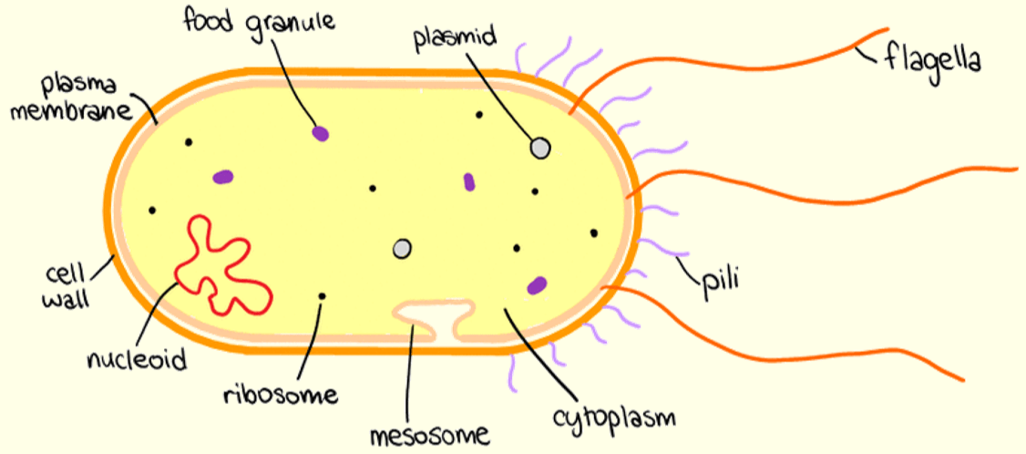
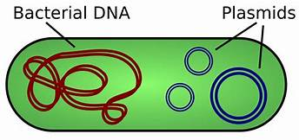
No organelles, like the ones in eukaryotes, are found in prokaryotic cells except for ribosomes.
Prokaryotes have something unique in the form of inclusions.
A specialised differentiated form of cell membrane called mesosome is the characteristic of prokaryotes. They are essentially infoldings of cell membrane

Slide 18
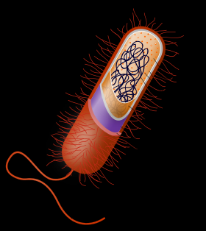
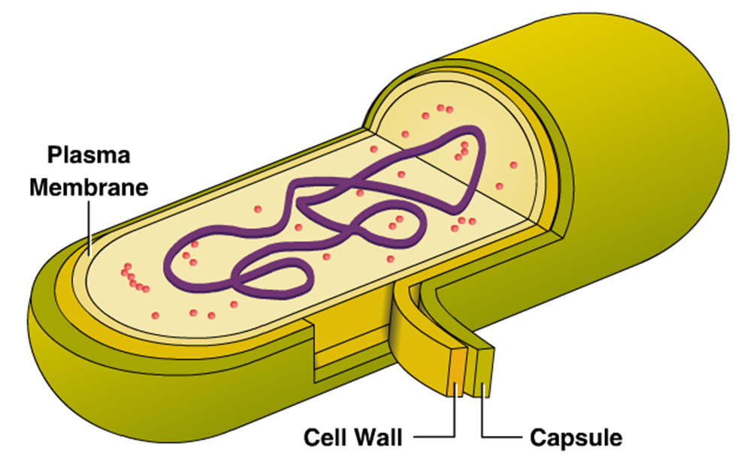
Cell Envelope and its Modifications
Most prokaryotic cells, particularly the bacterial cells, have a chemically complex cell envelope.
The cell envelope consists of a tightly bound three layered structure i.e., the outermost glycocalyx followed by the cell wall and then the plasma membrane.

Slide 19
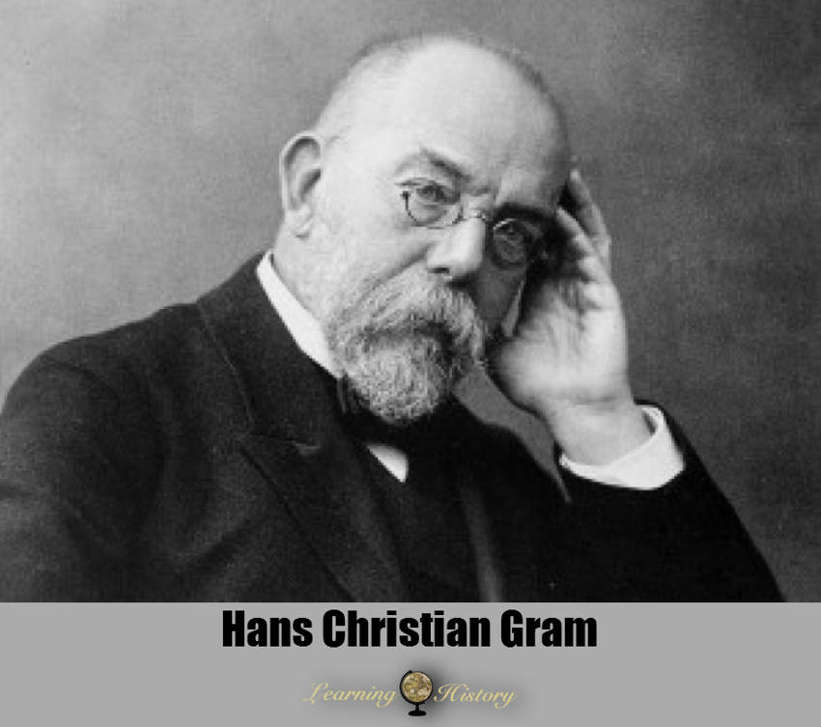
CLASSIFICATION OF BACTERIA
Although each layer of the envelope performs distinct function, they act together as a single protective unit.
Bacteria can be classified into two groups on.
The basis of the differences in the cell envelopes and the manner in which they respond to the staining procedure
developed by Gram.
those that take up the gram stain are Gram positive and the others that do not are called Gram negative bacteria.

Slide 20
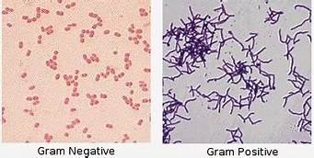
GRAM STAINS
The gram-positive forms include many well-known genera such as Lactobacillus, Bacillus, Listeria, Staphylococcus, Streptococcus, Enterococcus, and Clostridium.
Gram-negative bacteria generally possess a thin layer of peptidoglycan between two membranes (diderms). Most bacterial phyla are gram-negative, including the cyanobacteria, green sulfur bacteria, and most.

Slide 21
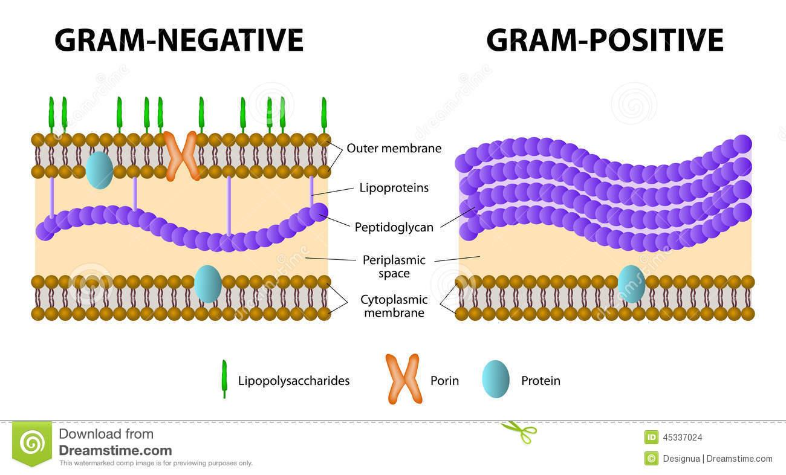
GRAM POSITIVE AND GRAM NEGATIVE

Slide 22
PROKARYOTIC CELLS
Glycocalyx differs in composition and thickness among different bacteria.
It could be a loose sheath called the slime layer in some, while in others it may be thick and tough, called the capsule.
The cell wall determines the shape of the cell and provides a strong structural support to prevent the bacterium from bursting or collapsing.
The plasma membrane is selectively permeable in nature and interacts with the outside world. This membrane is similar structurally to that of the eukaryotes.

Slide 23
PROKARYOTIC CELLS
A special membranous structure is the mesosome which is formed by the extensions of plasma membrane into the cell.
These extensions are in the form of vesicles, tubules and lamellae. They help in cell wall formation, DNA replication and distribution to daughter cells.
They also help in respiration, secretion processes, to increase the surface area of the plasma membrane and enzymatic content.
In some prokaryotes like cyanobacteria, there are other membranous extensions into the cytoplasm called chromatophores which contain pigments.

Slide 24
PROKARYOTIC CELLS-LOCOMOTARY ORGANS
Bacterial cells may be motile or non-motile.
If motile, they have thin filamentous extensions from their cell wall called flagella.
Bacteria show a range in the number and arrangement of flagella.
Bacterial flagellum is composed of three parts – filament, hook and basal body.
The filament is the longest portion and extends from the cell surface to the outside.
Besides flagella, Pili and Fimbriae are also surface structures of the bacteria but do not play a role in motility.
The pili are elongated tubular structures made of a special protein.
The fimbriae are small bristle like fibres sprouting out of the cell.
In some bacteria, they are known to help attach the bacteria to rocks in streams and also to the host tissues.

Slide 25
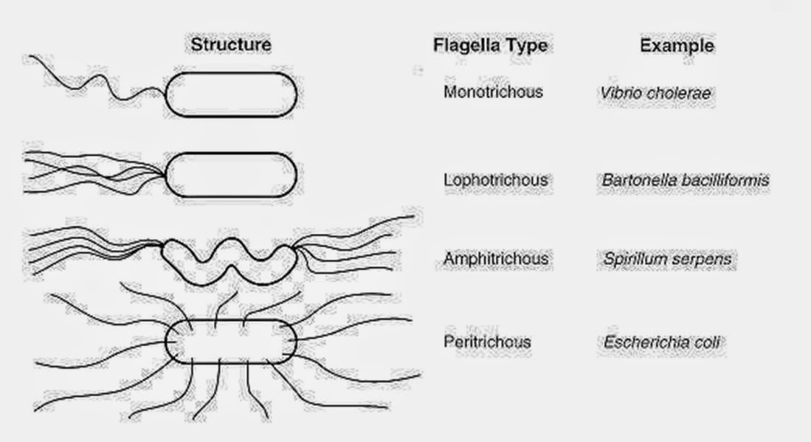

Slide 26
RIBOSOMES
In prokaryotes, ribosomes are associated with the plasma membrane of
the cell.
They are about 15 nm by 20 nm in size and are made of two subunits - 50S and 30S units which when present together form 70S prokaryotic ribosomes.
Ribosomes are the site of protein synthesis. Several ribosomes may attach to a single mRNA and form a chain called polyribosomes or polysome.
The ribosomes of a polysome translate the mRNA into proteins.

Slide 27
INCLUSION BODIES
Reserve material in prokaryotic cells are stored in the cytoplasm in the form of inclusion bodies.
These are not bound by any membrane system and lie free in the cytoplasm, e.g., phosphate granules, cyanophycean granules and glycogen granules.
Gas vacuoles are found in blue green and purple and green photosynthetic bacteria.

Slide 28
PROKARYOTIC CELLS and eukaryotic cells
 | PROKARYOTES | EUKARYOTES
Typical organisms | bacteria, archaea | protists, fungi, plants, animals
Typical size | ~ 1–5 µm[18] | ~ 10–100 µm[18]
Type of nucleus | nucleoid region; no true nucleus | true nucleus with double membrane
DNA | circular (usually) | linear molecules (chromosomes) with histone proteins
RNA/protein synthesis | coupled in the cytoplasm | RNA synthesis in the nucleus
 |  | protein synthesis in the cytoplasm
Ribosomes | 50S and 30S | 60S and 40S

Slide 29
PROKARYOTIC CELLS and eukaryotic cells
 | PROKARYOTES | EUKARYOTES
Cytoplasmic structure | very few structures | highly structured by endo-membranes and a cytoskeleton
Cell movement | flagella made of flagellin | Flagella and cilia containing microtubules
Mitochondria | none | one to several thousand
Chloroplasts | none | in algae and plants

Slide 30
PROKARYOTIC CELLS AND EUKARYOTIC CELLS
 | PROKARYOTES | EUKARYOTES
Organization | usually single cells | single cells, colonies, higher multicellular organisms with specialized cells
Cell division | binary fission (simple division) | mitosis (fission or budding), meiosis
Chromosomes | single chromosome | more than one chromosome
Membranes | cell membrane | Cell membrane and membrane-bound organelles

Slide 31
THANKING YOU
ODM EDUCATIONAL GROUP

