Slide 1


LITERATURE
STD-VII
SUBJECT : ENGLISH
CHAPTER NUMBER:
PERIOD NUMBER : 1
CHAPTER NAME : The Bangle Sellers
BY Sarojini Naidu

Slide 2
EXPECTED LEARNING OUTCOMES
GENERAL OBJECTIVES
Reading Comprehension followed by questions
Be acquainted with short story/Fiction
Understanding the plot
Understanding characters
Developing LSRW Skills
Know how to write a poem - Beginning, middle and end
SPECIFIC OBJECTIVES/ EXTENDED OBJECTIVES
Appreciate traditional professions
Appreciate traditional attires and accessories as an important part of a culture
Discuss the positive and negative impacts of technological advancement on traditions and culture
Identify alliteration and assonance

Slide 3
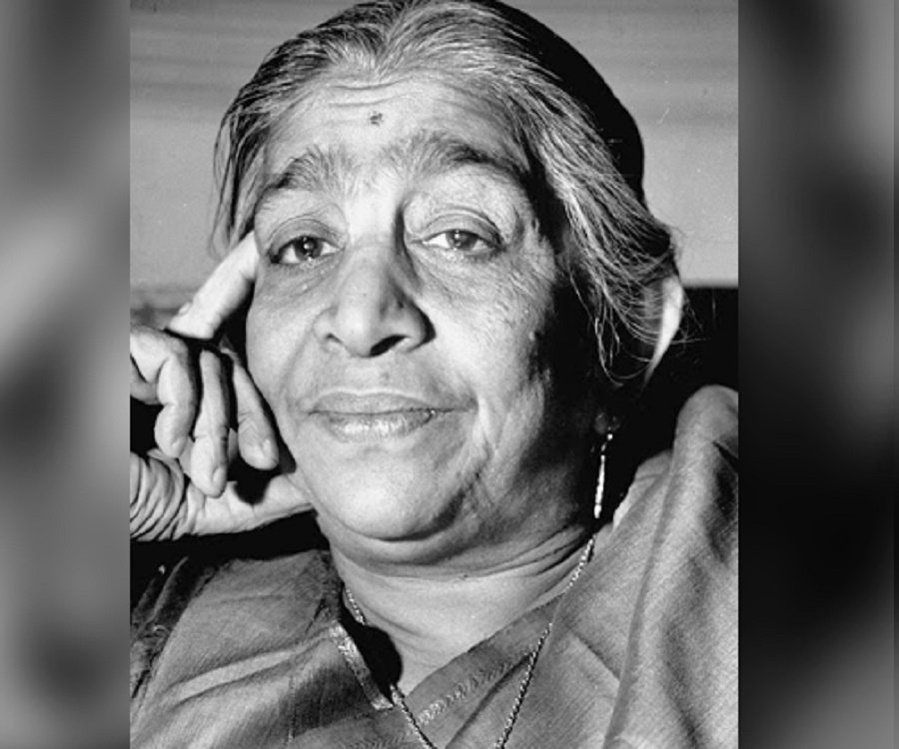
INTRODUCTION TO THE POET
Sarojini Naidu was an India political leader born on February 13, 1879 in Hyderabad, India.
At a young age she wrote poetry and plays, a hobby she kept throughout her life. She later studied in England, and in 1916 she met Mahatma Gandhi which sparked her interest in the fight for India’s freedom.
In 1925 she was elected as the first female President of the India National Congress. After India’s independence from England, Naidu became the first woman Governor of Uttar Pradesh.
Naidu died on March 02, 1949 at Lucknow, Uttar Pradesh.

Slide 4
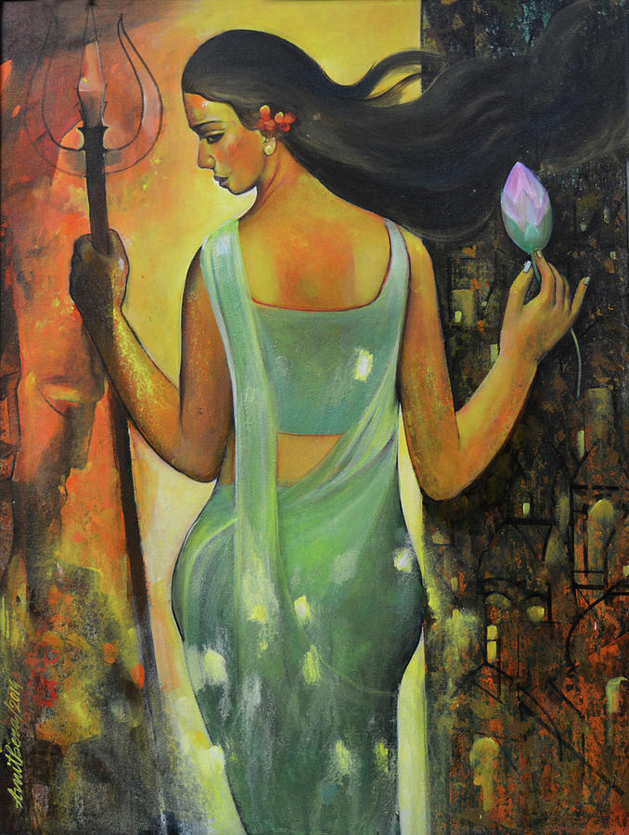
THEME OF THE POEM
The theme of the poem is the celebration of indian womanhood.
Sarojini Naidu describes each stage of an indian woman with a colour that is suitable.
The poem shows the life of an indian woman from a dreamy maiden to an excited bride and then to a faithful wife.

Slide 5
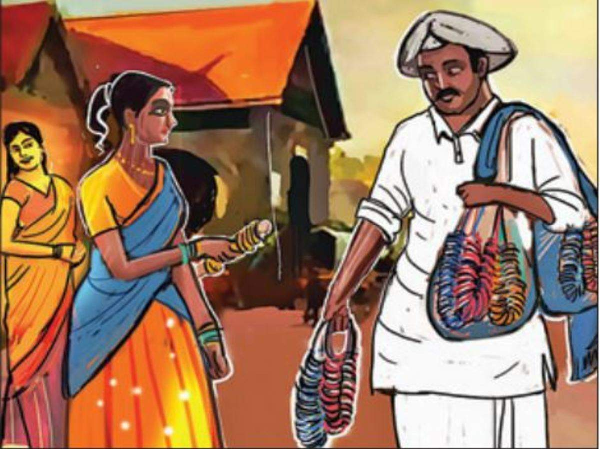
Bangle sellers are we who bear
Our shining loads to the temple fair…
Who will buy these delicate, bright
Rainbow-tinted circles of light?
Lustrous tokens of radiant lives,
For happy daughters and happy wives.
Summary: The poem begins with the speakers introducing themselves as bangle sellers who sell their articles at the temple fair. They call out to the people to buy their bangles. These hawkers describe their bangles as delicate, bright, rainbow-tinted circles of light. They advertise by questioning who will buy these bangles for their daughters and wives.

Slide 6
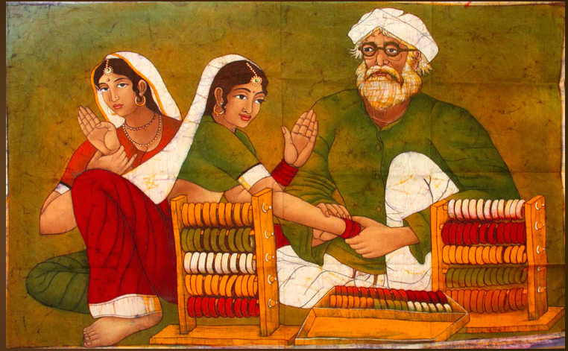
Some are meet for a maiden’s wrist,
Silver and blue as the mountain mist,
Some are flushed like the buds that dream
On the tranquil brow of a woodland stream,
Some are aglow with the bloom that cleaves
To the limpid glory of new born leaves
Summary : The speakers talk of the kinds of bangles they have. Some of these bangles are suited for a maiden’s, that is, a young unmarried woman’s wrist. They are Silver and Blue in colour like the mountain mist. Some of them are ‘flushed’, that is pink and light red in colour like flower buds growing beside a woodland stream. Still others are green and glowing like the transparent beauty of new born leaves.

Slide 7
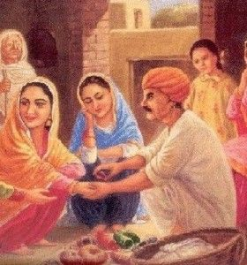
Some are like fields of sunlit corn,
Meet for a bride on her bridal morn,
Some, like the flame of her marriage fire,
Or, rich with the hue of her heart’s desire,
Tinkling, luminous, tender, and clear,
Like her bridal laughter and bridal tear.
Summary:
The bangle sellers say that some of their bangles are yellow like ‘fields of sunlit corn‘. Bangles of this color are perfect for a bride on her bridal morn. Some of the bangles they have are bright red. They represent the flame of a newly turned bride’s marriage fire, that is, the passion of her newly made relation. The red bangles also stand for her heart’s desire. The bangles are ‘tinkling, luminous, tender and clear’. They express both her joy of starting a new life with her husband and the sorrow of leaving her parents behind.

Slide 8
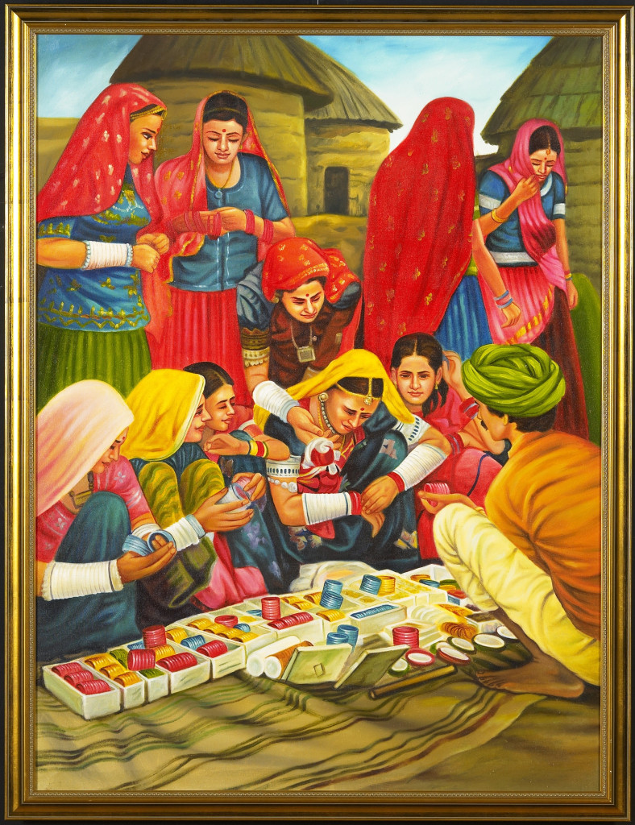
Some are purple and gold flecked grey
For she who has journeyed through life midway,
Whose hands have cherished, whose love has blest,
And cradled fair sons on her faithful breast,
And serves her household in fruitful pride,
And worships the gods at her husband’s side.
Summary: The speakers continue to advertise their bangles. They shout that some of their bangles are purple and gold flecked grey. These are suited for a middle-aged woman who has ‘journeyed through life’. They are for her who has raised her children well, and has remained faithful to her husband and family. These bangles are, they say, perfect for she who has maintained her household with pride and “worships the gods at her husband’s side”.
Exercise, Get Going A- Page 92
Exercise, Get Going B- Page 92

Slide 9
Questions:
“Ram Lal…………some are green.”
What was the name of the bangle seller?
What was he selling?
Who was walking in front of Mr Verma’s house?
What was he singing?
Answer the following:
Who does the line, 'For she who has journeyed through life midway,' refer to in the last stanza?
The bangle sellers carry their loads of bangles to the___ to sell them.
Exercise, Get Going A- Page 92
Exercise, Get Going B- Page 92

Slide 10
THANKING YOU
ODM EDUCATIONAL GROUP

