Slide 1


NATURE AND PURPOSE OF BUSINESS
SUBJECT : BUSINESS STUDIES
CHAPTER NUMBER: 1
CHAPTER NAME : BUSINESS, TRADE AND COMMERCE

Slide 2
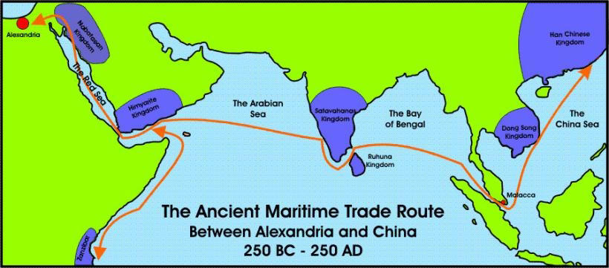
BUSINESS, TRADE AND COMMERCE
Is it possible to think a week without business firms? It is closely connected with our life. They satisfy our needs and wants by providing various types of goods and services.
The purpose of business is to earn profit through customer satisfaction. This chapter is divided into two sections.
Section I - deals with the history of trade and commerce in ancient India.
Section II - deals with the concept, nature and purpose of business
SECTION- I
History of Trade and Commerce Trade and commerce have played a vital role in making India to evolve as a major player in the economic world in ancient times. Archaeological evidences have shown that trade and commerce was the basis of the economy of ancient India. Commercial cities like Harappa and Mohenjodaro were founded in 3300 B.C. The civilisation had established commercial connections with Mesopotamia and traded in gold, silver, copper, coloured gemstones, pearls, sea shells, terracotta pots, etc. There were diverse types of coins and weighing practices.
Maritime
transport is the
shipment of
goods (cargo)
and people by
sea and other
waterways.

Slide 3
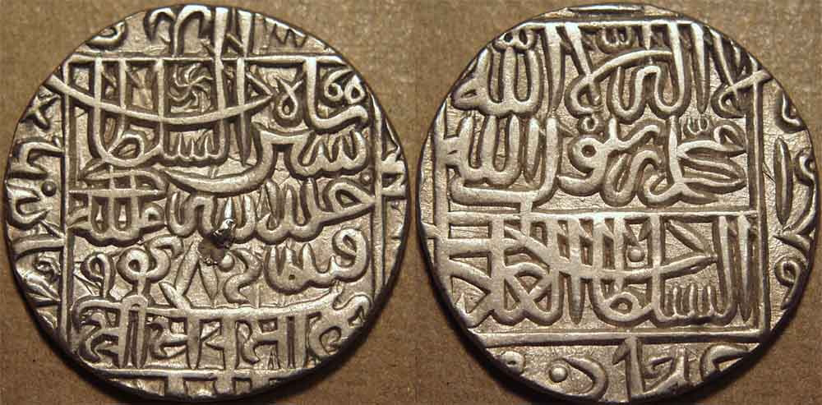
BUSINESS, TRADE AND COMMERCE
1.1 Indigenous Banking System As economic life progressed, money served as a medium of
exchange, the introduction of metallic money and its use accelerated economic activities. Documents such as Hundi and Chitti were in use for carrying out transactions in which money passed from hand to hand.
Hundi as an instrument of exchange, which was famous in the subcontinent. It involved a contract which — (i) warrant the payment of money, the promise or order which is unconditional
(ii) capable of change through transfer by valid negotiation.

Slide 4
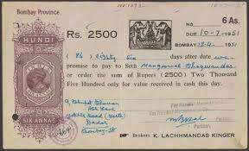
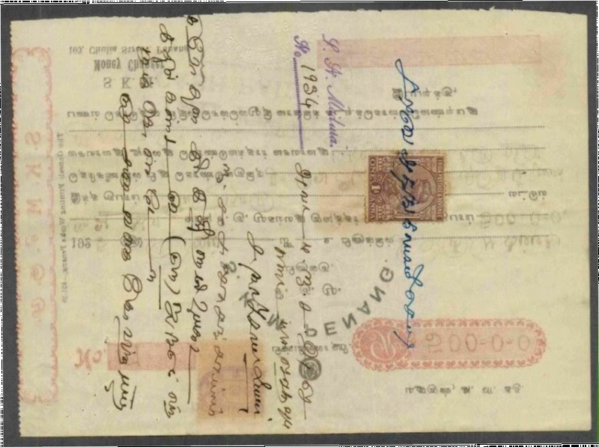
Hundi
:Hundi refer to financial instruments (as bill of exchange) evolved on the Indian sub-continent used in trade and credit transactions. They were used:-
-As remittance instruments (to transfer funds from one place to another),
-As credit instruments (to borrow money),
-For trade transactions (as bills of exchange).

Slide 5
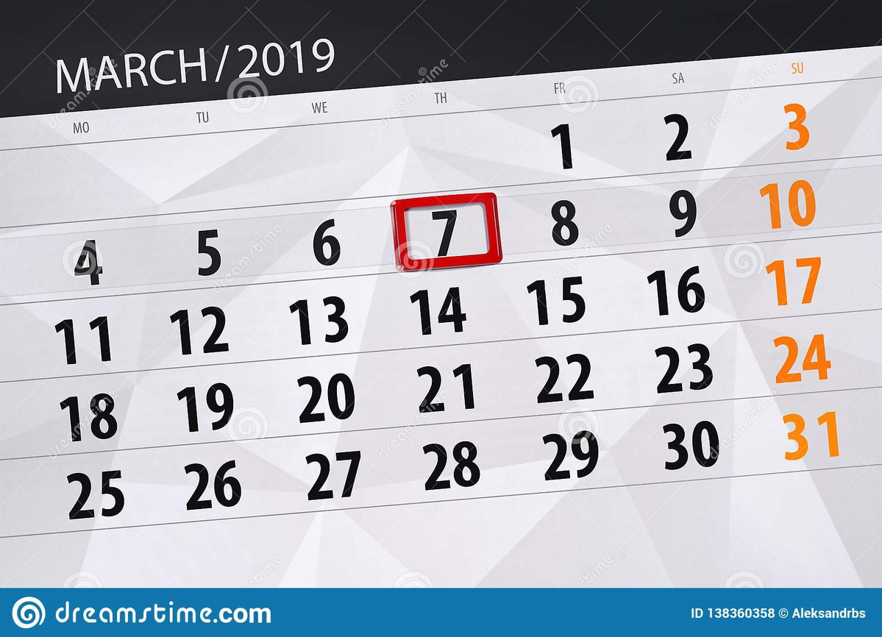

Category of Hundis
On the basis of payment time,Hundis can be classified as ‘Dharshani’ and 'Muddati'
1. Dharshani Hundi- a Hundi payable at sight is called darshani hundi. It is like a ‘Demand Bill’
2.Muddati (Miadi) –Muddati hundi is one which is payable after a specified period of time .It is like a ‘Time Bill’

Slide 6
Name of Hundi | Category | Functions of Hundi
1.Dhani-jog | Darshani/ Muddati | A Dhani-jog hundi(‘Dhani’ means owner) is one which is made payable to the owner, or holder or bearer owner. It is just like a bearer cheque
2.Sah-jog | Darshani/ Muddati | Sha-jog hundi is payable only to a Sha (‘respectable ’person of financial worth). In some respect it is similar to a crossed cheque
3.Firman-jog | Darshani/ Muddati | The term ‘Firman’ refers to order This Hundi made payable to the order of payee. It is just opposite of Dhani-jog hundi
4.Dekhan-har | Darshani | Payable to the presenter or bearer.
5.Jokhmi | Muddati | The term ‘Jokhm’ means ‘risk’. Such hundi is usually drawn against goods shipped on vessel and a certain risk involved. If goods lost in transit, the drawer or holder bears the coasts, and the Drawee carries no liability.

Slide 7
Rise of Intermediaries
Intermediaries played a prominent role in the promotion of trade. They helped manufacturers especially in foreign trade. Intermediaries consist of commission agents, brokers and distributors both for wholesale and retail goods. Bankers began to act as trustees and executors of endowments.
TRANSPORT
Transport by land and Sea (maritime) was popular in the ancient times. Roads as a means of communication had assumed key importance in the entire process of growth. Pepper was particularly valued in the Roman Empire and was known as ‘Black Gold’. Various empires conflict each others to dominate the route for this trade.It was in the search for an alternate route to India for spices that led to the discovery of America by Columbus in the closing years of 15th century and also brought Vasco da Gama to the shores of Malabar in 1498.

Slide 8
Major Trade Centres
There were all kinds of towns—port towns, manufacturing towns, mercantile towns, and pilgrimage towns. Their existence is an index of prosperity of merchant communities and professional classes. The following were the leading trade centres in ancient India:
1.Pataliputra: It was not only a commercial town, but also a major centre for export of stones.
2.Peshawar: It was an important exporting centre for wool and for the import of horses.
3.Indraprastha: It was the commercial junction on the royal road where most routes leading to the east, west, south and north come together.
4.Taxila: It was a city of financial and commercial banks. The city occupied an important place as a Buddhist centre of learning. The famous Taxila University flourished here.
5.Mathura: It was a centre of trade and people here live depends on commerce. Many routes from
South India touched Mathura and Broach.
6.Ujjain: Cloths were exported from Ujjain to different centres. It also had trade relations through
the land route with Taxila and Peshawar.

Slide 9
Major Trade Centres
7.Varanasi: It grew as a major centre of textile industry and became famous for beautiful gold silk cloth and sandalwood workmanship. It had links with Taxila and Bharuch.
8.Surat: It was the centre of western trade during the Mughal period. Textiles of Surat were famous for their gold borders (zari). It is noteworthy that Surat hundi was honoured in far off markets of Egypt and Iran.
9.Kanchi: Today known as Kanchipuram, it was here that the Chinese used to come in foreign ships to purchase pearls, glass and rare stones and in return they sold gold and silk.
Major Exports and Imports
Exports: Exports consisted of spices, wheat, sugar, indigo, opium, sesame oil, cotton, parrot, live
animals and animal products—hides, skin, furs, horns, tortoise shells, pearls, sapphires,
quartz, crystal, lapis, lazulite, granites, turquoise and Copper etc.
Imports: Imports included horses, animal products, Chinese silk, flax and linen, wine, gold, silver, tin,
copper, lead, rubies, coral, glass, amber, etc.

Slide 10
POSITION OF INDIAN SUBCONTINENT IN WORLD ECONOMY ( 1 AD UP TO 1991)
Between the 1st and the 7th centuries BC, India is estimated to have the largest economy of the ancient and medieval world, controlling about one- third of the world’s wealth. The country was often referred to as ‘Swaranbhumi’ and ‘Swarndweep’ in the writings of many travellers, such as Megasthenes, Faxian (Fa Hein), Xuanzang (Huen Tsang) and others. They repeatedly refer to the prosperity of the country.
The British empire began to take roots in India in the mid – 18th century. Condition of Indian Economy slowly changed.This changed the condition of the Indian economy from being an exporter of processed goods to the exporter of raw materials and buyer of manufactured goods.

Slide 11
QUESTION
Name any two instruments of exchange used in ancient times.
Name any two trading communities prevalent in India during ancient times.
What is Maritime trade?
What is Hundi?
Explain Different types of Hundis.

Slide 12
Multiple Choice Questions
Tick (✓) the appropriate answer.
In this type of hundi the merchant on whom the hundi is drawn has to have certain level of 'credit worthiness' in the market.
Nam-jog Hundi
Sahyog- Hundi
Dhani-jog Hundi
Furman-jog Hundi
Such a hundi is like any other bearer instrument and is payable to the holder or bearer.
Sahyog- Hundi
Dhani-jog Hundi.
Furman-jog Hundi
Darshani Hundi
It is similar to a cheque payable on order to either to the person whose name is mentioned in the hundi or to any person so ordered by him.
Dhani-jog Hundi
Furman-jog Hundi
Darshani Hundi
Jokhim-Hundi

Slide 13
THANKING YOU
ODM EDUCATIONAL GROUP

