Slide 1


BON APPETIT
SUB-HEADING- LES APPRENONS ET TRANSLATIONS
CLASS- 8
SUBJECT : FRENCH
CHAPTER NUMBER: 7
CHAPTER NAME : BON APPETIT

Slide 2
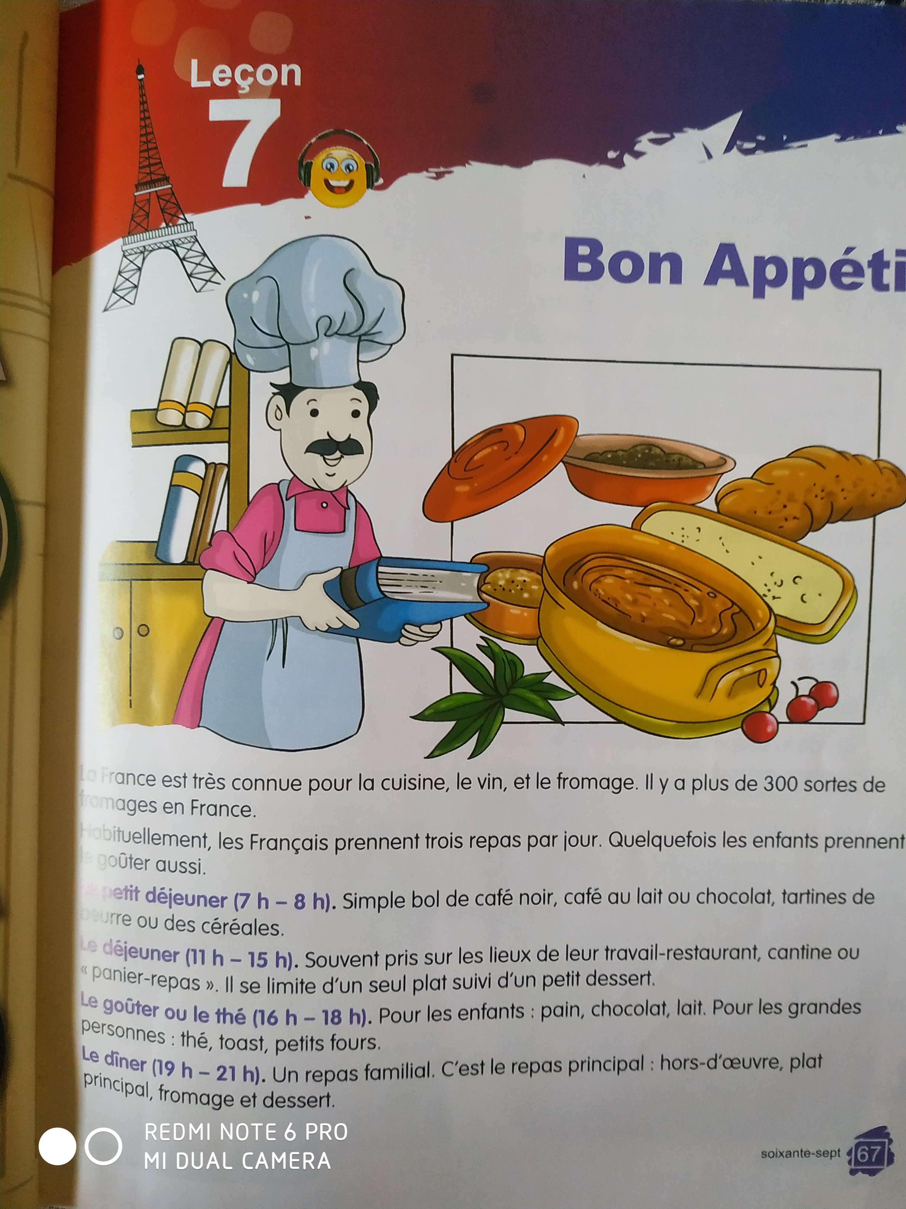
LES APPRENONS ET TRANSLATIONS

Slide 3
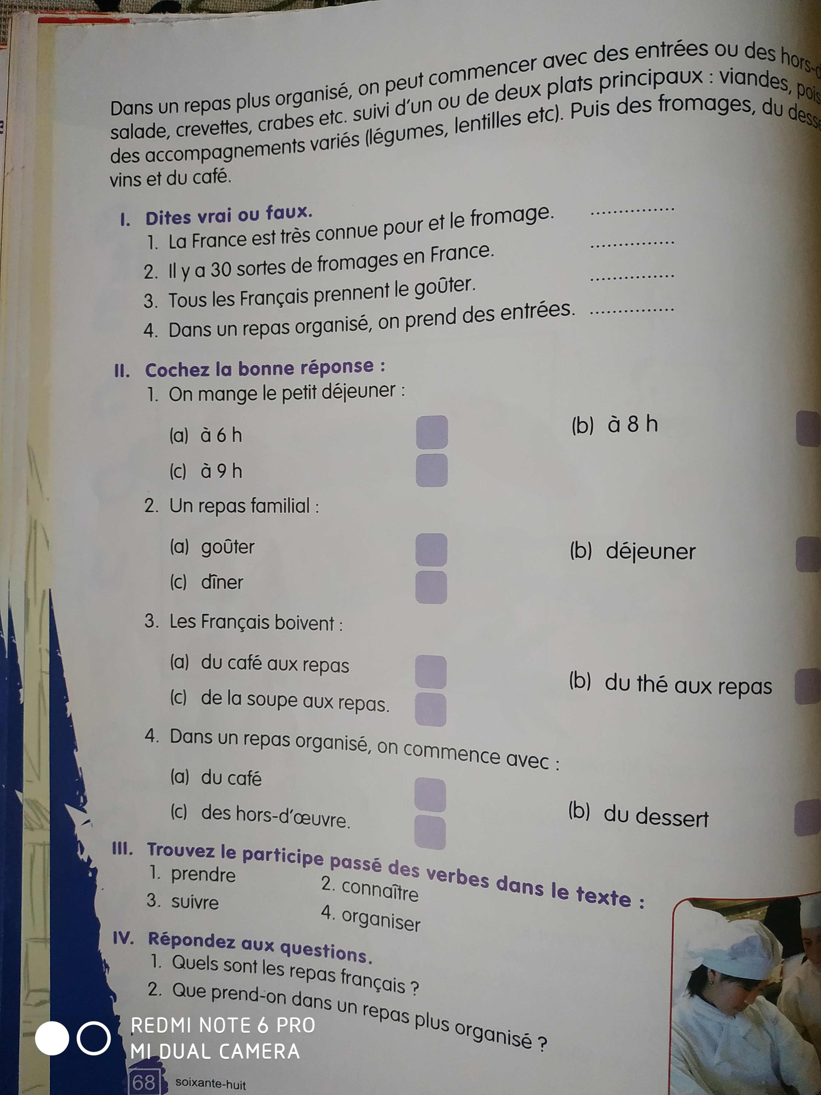
LES APPRENONS ET TRANSLATIONS
From here you can type content. (Size of Content will be 14-Calibri-Black Colour)

Slide 4
THANKING YOU
ODM EDUCATIONAL GROUP

