Slide 1


LITERATURE
STD-VII
SUBJECT : ENGLISH
CHAPTER NUMBER:
PERIOD NUMBER : 1
CHAPTER NAME : Autumn in the Hills
BY Meera Uberoi

Slide 2
EXPECTED LEARNING OUTCOMES
GENERAL OBJECTIVES
Reading Comprehension followed by questions
Be acquainted with short story/Fiction
Understanding the plot
Understanding characters
Developing LSRW Skills
Know how to write a story- Beginning, middle and end
SPECIFIC OBJECTIVES/ EXTENDED OBJECTIVES
Develop LSRW
Appreciating the story, plot, characters
Developing skill of Critical appreciation
Be aware of the importance of asking questions
Be acquainted with typical vocabulary meant for story writing
Appreciating varieties of style and diction in literary writing

Slide 3
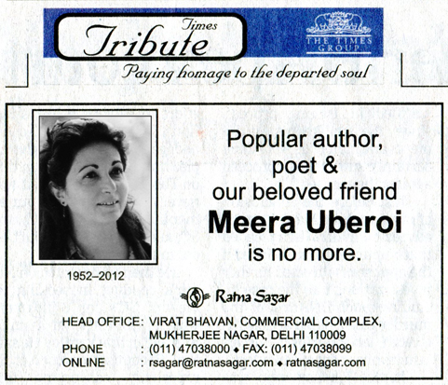
INTRODUCTION TO THE POET
Meera Uberoi (1952-2012) was a children’s writer, who was also a painter and an enthusiastic gardener. Some of her books are Penguin Book of Gardening in India and stories from Mahabharat.

Slide 4
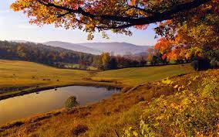
Summary of the poem
In the poem 'Autumn in the Hills' Meera Uberoi appreciates the beauty of the season. Autumn comes before winter. The trees shed their leaves in this season. Autumn will slowly make room for the mists and gradually all the birds would stop singing as the winter would set in.

Slide 5
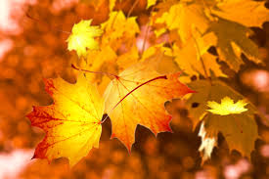
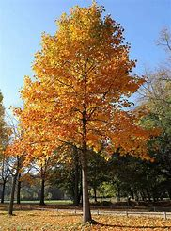
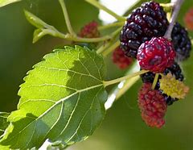
The mulberry trees
Have shed their leaves,
The poplar trees are bare;
The peach tree rears
Its slender spears,
Into the cold grey air.
Summary:
The poet says that the mulberry trees and poplar trees have shed their leaves and become bare. The slender spears of the peach tree have become exposed to the cold air.

Slide 6
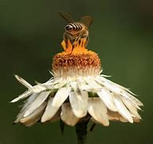
No humming bees Fly through the trees, Laden with stolen gold; No blossom bright Will scent the night It is now withered, old.
Summary:
There are no humming bees which pick up pollen grains from the flowers. There are no flowers which will spread their fragrance in the night. The blossoms are withered and old.

Slide 7

The last bird-song,
Will not be long,
Then silence everywhere;
You will not hear
Those crystal clear
Notes rippling in the air.
Summary:
The last song of the birds will be heard after which there will be silence. The air will no longer be filled with the melodious songs of the birds

Slide 8
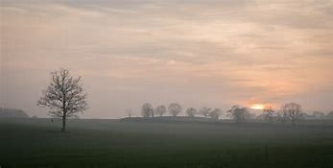
These misty days, Autumn’s last phase, Pierced with an icy prong; Cold winter’s breath Will bring their death They’ll fade out with the song.
Summary:
The days will be foggy in the last phase of autumn. Cold weather will set in with the coming of winter season and autumn will fade away.

Slide 9
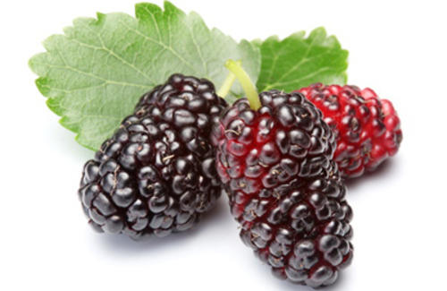
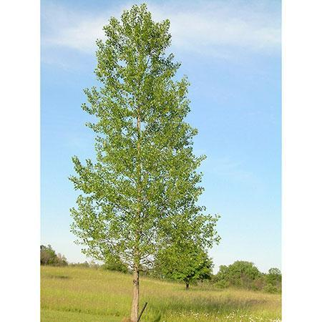
Difficult Words:
mulberry : a berry of dark purple color.
poplar : a tall, thin tree that grows very straight
rears : raises
slender : slim, thin
spears : pointed stems
laden : heavily loaded
withered : dry
rippling : spreading through; rising and falling, like a wave
HW- Exercise, Reading A- Page 78
Exercise, Reading B- Page 78

Slide 10
Evaluation
1. What is the mood of the poem ?
2. Did you notice that the poem stimulates our sense organs ? We are able to see, feel , hear and smell the changes as one season gives way to another.
Find out examples of different seasons from the poem . How do you know which season is the poet talking about ? Write 2 examples each.
3. Which figure of speech is used in ‘Cold winter’s breath will bring their death’ ?
4. Write two examples of Alliteration from the poem .
5. An example of metaphor in the poem is ………………………………
6. Rhyme scheme in the last four lines is …………………………..

Slide 11
THANKING YOU
ODM EDUCATIONAL GROUP

