Slide 1


LITERATURE
STD-VII
SUBJECT : ENGLISH
CHAPTER NUMBER: 2
PERIOD NUMBER : 1
CHAPTER NAME : An old Woman
BY Arun Kolatkar

Slide 2
EXPECTED LEARNING OUTCOMES
GENERAL OBJECTIVES
Reading Comprehension followed by questions
Be acquainted with short story/Fiction
Understanding the plot
Understanding characters
Developing LSRW Skills
Know how to write a story- Beginning, middle and end
SPECIFIC OBJECTIVES/ EXTENDED OBJECTIVES
Develop LSRW
Appreciating the story, plot, characters
Developing skill of Critical appreciation
Focus on the underprivileged tribal of India
Be aware of the importance of asking questions
Be acquainted with typical vocabulary meant for story writing
Appreciating varieties of style and diction in literary writing

Slide 3
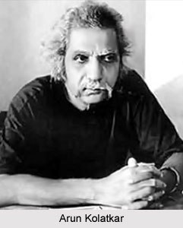
INTRODUCTION TO THE POET
Arun Balkrishna Kolatkar (1 November 1932 – 25 September 2004) was an Indian poet who wrote in both Marathi and English. His poems found humour in everyday matters. Kolatkar is the only Indian poet other than Kabir to be featured on the World Classics titles of New York Review of Books.
Arun Kolatkar was bilingual and wrote in both English and Marathi. He seemed to have believed his skills were equal in both, which is no small thing. Through his poetry, Arun Kolatkar deals with many themes, obstacles, religious dogmas, blind faith, superstition, religious practices that prevalent in society and he also shows how common man is easily deceived and affected by these. So it is very much true that Arun Kolatkar is really the poet of common man and society. It is very much true that the impact of tradition, culture and blind faith turn the Indians religious minded. But the youth like Arun Kolatkar sees everything in light of reality, logic and scientific explanation. So society is now turned into mix culture, tradition and thoughts. Kolatkar with his trans-historical and cross-cultural images wants to show the society and culture in his poems. Some of the poems from his famous and eternal poetic collection ‘Jejuri’ show these.

Slide 4
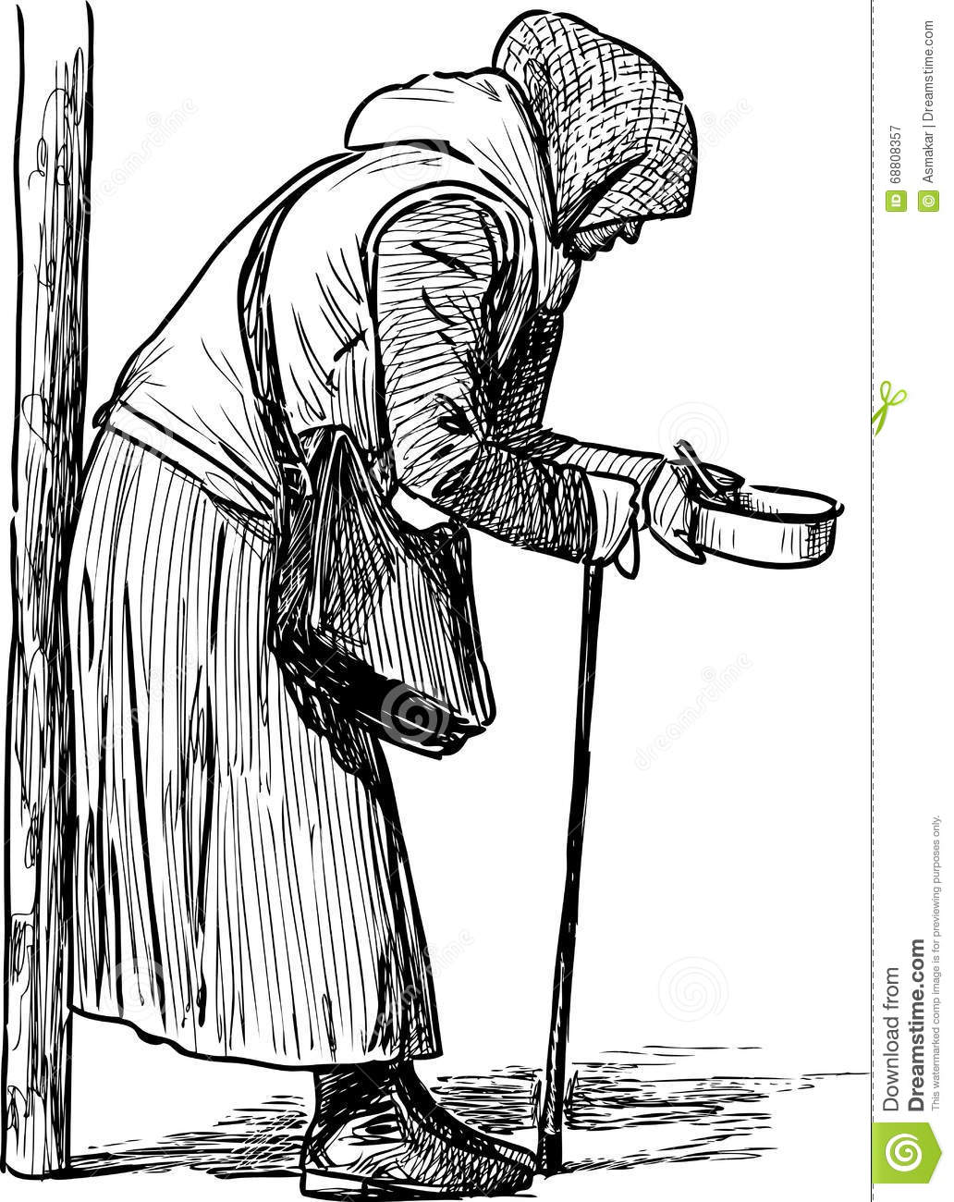
THEME OF THE POEM
In Arun Kolatkar’s poem, “An Old Woman,” the main theme is about keeping what is important in perspective—in this case, an old woman and her heritage—the land from which she comes.
Someone may be walking and a woman may grab a hold of his or her sleeve. For a price, she will take what seems to be a sightseer to a nearby shrine. The man will not interested: he has seen the shrine before. However, the woman will be insistent; the man may want to dismiss her because she is an old woman, and they cling and won’t let go.

Slide 5
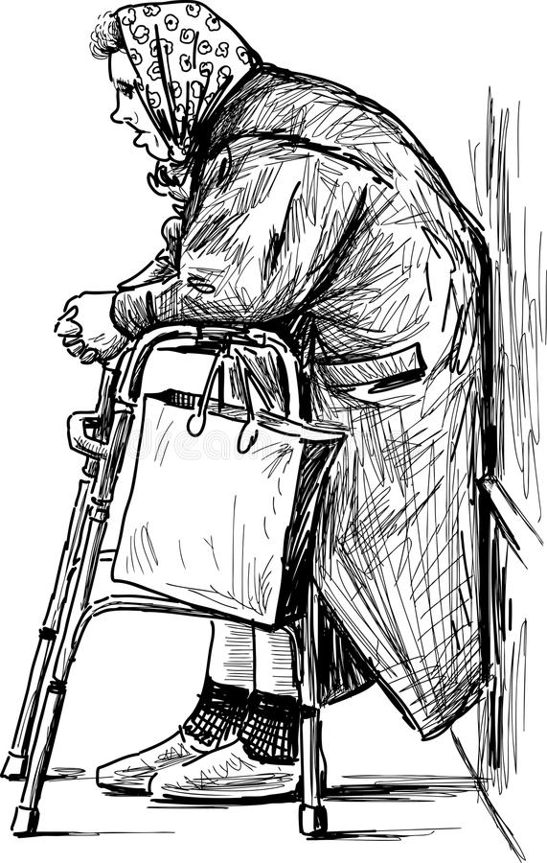
Summary of the Poem
An old beggar woman catches hold of the sleeve of the speaker and insists on getting a fifty paisa con in alms. She tags along with him and promises that she will take him to the horseshoe temple. If he tells her that he has already seen the temple, she hobbles along with him and catches hold of his shirt tightly and again insists on getting a fifty paisa coin. She will not let him go. Like all other old women, she, too, sticks to him life a burr (prickly seed case of plants which stick to clothes). He turns around and wants to get rid or her. In order to end this useless activity, he tells her firmly to leave him. When she remarks,
“What else can an old woman do
On hills as wretched as these”.
He looks right at the sky in contemplation. As he looks on her, he finds that the cracks that begin around her eyes have spread beyond her skin. The decay of the old woman has spread to the hills and the temples and in our lives. The old woman stands there alone. And he is reduced to the small change in her hand.

Slide 6
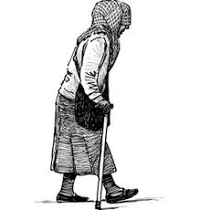
An old woman grabs
hold of your sleeve
and tags along.
She wants a ﬁfty paise coin.
She says she will take you
to the horseshoe shrine.
Summary :

Slide 7
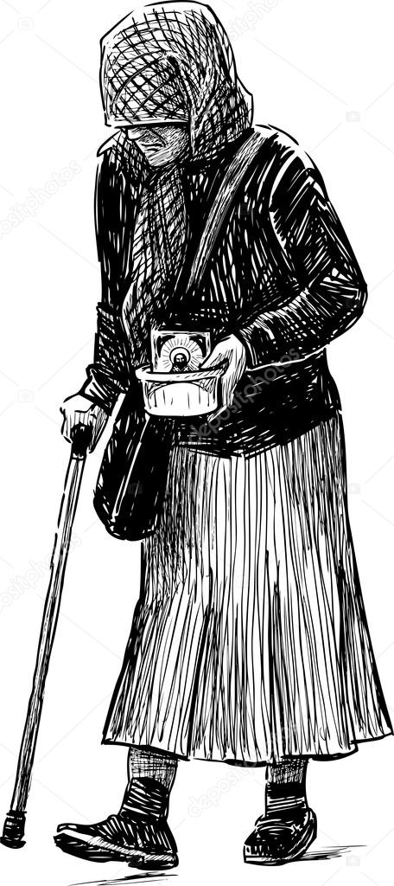
You've seen it already.
She hobbles along anyway
and tightens her grip on your shirt.
She won't let you go.
You know how old women are.
They stick to you like a burr.
You turn around and face her
with an air of ﬁnality.
You want to end the farce.
Summary :

Slide 8
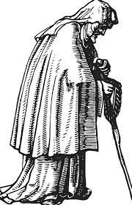
When you hear her say,
‘What else can an old woman do
on hills as wretched as these?'
You look right at the sky.
Clear through the bullet holes
she has for her eyes.
And as you look on
the cracks that begin around her eyes
spread beyond her skin.
Summary :

Slide 9
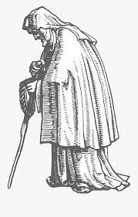
And the hills crack.
And the temples crack.
And the sky falls
with a plateglass clatter
around the shatter proof crone
who stands alone.
And you are reduced
to so much small change
in her hand.
Summary:

Slide 10
THANKING YOU
ODM EDUCATIONAL GROUP

