Slide 1


AN OLD WOMAN
STD-VII
SUBJECT : ENGLISH
PERIOD NUMBER:1
CHAPTER NAME : An Old Woman

Slide 2

EXPECTED LEARNING OUTCOMES
GENERAL OBJECTIVES
Understand and appreciate poetry as a literary art form
Analyze the various elements of poetry, such as diction, tone, form, genre, imagery, figures of speech, symbolism, theme, etc.
Recognize the rhythms, metrics and other musical aspects of poetry
Develop their critical thinking skills
Develop their own creativity which will help to enhance writing skills
SPECIFIC LEARNING OBJECTIVES
Analyse the poem and understand its central theme
Relate the theme of the poem to his/her personal life
Analyse the structure of the poem
Interpret the tone and mood of the poem

Slide 3
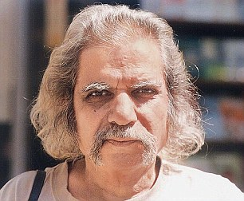
About the Poet
Arun Kolatkar (1932-2004) was educated and employed as a graphic artist in Mumbai. Kolatkar, a Commonwealth Poetry Prize recipient, has written to ‘Kavi,’ ‘Opinion Literary Review,’ ‘New Writing in India,’ and ‘The Shell and The Rain,’ among other publications. He is a poet who is bilingual and has also translated Marathi poetry. This poem is from his book ‘Jejuri,’ which contains a compilation of his poetry.

Slide 4
Theme
In this poem, the visitor’s impression of the woman as someone who just pestered the tourists for money has transformed. He realizes that despite witnessing a catastrophe, this woman prefers to earn her life on her own. The poem ends on a note that, no one can be taken for granted.

Slide 5
Introduction
In the poem ‘An Old Woman’, Arun Kolatkar wonderfully paints the graphic picture of an old begging woman. The decay of this old woman here clearly symbolizes the decay in our own lives, in our society.

Slide 6
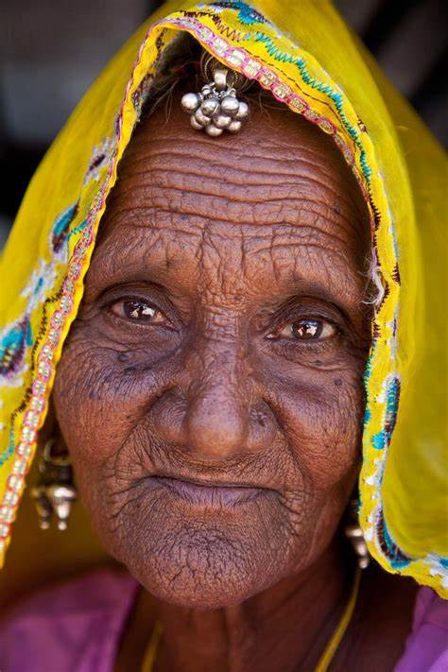
Summary
At Jejuri, an old woman catches hold of a pilgrim in order to extract some money from him. She is a very poor woman who earns her living by begging money from the pilgrims who go to Jejuri.

Slide 7
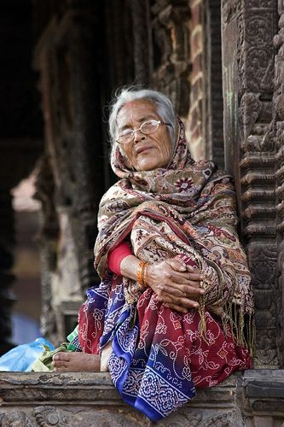
Summary
Her demand is very modest because she asks a pilgrim for only a fifty-paise coin; and, when the pilgrim shows his unwillingness to give her the money, she says that, in return for the money, she would take him with her and show him the Horseshoe Shrine.

Slide 8
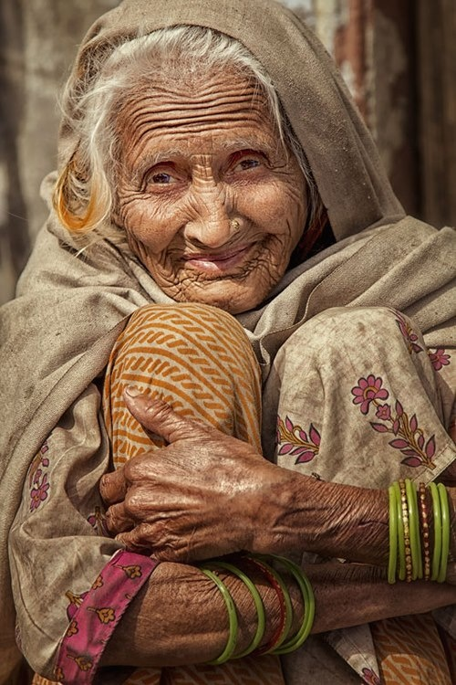
Summary
When the pilgrim replies that he has already seen that shrine, she still clings to him and, in fact, tightens her grip on his sleeve. The pilgrim looks at her with an expression of finality, indicating his refusal to give her any money. But the woman still does not leave him and says that a poor old woman has no alternative but to maintain herself on the charity of people.

Slide 9
THANK YOU
ODM EDUCATIONAL GROUP

