Slide 1

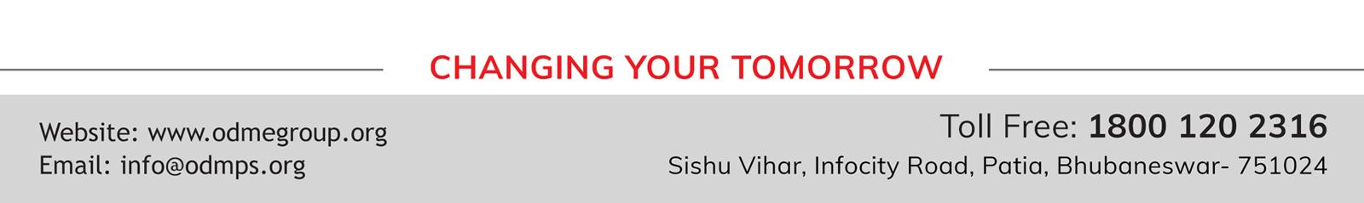
WELCOME YOU ALL TO THE ONLINE CLASS
SUBJECT :- MATHS
CHAPTER : NUMBERS

Slide 2
AFTER NUMBERS

Slide 3
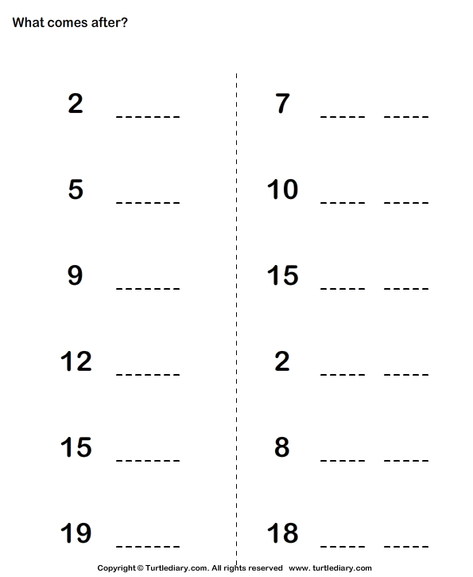

8
9
3
11
12
6
10
16
17
13
3
4
16
9
10
20
19
20

Slide 4
THANKING YOU
ODM EDUCATIONAL GROUP

