Slide 1

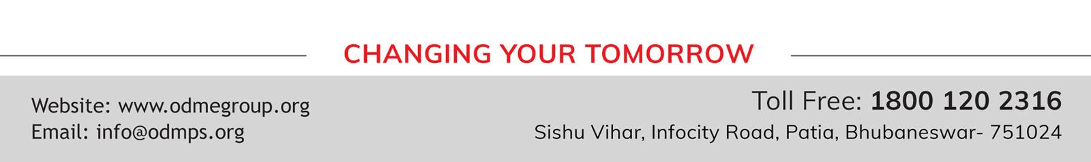
WELCOME TO ONLINE CLASS
SUBJECT : CONVERSATION
ACTION WORDS

Slide 2
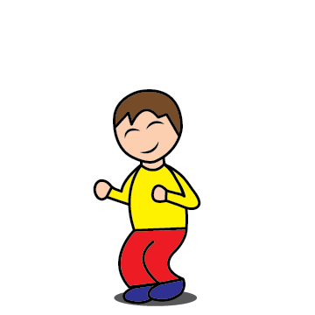

I am jumping

Slide 3
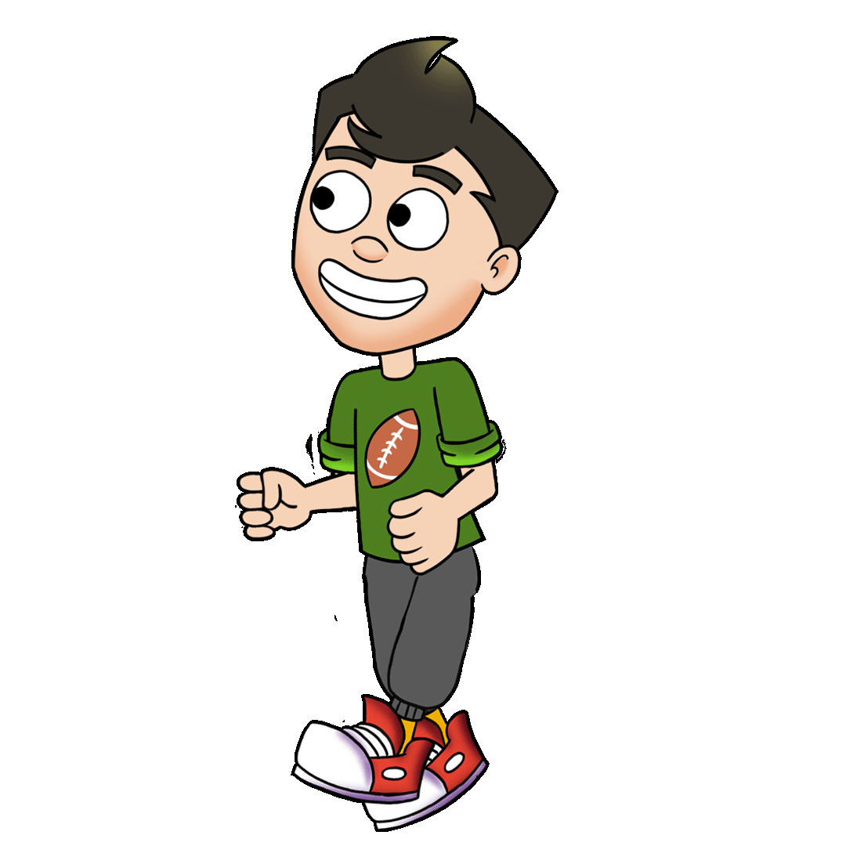
I am walking

Slide 4
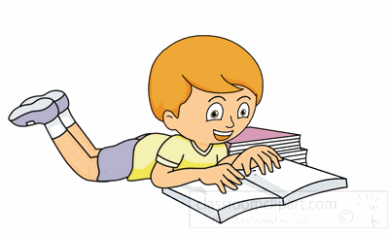
I am reading

Slide 5
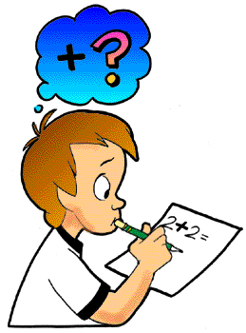
I am writing

Slide 6
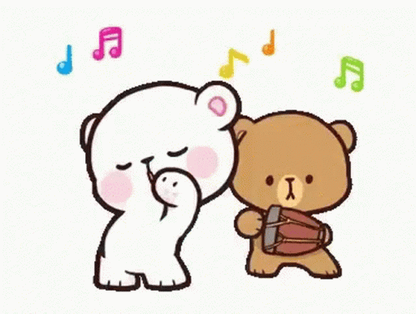
We are dancing

Slide 7


We are crying

Slide 8

I am laughing

Slide 9
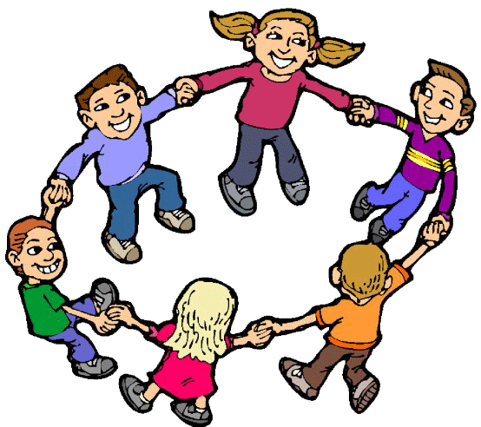
We are playing

Slide 10

I am eating

Slide 11
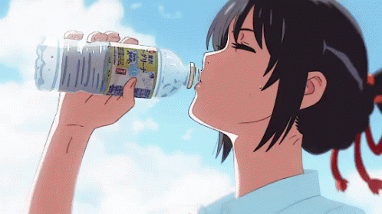
I am drinking

Slide 12

I am sleeping

Slide 13
THANKING YOU
ODM EDUCATIONAL GROUP

