Slide 1



CLASS: NURSERY
DATE:11-11-21
SUBJECT:CONVERSATION
TOPIC: ACTION WORDS

Slide 2
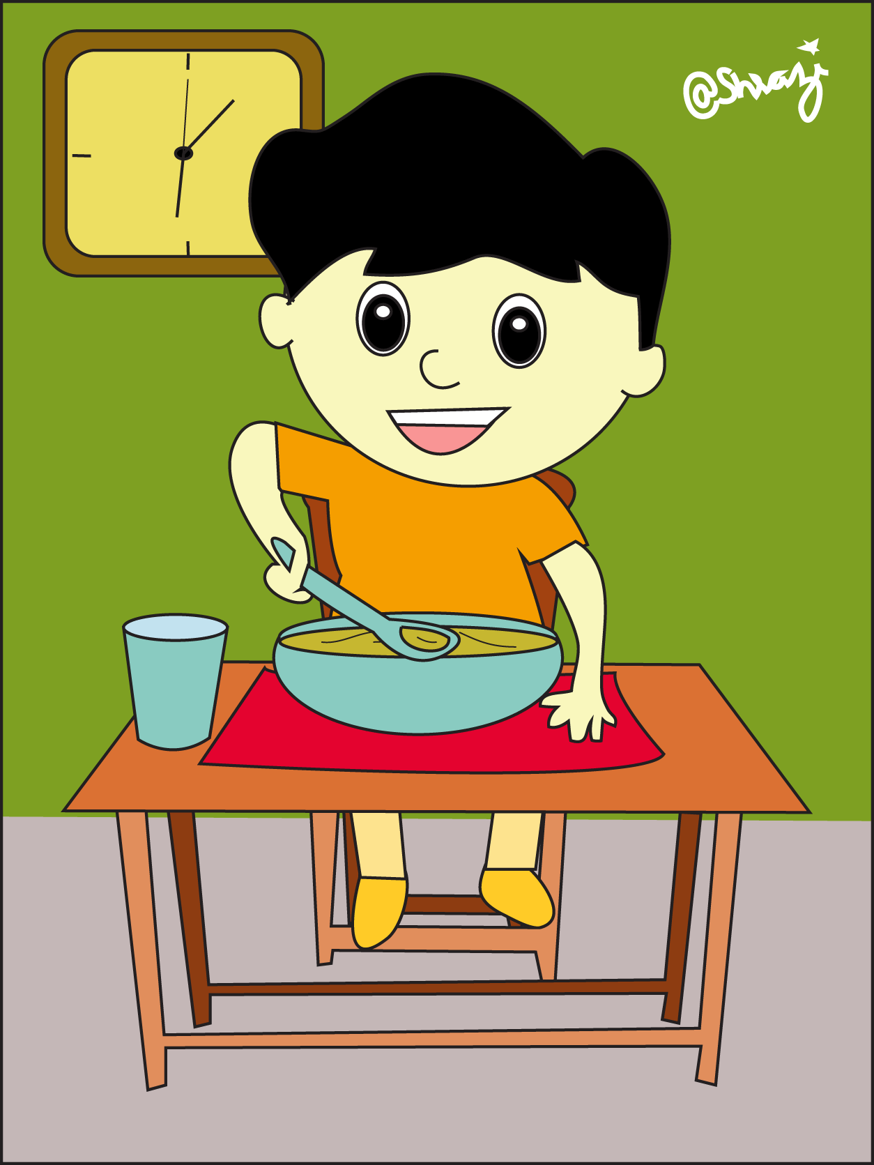

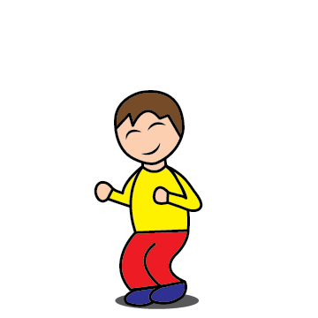
Eating
Reading
Jumping

Slide 3
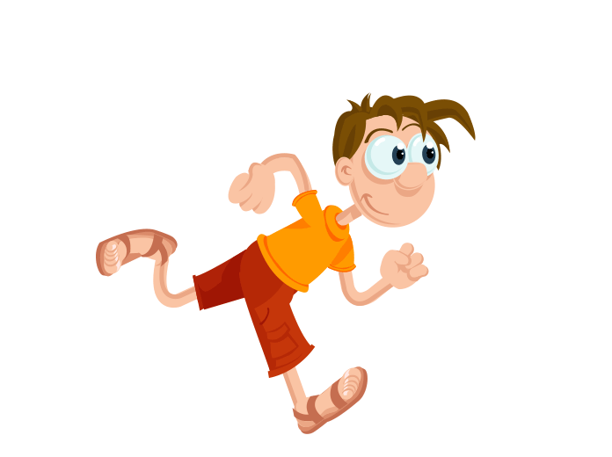
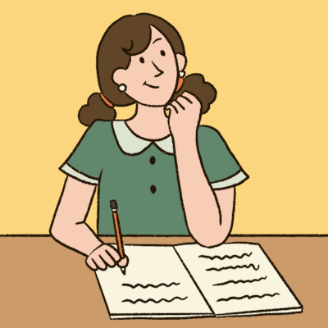
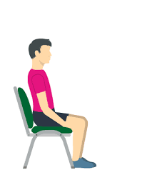
WRITING
RUNNING
SITTING

Slide 4


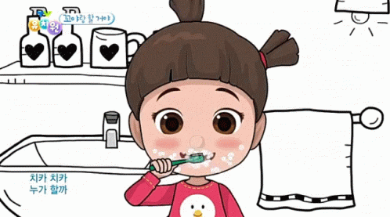
DRINKING
SLEEPING
BRUSHING

Slide 5

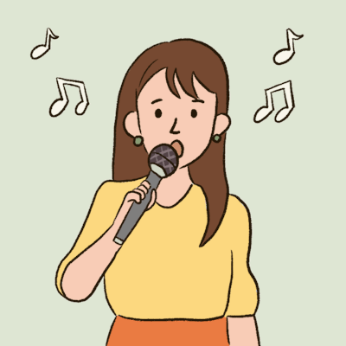


DANCING
SINGING
CRYING
LAUGHING

Slide 6
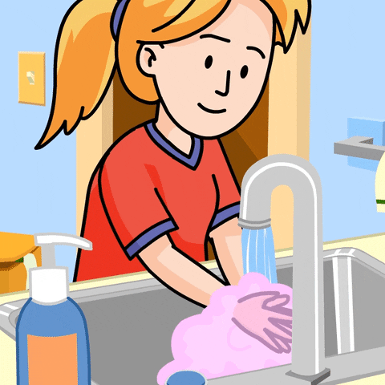
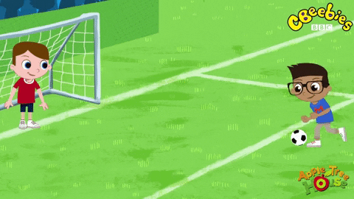
PLAYING
WASHING
So he jumped again and again. But could not get at them.

Slide 7


11/11/21
HOME ASSIGNMENT:
Practice the action words

Slide 8
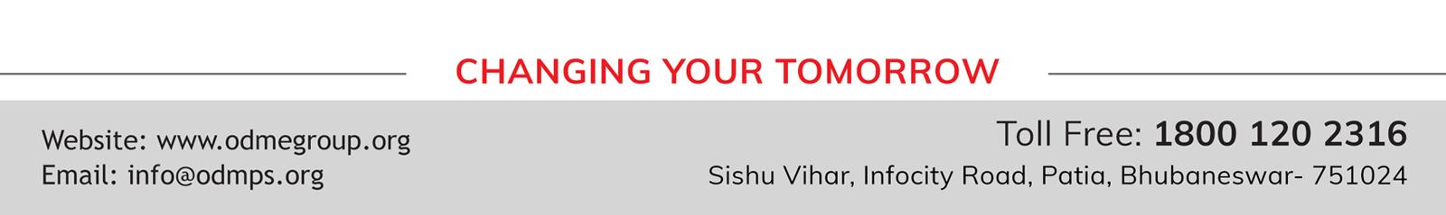
THANKING YOU
ODM EDUCATIONAL GROUP

