Slide 1



CLASS: NURSERY
DATE:09-11-21
SUBJECT:CONVERSATION
TOPIC: ACTION WORDS

Slide 2
ACTION WORDS
Action words are also known as doing words.
Let’s learn some action words……..

Slide 3
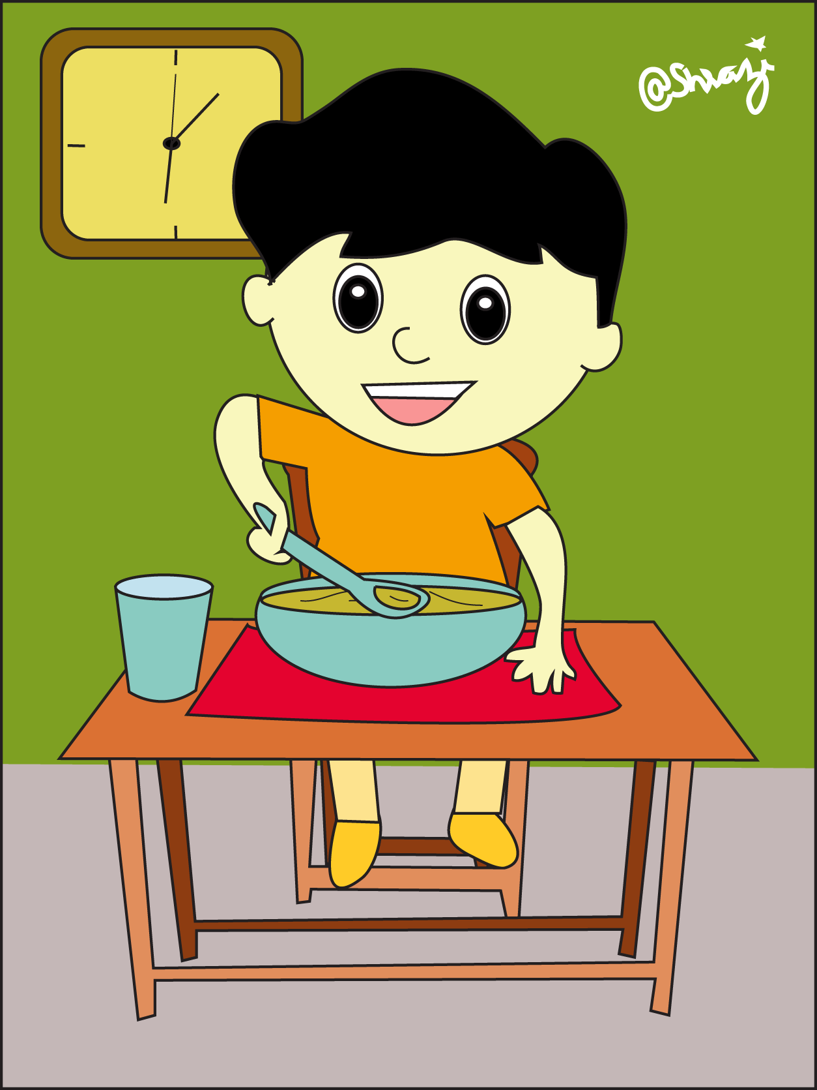
Eating

Slide 4
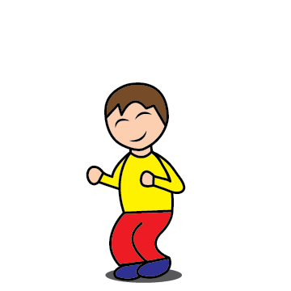
Jumping

Slide 5

Reading

Slide 6
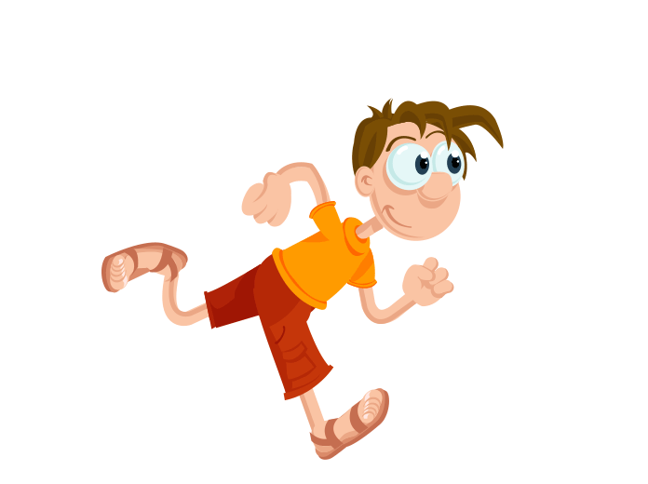
Running

Slide 7
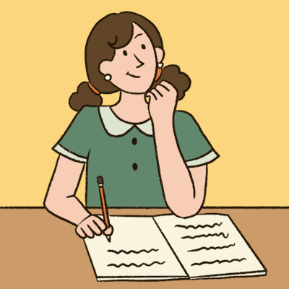
Writing
So he jumped again and again. But could not get at them.

Slide 8
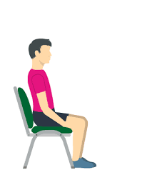
Sitting

Slide 9

Drinking

Slide 10
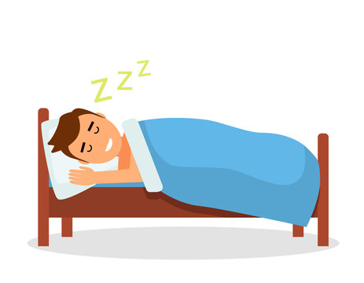
Sleeping

Slide 11


09/11/21
HOME ASSIGNMENT:
Practice the action words

Slide 12
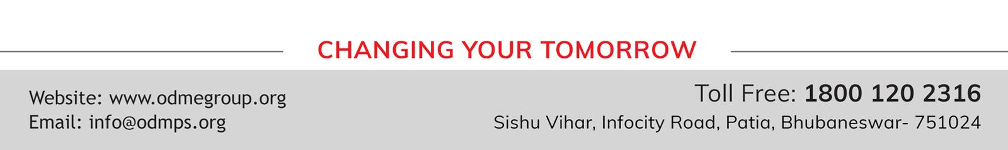
THANKING YOU
ODM EDUCATIONAL GROUP

