Slide 1
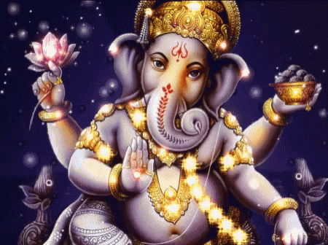


Slide 2

CLASS : 2
SESSION NO. : 7
SUBJECT : MATHEMATICS
TOPIC: CH-4 SUBTRACTION
SUB TOPIC: DOUBT CLEARING AND CLASS TEST.
.
.

Slide 3

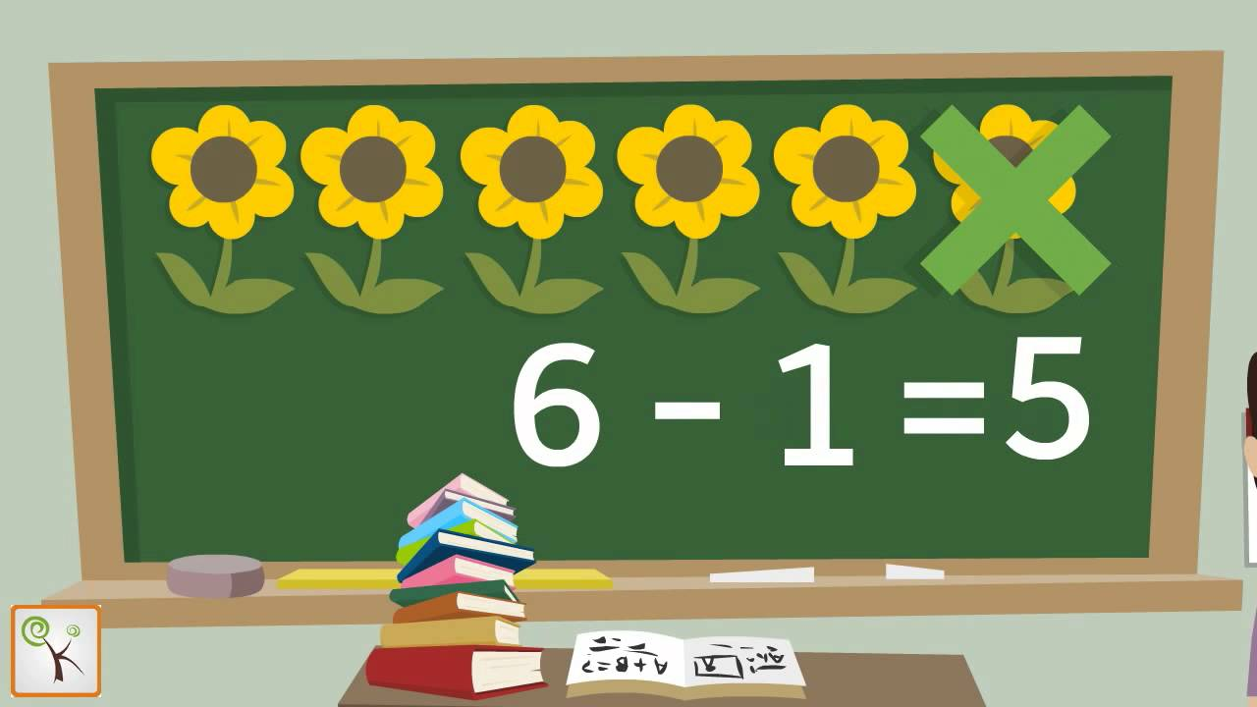
Taking away a number from another number is called SUBTRACTION.

Slide 4

TODAY’S TOPIC
DOUBT CLEARING AND CLASS TEST.

Slide 5

CLASS TEST
1.Choose the correct answer and fill in the blanks.
a.Taking away a number from another number is called___________.
subtraction
(addition /
Subtraction)
b.On subtracting 0(zero) from a number,the difference is the number_____________.(itself/predecessor)
itself
difference
c.The answer of subtraction is called_________.( sum/difference)

Slide 6

2.Subtract the following.
 | H | T | O
H T O
3
11
16
6
4 4 1
7 7 6
_
_
3 2 6
1 4 8
1
1
5
6
2
8

Slide 7

3.Solve the story problem.
In an orchard,there were 327 apples trees.Of these,159 were destroyed in a storm.How many trees are left now?
11
2
1
17
_
3 2 7
Total apple trees= ______
1 5 9
Number of trees destroyed= ______
6
8
Number of trees left= ______
1
168
Ans:Now ______ trees are left.

Slide 8
SUB | HOME ASSIGNMENT
Mathematics | ________________________

Slide 9
THANKING YOU
ODM EDUCATIONAL GROUP

