Slide 1


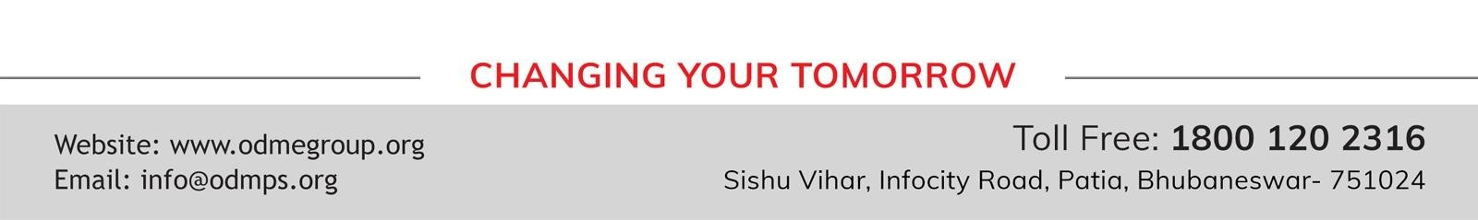
STD-IX
SUBJECT- LITERATURE CHAPTER - 4
TOPIC- A TRULY BEAUTIFUL MIND PERIOD-4

Slide 2














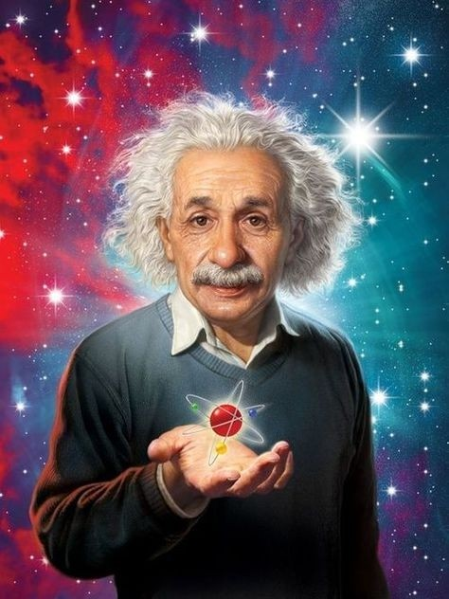


Slide 3
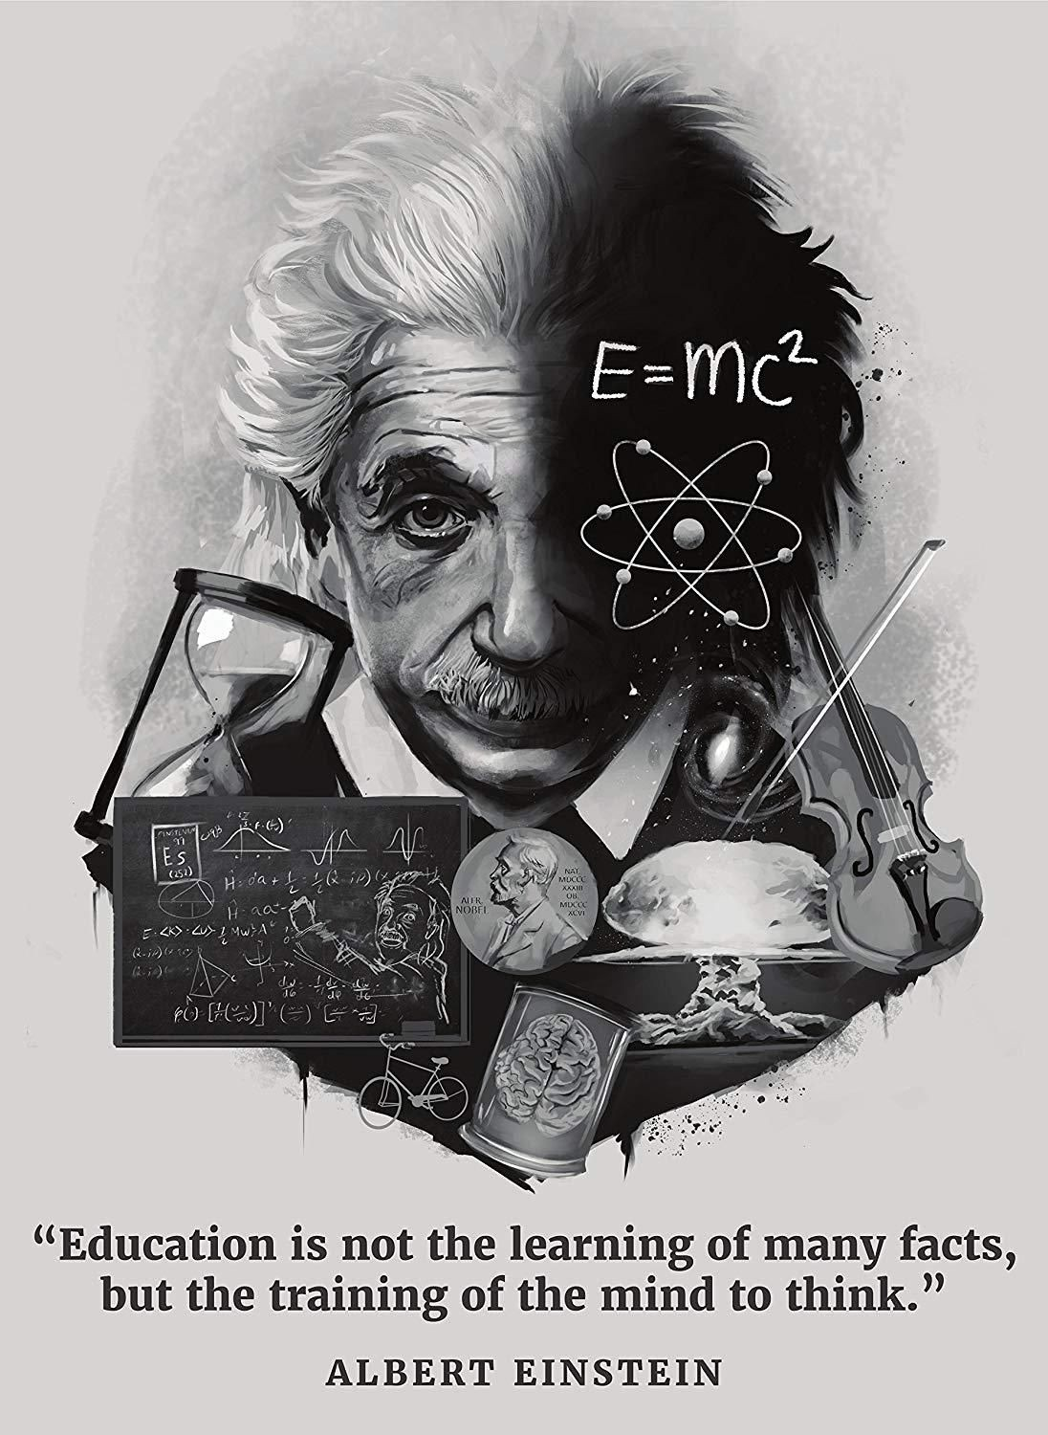
EXPECTED LEARNING OUTCOMES:
GENERAL OBJECTIVES
Understanding the concept
Being acquainted with prose and author’s biography
Understanding the idea
Appreciate the language of the prose
Developing LSRW Skills
SPECIFIC OBJECTIVES/ EXTENDED OBJECTIVES
Understanding the concept
Being acquainted with prose and author’s biography
Understanding the idea
Appreciate the language of the prose
Developing LSRW Skills

Slide 4
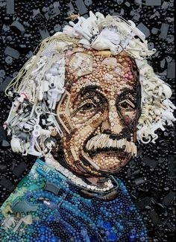
THEME OF THE STORY:
A Truly Beautiful Mind is a summary of the biography of famous scientist Albert Einstein.
The story portrays the other side of his life that he concerns and promote human welfare.
That is the reason why the title of the story is ‘A Truly Beautiful Mind’.

Slide 5
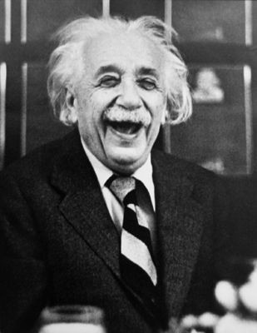
EMIGRATION TO USA
In 1933, when Germany came under the power of Nazis, (the famous Nazi ruler was Adolf Hitler), at that time, Einstein left Germany and shifted to the United State of America forever.
After 5 years, the Germans discovered the process of nuclear fission - the process through which nuclear bombs or atomic bombs are made.
This process was prepared in Berlin. Due to this, all the physicists in America were upset as they feared misuse of the technology.

Slide 6

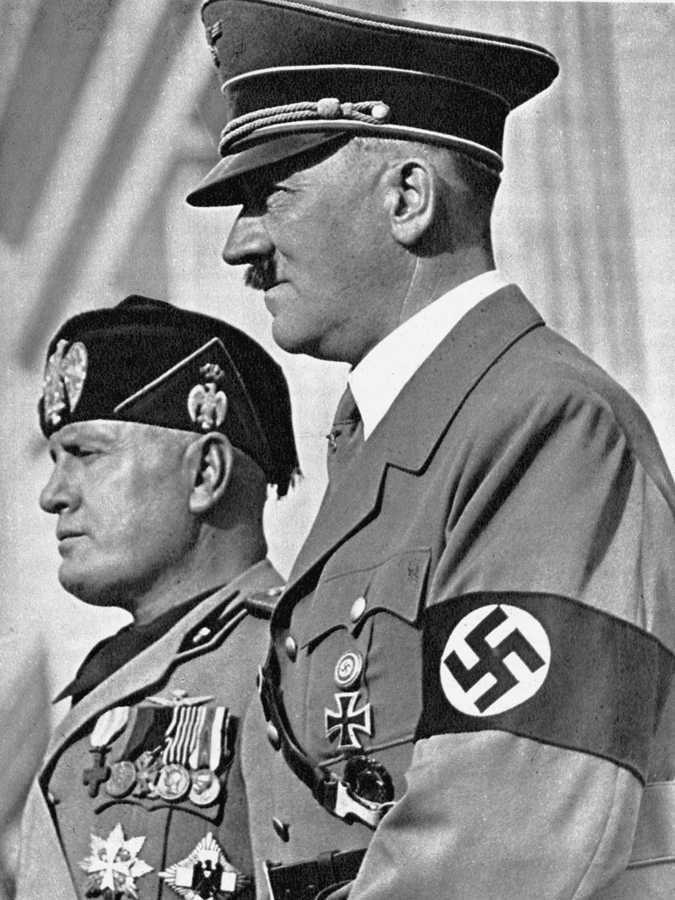
There were many scientists who escaped to America because of Fascism.
(Fascism was a dictatorial concept that was started in Europe from Italy by the rule of Benito Mussolini.)
All the scientists were afraid that the Nazis could misuse the atomic bomb.

Slide 7
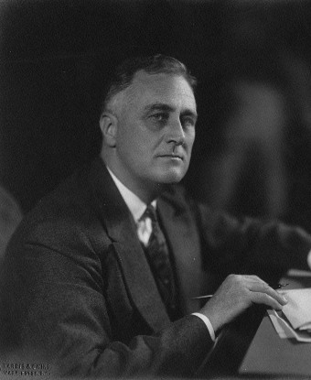
WROTE TO ROOSEVELT
Albert Einstein was requested by a colleague and so, he wrote a letter to the President of America, Franklin D. Roosevelt on 2nd August 1939.
He warned him that the atomic bomb which was developed by Germany was very powerful. If one of these bombs exploded on any port, it would not only destroy the area, but also it would destroy the surrounding territory.
This shows Einstein’s humanitarian quality. He wanted good for the people, he wanted peace in the world. That is why he wrote his concern to the president of America and warned him.

Slide 8
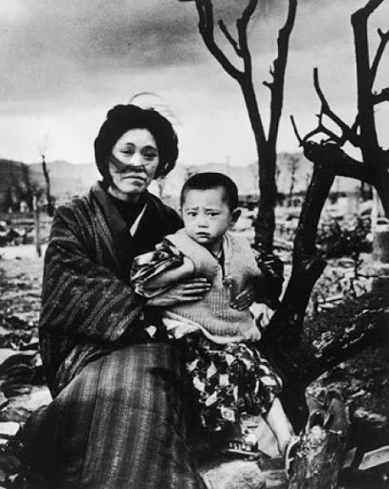
DROPPING OF ATOM BOMB
The Americans developed the atomic bomb secretly and dropped it on two cities of Japan
– Hiroshima and Nagasaki.
The Germans had just developed the atomic bomb, they did not use it on any country, but America did.
Lot of destruction took place and Einstein was shaken.
He wrote an official letter to the United Nations Organization.
Albert Einstein proposed to form a world government, but this letter did not bear any fruit.

Slide 9

A GLOBAL CITIZEN
For another ten years Albert Einstein was involved in World Peace.
He was involved in politics and his agenda was to stop the countries involved in collecting arms and developing weapons.
He campaigned for world peace and democracy. His main agenda was world peace and freedom of people.
Einstein could foresee the future. When he died in 1955 at the age of 76, the world celebrated him as a visionary.
He was a world citizen and a scientific genius too.

Slide 10
VOCABULARY
visionary: a person who can think about the future in an original and intelligent way
missive: letter, especially long and official
in an uproar: very upset
Emigrated: leave one’s own country in order to settle permanently in another
HOMEWORK
NCERT textbook question 3-8
A VIDEO ON NAZISM AND EINSTEIN
https://www.biography.com/video/albert-einstein-nazi- germany-1453635735
EINSTEIN AND ATOMIC BOMB
https://www.youtube.com/watch?v=ZyYqyYAKGC0

Slide 11
THANK YOU
ODM EDUCATIONAL GROUP

