Slide 1












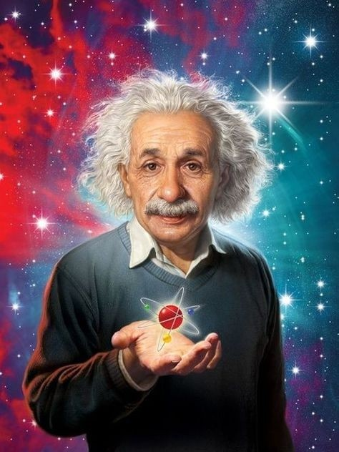





Slide 2
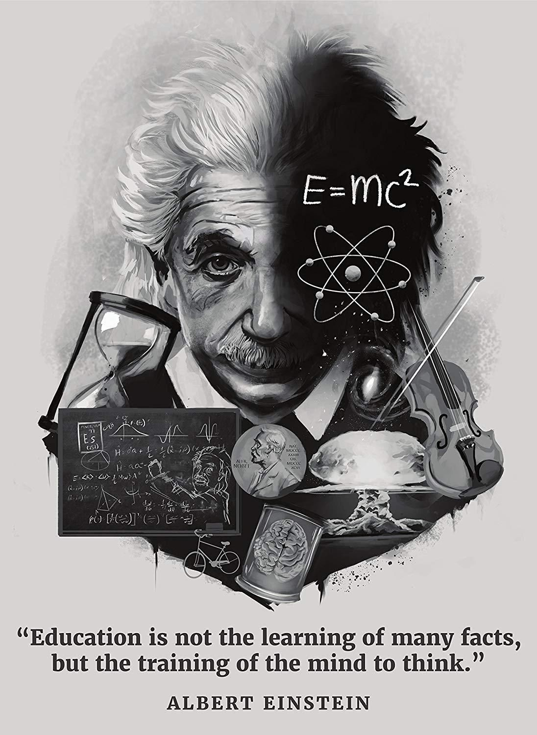
EXPECTED LEARNING OUTCOMES:
GENERAL OBJECTIVES
Understanding the concept
Being acquainted with prose and author’s biography
Understanding the idea
Appreciate the language of the prose
Developing LSRW Skills
SPECIFIC OBJECTIVES/ EXTENDED OBJECTIVES
Understanding the concept
Being acquainted with prose and author’s biography
Understanding the idea
Appreciate the language of the prose
Developing LSRW Skills

Slide 3
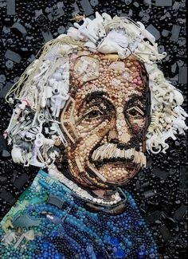
THEME OF THE STORY:
A Truly Beautiful Mind is a summary of the biography of famous scientist Albert Einstein.
The story portrays the other side of his life that he concerns and promote human welfare.
That is the reason why the title of the story is ‘A Truly Beautiful Mind’.

Slide 4
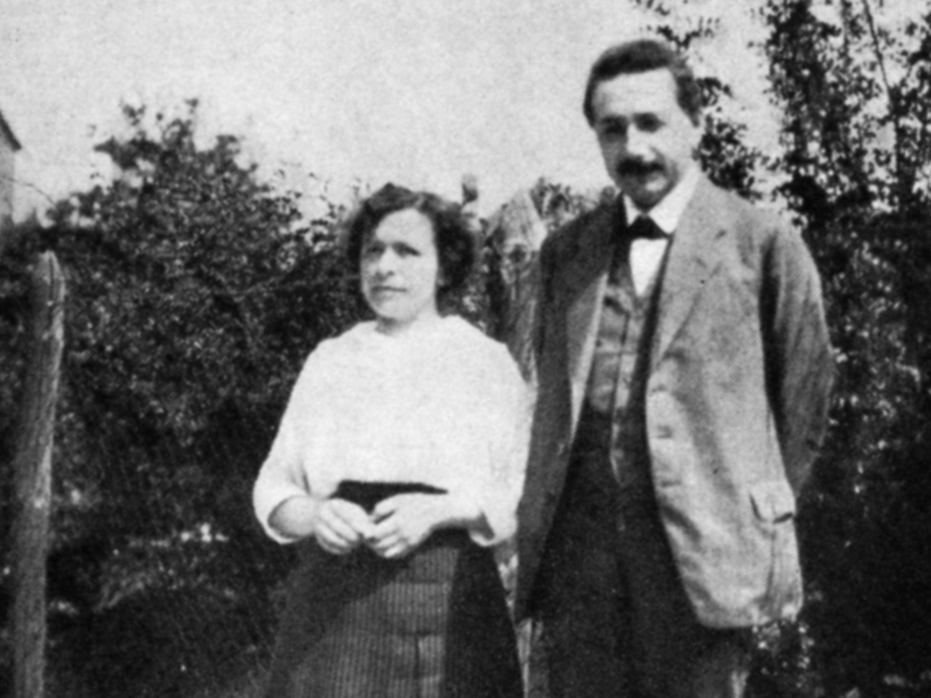
PERSONAL LIFE
Though he was solving the complicated problems in physics for the world, his personal life started becoming problematic.
He started to fail in his personal life
As his mother was against this marriage, he cancelled his wedding with Mileva.
Albert Einstein married Mileva Maric in the year 1903 and they had two sons.

Slide 5
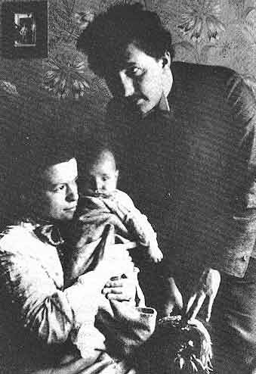
Their marriage failed.
As Mileva Maric was very intelligent, being a housewife she could not cope with her ambitions. She could not fulfill her ambitions and so, she started becoming unhappy.
Mileva was unhappy from this marriage, she could not fulfill her career dreams, so, finally in the year 1919 after prolonged fighting both of them separated.

Slide 6
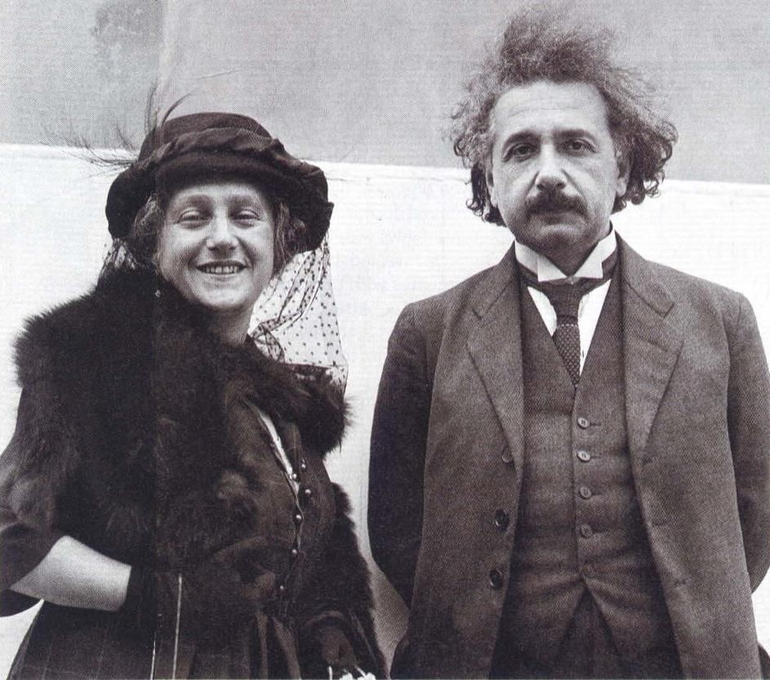
REMARRIED
Albert Einstein married the second time.He married his cousin Elsa.
At the time Einstein married Elsa, another thing coincided. It was Einstein’s rise to world fame.
Einstein became world famous. Everyone acknowledged him as a great scientist.

Slide 7
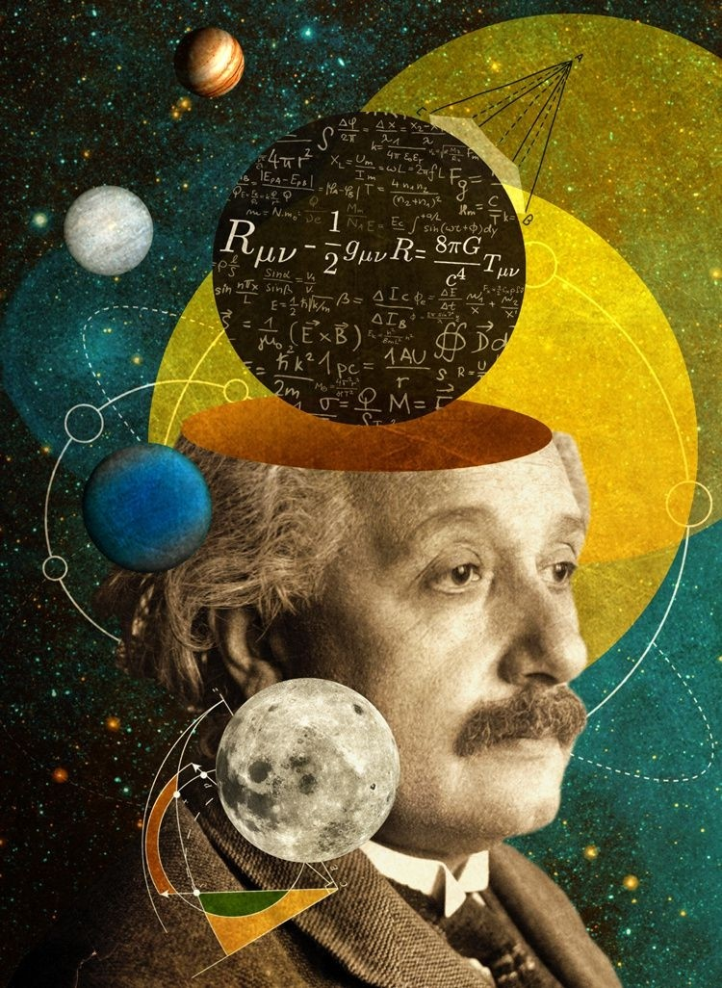
NEW FINDINGS
In the year 1915, he published one more paper which was based on the General Theory of Relativity which gave a new interpretation to gravity.
In the year 1919, there was a solar eclipse which proved that Albert Einstein’s General theory of Relativity was correct.
Albert Einstein had calculated in the year 1915 that in the year 1919 there would be a solar eclipse.
Due to it, the apparent position of the stars would change to some extent. His calculation was accurate. So, it was announced that Albert Einstein’s work was a scientific revolution.

Slide 8
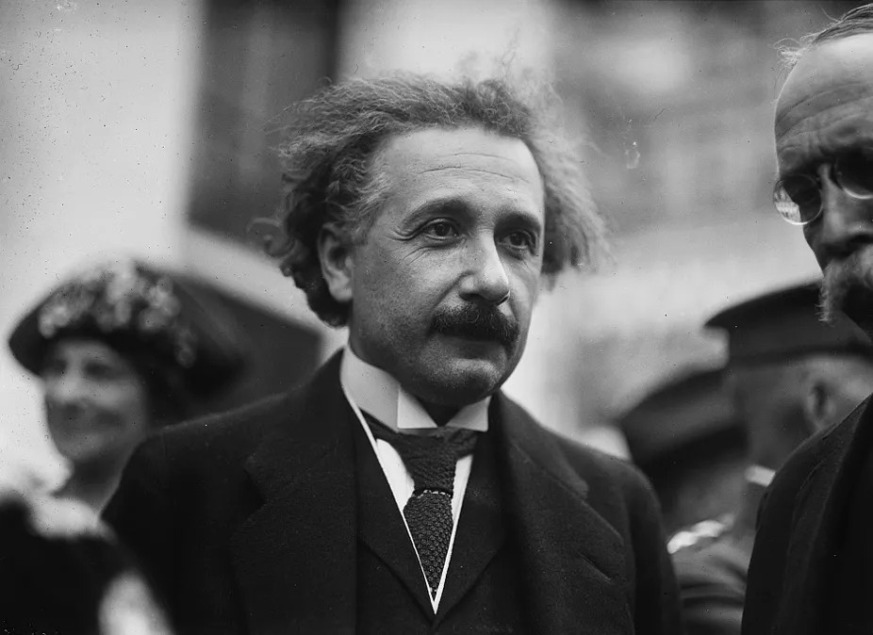
NOBEL PRIZE RECEIVED
The Nobel Prize was based on the will of the famous Swedish scientist, a scientist who belongs to Sweden, Alfred Nobel. It was established in 1895 and the first Nobel Prize was given in the year 1901.
Einstein was awarded the Nobel Prize for Physics in the year 1921.
He was showered with honors and invitations from all over the world and lauded by the press.

Slide 9
VOCABULARY
deflected: changed direction because it hit something
faltered: became weak
absolute: measured in itself, not in relation to anything else
HOMEWORK
NCERT textbook question 1,2
A VIDEO ON EINSTEIN’S LIFE
https://www.nobelprize.org/prizes/physics/1921/einstei n/documentary/

Slide 10
THANK YOU
ODM EDUCATIONAL GROUP

