Slide 1

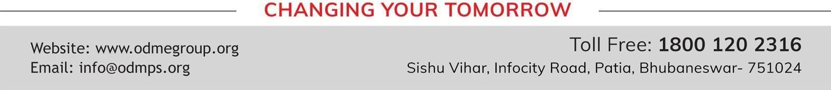
SESSION : 3
CLASS : 5
SUBJECT : SOCIAL SCIENCE
CHAPTER NUMBER: 4,5,6 and 7
CHAPTER NAME : CLIMATE, DRC, GREENLAND AND SAUDI ARABIA
SUBTOPIC : REVISION TEST – 1, MAP SKILL

Slide 2
LEARNING OBJECTIVES
Enable the learner to know about:
A clear understanding of where they are headed.
Well-written learning objectives.

Slide 3
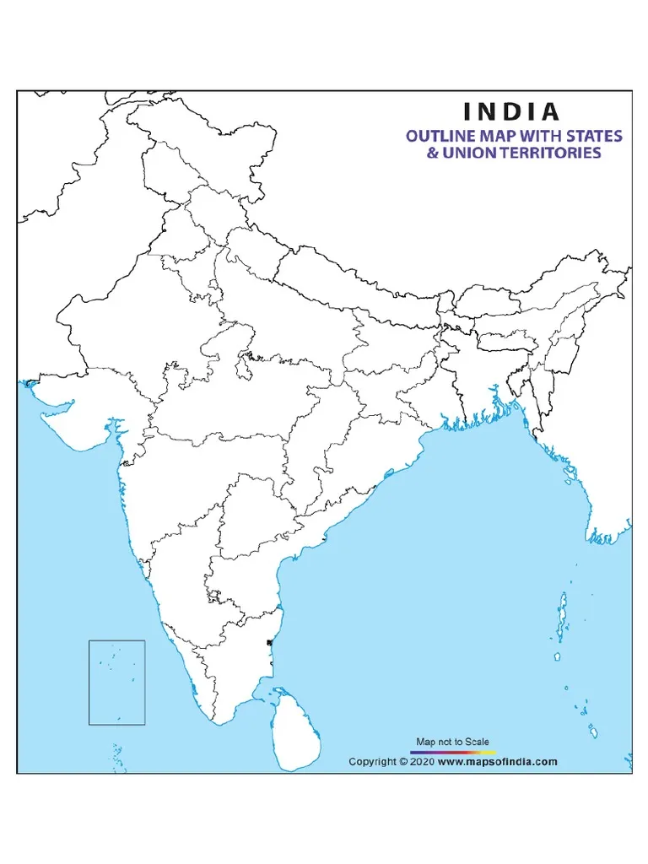
Locate the following on the outline map f India:
a. The state where Taj Mahal is located.
b. The state where Gandhi was born.
c. The state Sikkim
c. Sikkim
a.UP
b.Gujarat

Slide 4
A. Fill in the blanks. (1X2=2)
pygmies
The well known inhabitants of the DRC are __________.
2. Fertile area formed in the desert by underground water that comes to the surface is called an ________.
oasis
B. Choose the correct answer. (1X2=2)
Meadow
Prairie is a French word meaning ________.
a) Tree b) Sun c) Meadow
2. Indians protested against the _________.
a) Gandhiji b) Simon c) Subhash Chandra Bose
Simon

Slide 5
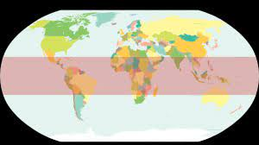
C. Correct the sentences by changing the underlined words. (1X2=2)
1. The purple colour zone shows the Frigid zone.
Ans. Torrid zone
Frigid zone b) Torrid zone c) Temperate zone
2. DRC has the world’s largest deposits of silver.
Ans. Cobalt
D. Give answer in one word. (1X2=2)
Parkas
Jackets with hoods lined with fur. __________
Small hills of sand keep shifting due to strong winds. ___________
Sand dunes

Slide 6
E. Read the paragraph and answer the following questions. (1X2=2)
Three species of great apes live in the DRC. These are the common chimpanzee, the bonobo and the gorilla. It is the only country in the world in which bonobos are found in the wild.
How many kinds of species of apes live in the DRC?
Ans. Three species of great apes live in the DRC.
2. Which is the only country in the world in which bonobos are found?
Ans. DRC is the only country in the world in which bonobos are found in the wild.

Slide 7
F. Answer the following questions. (2X3=6)
Why did Eric the Red name the island ‘Greenland’?
Ans. Eric, the Red named the island ‘Greenland’ in the hope that the name would attract settlers from other countries, particularly Iceland, the nearest European country.
2. Define Savanna. Which part of the DRC has this type of vegetation?
Ans. Ans. Savanna
- a large flat area of grassland with scattered trees, found in warm parts.
- the southern part of DRC have Savanna.
3. How did Bedouins traditionally earn their living?
Ans. The Bedouins sell animals and their products at market places in villages and buy food grains, dates and other things to earn their living.

Slide 8
HOMEWORK
Learn Q/A of ch-8 & 16 for Revision 3

Slide 9
LEARNING OUTCOME
By the end of the class, learners will be able to know:
A clear understanding of where they are headed.
Well-written learning objectives.

Slide 10
THANKING YOU
ODM EDUCATIONAL GROUP

