Slide 1


SESSION : 4
CLASS : 5
SUBJECT : SOCIAL SCIENCE
CHAPTER NUMBER: 8 and 16
CHAPTER NAME : GRASSLAND OF THE TEMPERATE ZONE AND SOME PEOPLE NEVER DIE
SUBTOPIC : REVISION 3, MAP SKILL

Slide 2
LEARNING OBJECTIVES
Enable the learner to know about:
A clear understanding of where they are headed.
Well-written learning objectives.

Slide 3
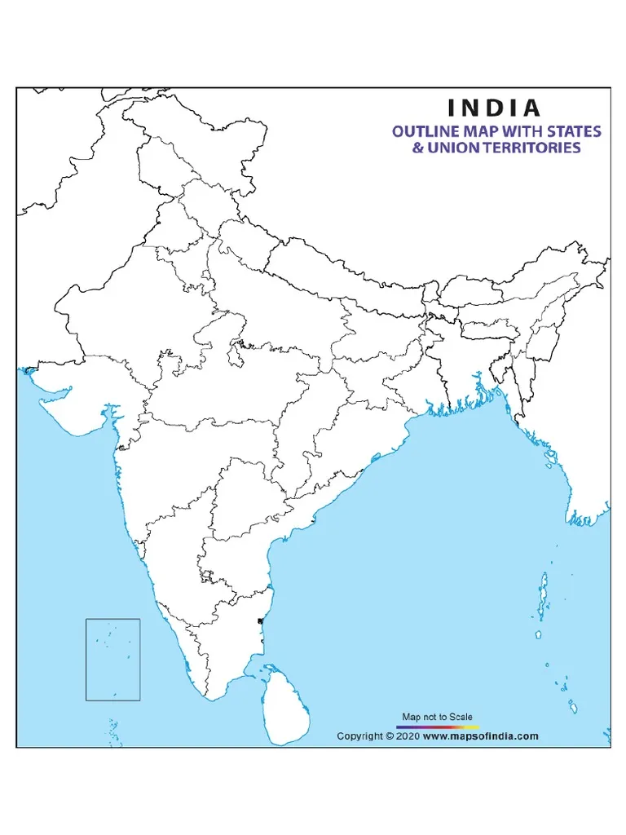
c. Chandigarh
a. New Delhi
Locate the following on the outline map f India:
The capital of India
The IT city of India
The capital of Punjab and Haryana
b. Bengaluru

Slide 4

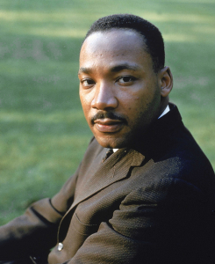
A. Choose the correct answer .
Abraham Lincoln was born in _____.
a) 1908 b) 1809 c) 1860
2. Identify the picture.
a) b)
Abraham Lincoln and M.K. Gandhi
Martin Luther King and Subhash Chandra Bose
Abraham Lincoln and Abraham Lincoln and Martin Luther King
1809
Ans. c) Abraham Lincoln and Abraham Lincoln and Martin Luther King

Slide 5
B. Fill in the blanks.
Missouri and ___________ are the two rivers passing through Prairies.
Lincoln became the president in ______ year.
The main crop grown in the prairies are ________.
Money or help given out of kindness to the poor and needy is called _______.
Mississippi
1860
wheat
charity
C. Answer the following questions.
Explain why are the prairies so attractive for farming.
Ans. Ans. Prairies are so attractive for farming because -
The soil is very fertile.
Water is available in plenty from the Mississippi and Missouri and their tributaries.
The climate is suitable for cultivation of wheat for which USA produces so much wheat that it is called the “ Wheat basket of the world”.

Slide 6
2. Why did Mother Teresa start working for the poor?
Ans. When she was staying in Kolkata, she saw the poor people suffering badly. She felt that God was telling her to work for the poorest of the city. So, she started to look after the poor and needy children.
3. Who inspired Martin Luther King to adopt non-violent methods of protest? What was the importance of King’s march on Washington?
Ans. Mahatma Gandhi inspired Martin Luther King to adopt non-violent methods of protesting against injustice. King’s March on Washington was a movement against injustice to the blacks. He led this march to fight for equality for the blacks.
4. Mother Teresa is remembered for her selfless service. Give reasons.
Ans.

Slide 7
HOMEWORK
Learn Q/A of Ch-10 & 20 for Revision 4

Slide 8
LEARNING OUTCOME
By the end of the class, learners will be able to know:
A clear understanding of where they are headed.
Well-written learning objectives.

Slide 9
THANKING YOU
ODM EDUCATIONAL GROUP

