Slide 1


A Lesson in the Hennouse
By : Jane Goodall
SUBJECT : (English)
CHAPTER NUMBER:8
CHAPTER NAME : A Lesson in the Hennouse

Slide 2
EXPECTED LEARNING OUTCOMES
GENERAL OBJECTIVES
Reading Comprehension followed by questions
Be acquainted with short story/Fiction
Understanding the plot
Understanding characters
Developing LSRW Skills
Know how to write a story- Beginning, middle and end
SPECIFIC OBJECTIVES/ EXTENDED OBJECTIVES
Develop LSRW
Appreciating the story, plot, characters
Developing skill of Critical appreciation
Be aware of the importance of asking questions
Be acquainted with typical vocabulary meant for story writing
Appreciating varieties of style and diction in literary writing

Slide 3
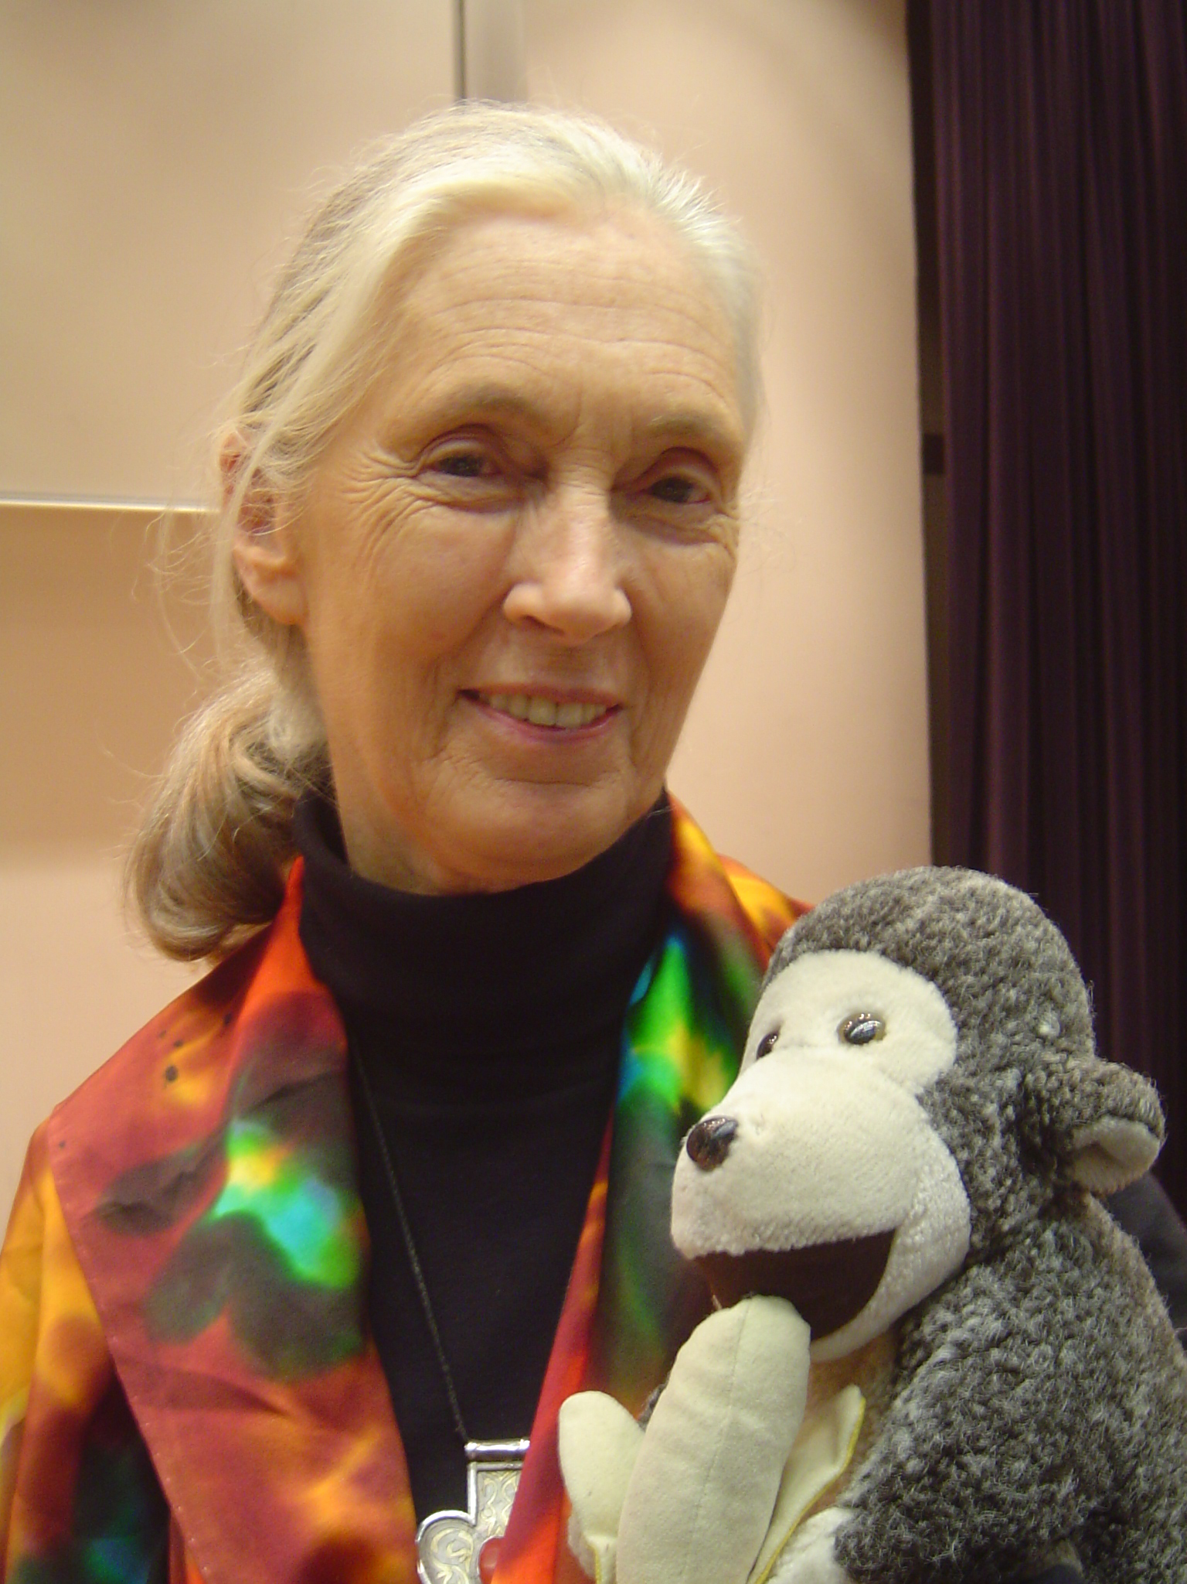
INTRODUCTION TO THE AUTHOR
On April 3, 1934, Valerie Jane Morris-Goodall is born in London, England to Mortimer, an engineer and Vanne, an author. Jane's childhood is a happy one with much time spent playing and exploring outside her family's home in Bournemouth. But World War II is raging and Jane's father is in the army as an engineer, disappearing from his daughter's life for a time. After the war, Jane's parents divorce. Jane continually urges her audiences to recognize their personal power and responsibility to effect positive change through consumer action, lifestyle change and activism: “Every individual counts,” she says. “Every individual has a role to play. Every individual makes a difference.”

Slide 4
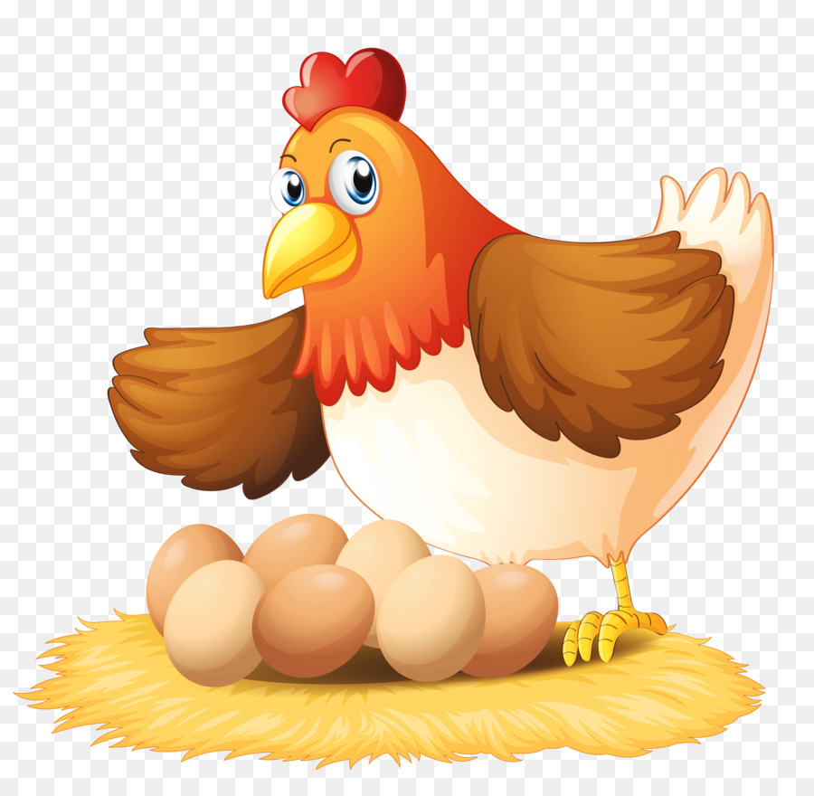
It was very stuffy and hot ..... I had just seen.
Summary: The narrator describes her first experience of watching a hen lau an egg. As a child, she was crouched in a chicken coop in an uncomfortable position for a long time, so as not to disturb the hen. Her mother, worried about her disaapearnce, was about to call the police. But instead of scolding her for causing her anxiety, she listened to her eagerly.
Exercise, Reading A- Page 61

Slide 5
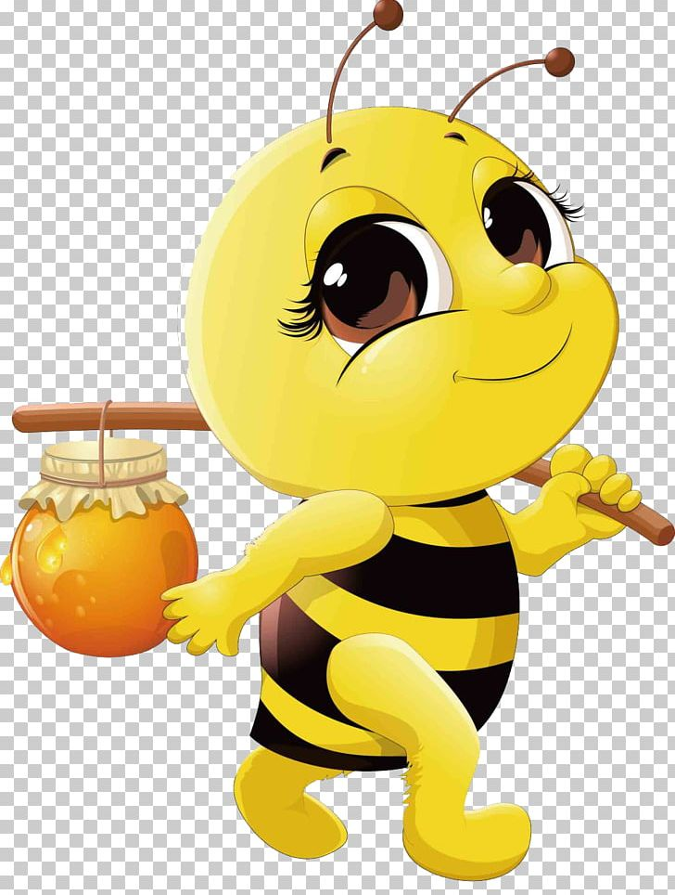
Even though I was soyoung ..... they came back to Lorenz.
Summary: When she grew up, she became an ethologist to study why animals do what they do to live their lives the way they do. Writing about other ethologist, she says Karl von Frich, a german, studied honey bees. He found out how a worker bee told other worker bees where to go for honey. She did a ‘waggle dance’ signalling wth her legs, wings and tails to tell them exactly where to go. He also found out about her sense of smell and her ability to distiguinsh colors. He learnt about bees because he was curious. She also writes about Konrad Lorenz, an Austrian. He is known as the father of ethology. He lived near Vienna with all kinds of wild animals in his home. He begain studying the graylag geese in 1935. He found out that they mate for life. When one dies, the other returns to its mother if she is still alive.

Slide 6
He found that baby geese ......At least, that is what I think.
Summary : Lorenz had raised many geese that returned to him after their mates died. He found out that newly hatched mallard eegs, the ducklings did not follow him as they would follow their mother or any duck that hatched them. Lorenz studied their behaviour and discovered that the mallard duck quacked as she walked away and the babies followed her. When Lorenz too bent down and quacked at them, they followed him, but if he stood upright or he stopped quacking, they stopped following and began to cry. People who saw him quacking and could not see the ducklings hidden in the grass thought he was crazy to be quacking to himself.
She also mentions another famous ethologist, Niko Tinbergen, who worked with different kind of seagulls. In 1960, she was working among chimpanzees in Tanzania, understanding their language and gestures and the way they live in their society. She says their behaviour is fascinating as human behaviour.
Exercise, Reading B,C- Page 62

Slide 7
THANKING YOU
ODM EDUCATIONAL GROUP

