Slide 1

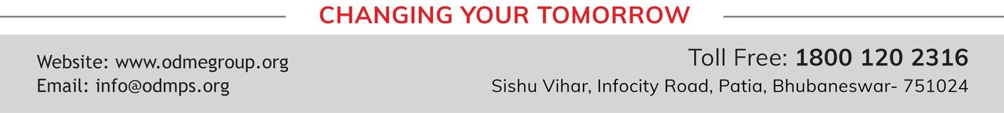
MOMENTS
STD-IX
SUBJECT- LITERATURE
TOPIC-THE ADVENTURES OF TOTO PERIOD-3

Slide 2
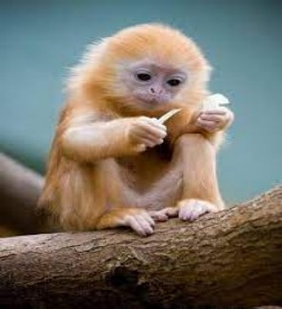













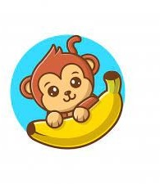
BY RUSKIN BOND

Slide 3
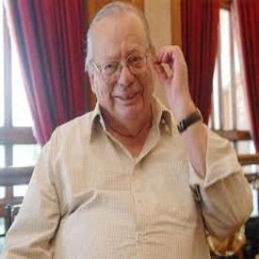
ABOUT THE AUTHOR:
Ruskin Bond was born to Edith Clarke and Aubrey Alexander Bond, in Kasauli, Punjab States Agency, British India. Most of his works are influenced by life in the hill stations at the foothills of the Himalayas, where he spent his childhood. His first novel, The Room on the Roof, was written when he was 17 and published when he was 21. His first children's book, Angry River, published in the 1970s, had its writing toned down on a publisher's request for a children's story. Bond's work reflects his Anglo-Indian experiences and the changing political, social and cultural aspects of India, having been through colonial, postcolonial and post-independence phases of India.

Slide 4
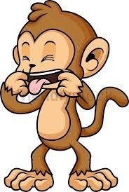
TOTO’S MISCHIEVES
If there is a part in our brain that governs our ability to create mischief, then that part in Toto’s brain was highly developed as he had great capacity to do mischief. He was always busy doing mischief. Whenever the writer’s aunts passed him, he tried to tear their dresses.

Slide 5
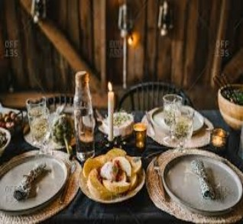

The writer recollects another incident when Toto created a lot of mischief. At lunchtime, a dish of rice was placed on the dining table. When the family reached to eat, they found Toto eating it. The writer’s grandmother screamed at Toto and In response, he threw a plate at her. When the aunts tried to catch Toto, he threw a glass of water in their face.

Slide 6
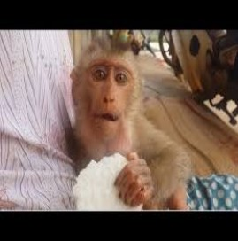
When the grandfather arrived, Toto left the place through a window with the dish of rice along with him. Toto remained out the entire afternoon. He sat on a branch of the Jackfruit tree, determined to eat all the rice. As the grandmother had screamed on him, he wanted to annoy her further and so, after eating the rice, he threw the dish. It broke into several pieces
.

Slide 7
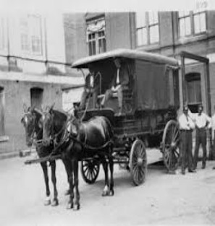
TOTO RESOLD
Finally, grandfather realised that Toto was not suitable to be kept at home. They could not afford the frequent losses that he gave them. He tore clothes, curtains, wallpapers and broke dishes. So, the grandfather sold Toto back to the same tonga driver for a sum of three rupees.

Slide 8
VOCABULARY
Spite: a desire to hurt, annoy or offend someone
Chattered: the sound made by the monkey
ASSIGNMENT
Find 5 synonyms and antonyms from the chapter

Slide 9
THANK YOU
ODM EDUCATIONAL GROUP…

