Slide 1

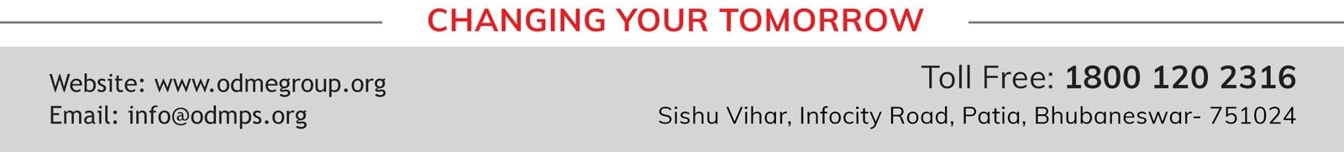
MOMENTS
STD-IX
SUBJECT- LITERATURE
TOPIC-THE ADVENTURES OF TOTO PERIOD-2

Slide 2
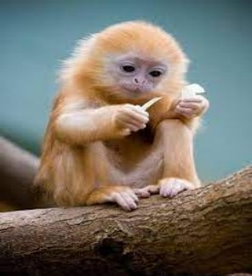














BY RUSKIN BOND

Slide 3
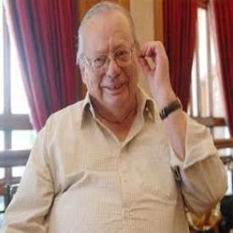
ABOUT THE AUTHOR:
Ruskin Bond was born to Edith Clarke and Aubrey Alexander Bond, in Kasauli, Punjab States Agency, British India. Most of his works are influenced by life in the hill stations at the foothills of the Himalayas, where he spent his childhood. His first novel, The Room on the Roof, was written when he was 17 and published when he was 21. His first children's book, Angry River, published in the 1970s, had its writing toned down on a publisher's request for a children's story. Bond's work reflects his Anglo-Indian experiences and the changing political, social and cultural aspects of India, having been through colonial, postcolonial and post-independence phases of India.

Slide 4
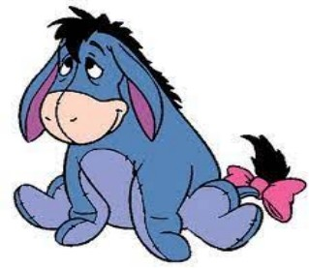
TOTO AND NANA
The writer’s grandmother finally came to know of Toto’s presence in the house. She allotted him space in the stable along with the family donkey Nana. On the first night in the stable, grandfather visited Toto. He found Nana restless, pulling its rope in order to stay away from the heap of hay.Grandfather hit Nana on the back in order to stop it. Nana jumped back with a jerk and Toto was dragged along with her

Slide 5
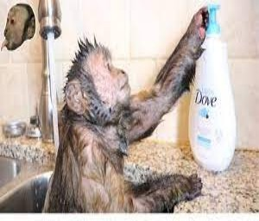
In the winter season, Toto enjoyed having a warm bath. He would pretend to be selfish and before starting his bath, he would check the temperature of the water. He would copy the writer and stepped into the tub,one foot at a time. Finally, he would would sit in the water with his face out of it. Then he would rub himself with soap. When the water became cold, he would run out of it to the stove in the kitchen in order to dry himself. Toto got annoyed if he was laughed upon, he would get hurt and then, refused to take bath. The writer recollects an incident when Toto had almost boiled himself.

Slide 6
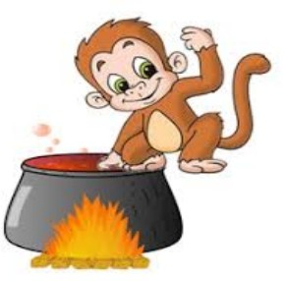
TOTO BOILING HIMSELF ALIVE
In a large kettle, water was boiling on the stove. Toto climbed up to the stove and removed the lid from it. He felt that the water was warm enough for him to take a bath. He entered the kettle with his head out of it. When the water started boiling, it became hot for Toto. He thought of coming out of the kettle but as the temperature outside was cold for him, he stayed in it. Toto kept on jumping in the cattle for a while. It was when the writer’s grandmother arrived that she took the half boiled monkey out
of the kettle.

Slide 7
VOCABULARY
To get his own back (idiom): to take revenge
Prodded: pushed
Stable: building set apart and adapted for keeping horses
Halter: a strap or loop placed around the head of a horse or other animal, used for leading or tethering it
Haunches: back
Hauled him: pulled him out

Slide 8
THANK YOU
ODM EDUCATIONAL GROUP…

