Slide 1


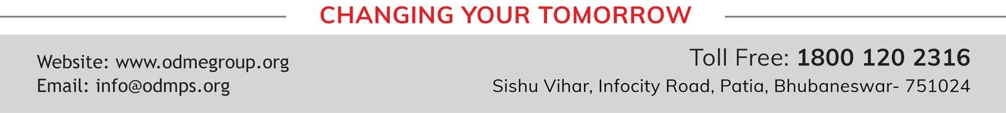
STD-IX
SUBJECT- LITERATURE
TOPIC- THE ADVENTURES OF TOTO PERIOD-1

Slide 2
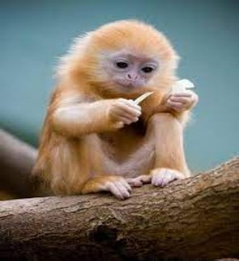














BY RUSKIN BOND

Slide 3
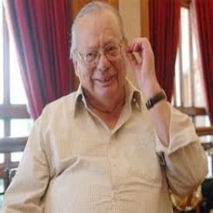
ABOUT THE AUTHOR:
Ruskin Bond was born to Edith Clarke and Aubrey Alexander Bond, in Kasauli, Punjab States Agency, British India. Most of his works are influenced by life in the hill stations at the foothills of the Himalayas, where he spent his childhood. His first novel, The Room on the Roof, was written when he was 17 and published when he was 21. His first children's book, Angry River, published in the 1970s, had its writing toned down on a publisher's request for a children's story. Bond's work reflects his Anglo-Indian experiences and the changing political, social and cultural aspects of India, having been through colonial, postcolonial and post-independence phases of India.

Slide 4

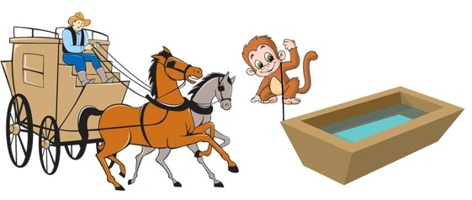
The writer’s grandfather purchased a monkey named Toto from a tonga driver by paying five rupees to him. The tonga driver had tied the little red - coloured monkey to a feeding trough, so that he could not run away. When the writer’s grandfather saw the monkey, he had a desire to add him to the collection of animals which he had in his zoo at home.

Slide 5
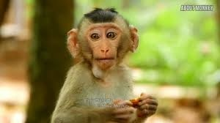
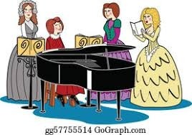
The writer gives a description of Toto. He had bright, shiny eyes which were full of mischief. The eyebrows were deeply set on his face. His teeth were like pearls. Many ladies belonging to the Anglo - Indian community got scared when they saw his teeth which were displayed when he smiled. Toto’s hands were dry and wrinkled as if they had been dried in the sun like pickled vegetables. He had a long tail. The writer’s grandfather thought that the tail added to the good looks of an animal. Toto’s tail was like a third hand for him. It helped him hang from the branch of a tree. He also used it to lift objects which were beyond his hand’s reach.

Slide 6

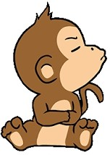
The writer’s grandmother was against the grandfather's attitude of bringing new pets - birds and animals. So, the grandfather thought that they would conceal this fact from her until she was in a good mood. At that time, they would disclose this to her. The writer and his grandfather secured Toto in a little cupboard in the writer’s room. In order to be sure that Toto did not escape, they tied him to a hook in the wall

Slide 7

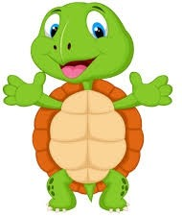
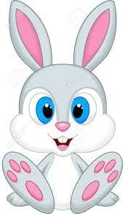
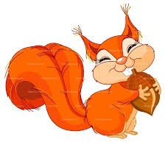
Toto was shifted to the servant quarter. He was put in a cage. He would live with the other pets in grandfather's zoo. The zoo comprised of a tortoise, a pair of rabbits, a squirrel and the writer’s pet goat. Toto was very mischievous. He did not let the animals sleep at night. The writer’s grandfather had to leave for Saharanpur the next day. He decided to take Toto along as he was unmanageable.

Slide 8
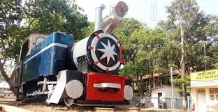
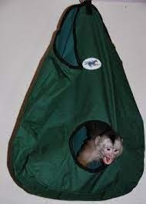
The writer was disappointed as he could not accompany his grandfather and Toto on the trip. His grandfather narrated the happenings of the trip to him later. He had got a special bag for Toto. It was made of a strong material - canvas. The writer’s grandfather ensured that when the bag was closed, Toto would not be able to escape out of it.
Neither could he come out of the opening as it was closed with a zipper, nor could it bite the strong canvas material in order to run away. Still, Toto made unsuccessful attempts to come out of the bag. Due to this, many times the bag would roll on the floor or it would certainly jump in the air. These movements were noticed by the people on the railway platform and made them curious to know what was inside the bag.

Slide 9
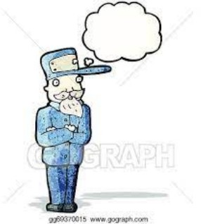

Toto remained secured in grandfather's bag till Saharanpur. At the Saharanpur railway station, the writer’s grandfather was taking out his ticket to cross the turnstile. At that time, Toto peeked out of the bag and smiled at the ticket collector.The ticket collector was astonished to see a monkey in grandfather's back. He recovered quickly and asked grandfather to pay the ticket money for travelling with a dog.Grandfather was unsuccessful in explaining to the ticket collector that Toto was a monkey and not a dog. He insisted that Toto was not even an animal with four feet. But the ticket collector was firm that Toto fell in the category of dogs. Grandfather had to pay 3 rupees for Toto’s ticket.

Slide 10
VOCABULARY
Anglo-lndian: a person relating to both britain and india
Pickled: food that is preserved in vinegar
scooping up: lifting
Ornamental: decorative
Naked: uncovered
Wrenched: broke
Socket: attachment
Shreds: cut into thin slices
Sociably: in a friendly manner
Vain: an unsuccessful attempt
Quadruped: an animal which has 4 feet
Fare: ticket price

Slide 11
THANK YOU
ODM EDUCATIONAL GROUP…

