Slide 1

CLASS-X
CLASS-X SUBJECT-CHEMISTRY CHAPTER-2 TOPIC – ACIDS BASES AND SALTS SUB TOPIC- PROPERTIES OF ACIDS AND BASES

Slide 2
Learning Outcome
After going through the topic students can able to
understand the difference between acids and bases
They can know their properties as well.
understand the reactions of acids with metals

Slide 3
TO DISTINGUISH BETWEEN PROPERTY OF ACIDS AND BASES.
ACIDS BASES
-> Sour taste, watery touch, -> Bitter taste, slippery in touch,
soluble at any propertion with water only alkalis are soluble.
-> Release H+ ions which really remain -> Release OH- ions when
in the form of H3O⁺ ions (hydronium) dissolved in water.
-> Their aq solution turns blue litmus to -> Their aq solution turns red
red. litmus to blue.
-> Their aq solution both conduct electricity.
-> Strong acids are corrosive than weak -> also strong bases are corrosive.
H₂SO₄ + H₂O -> H₃O⁺ + SO₄²⁻ KOH + H₂O -> K⁺ + OH⁻

Slide 4
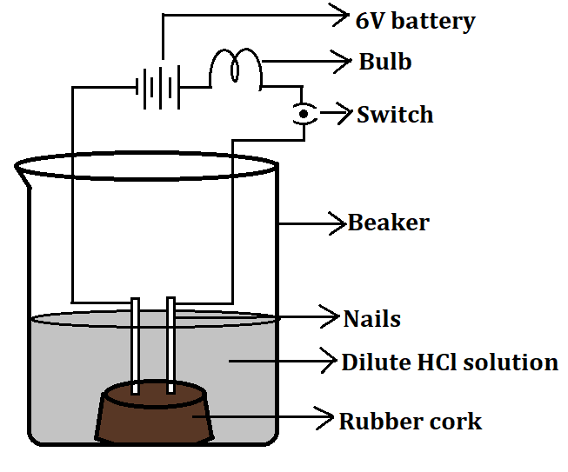
EXPERIMENTAL DEMONSTRATION
To show that electric current passes through an aq solution of acids

Slide 5
Reaction of Acids with Metals
Acid + Metal -> Salt + H₂
* Reaction with highly reactive metals (Na,K...)
* Reaction with moderately reactive metals (Mg,Zn,Fe...)
* Reaction with least reactive metals (No reaction as H is more reactive than those metals) -(Cu,Ag..). but they can only react with an acid mixture (3HCl + HNO3 both conc.) known as Aqua Regia or Royal Water where they form corresponding Chlorides.
* H2 gas is not released when Nitric Acid reacts with metals as
dil. or conc. HNO3 is a strong Ox Agent which releases nascent
Oxygen which instantly combines with H2 gas released to form water.

Slide 6
Examples of different metals reaction with Acids.
Na + HCl (dil) → NaCl + H2 [vigorous and highly exothermic]
Zn + H2SO4(dil) → ZnSO4 + H2 [less vigorous]
Cu + HCl (dil) → No reaction
Ag, Cu and Pt only can react with aqua regia to form corresponding
chlorides.

Slide 7
THANKING YOU
ODM EDUCATIONAL GROUP

