Slide 1

WELCOME TO ON LINE CLASS
CLASS-UKG
SUBJECT-MATHS
TOPIC-BACKWARD NUMBERS
(NOTEBOOK WORK)

Slide 2
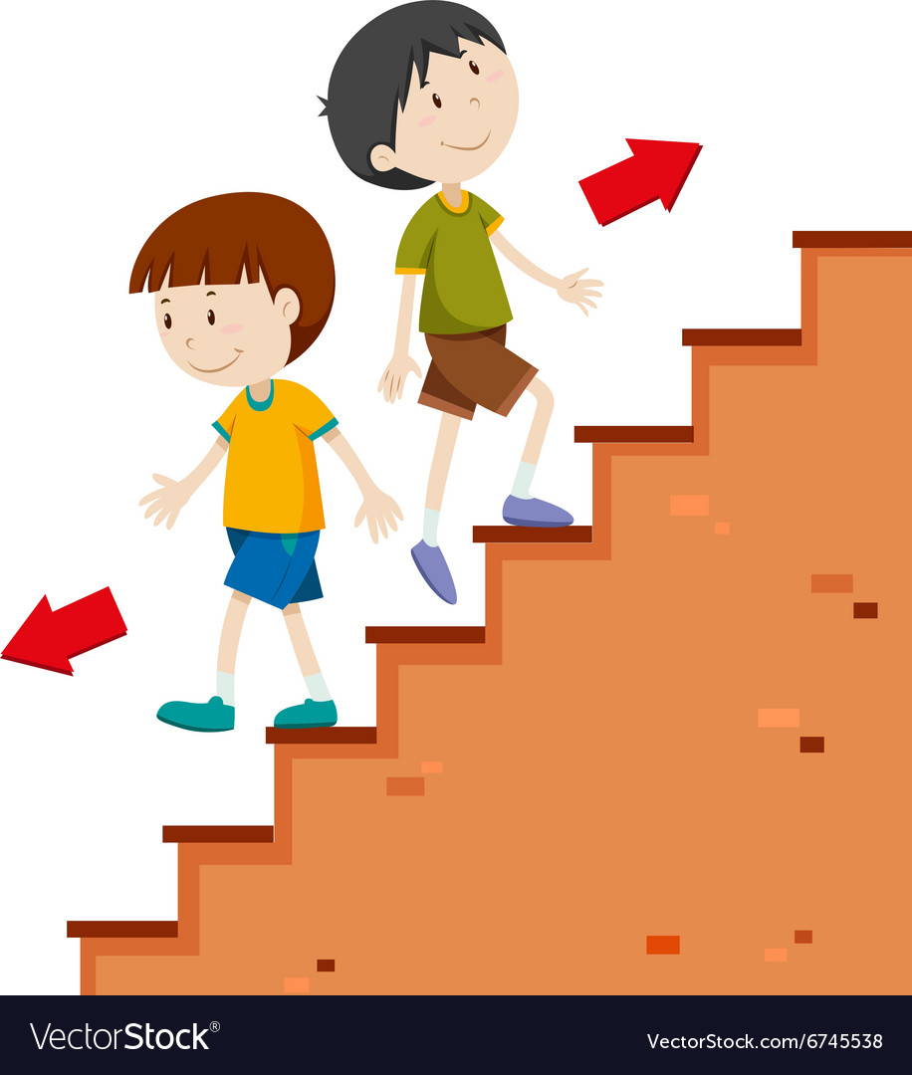
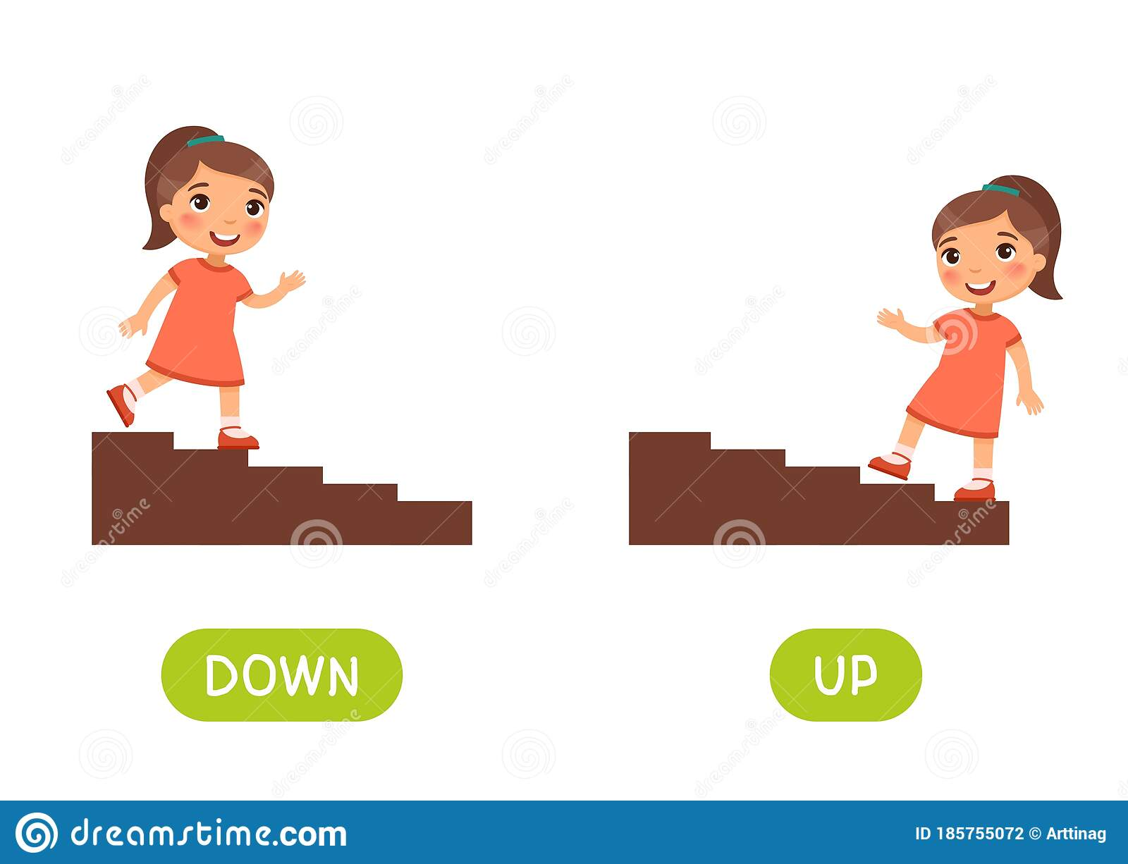
Count forward
Count backward
Count forward
Count backward

Slide 3
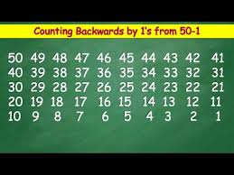
Let’s count backward – 50-1

Slide 4


45
44
Count 6
backward
numbers
from - 45
43
42
41
40
39

Slide 5
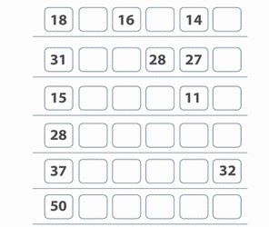
Count backward numbers from-
1
17
15
13
2
30
29
26
3
14
13
12
10
4
27
26
25
24
23
5
36
35
34
33
6
49
48
47
46
45

Slide 6
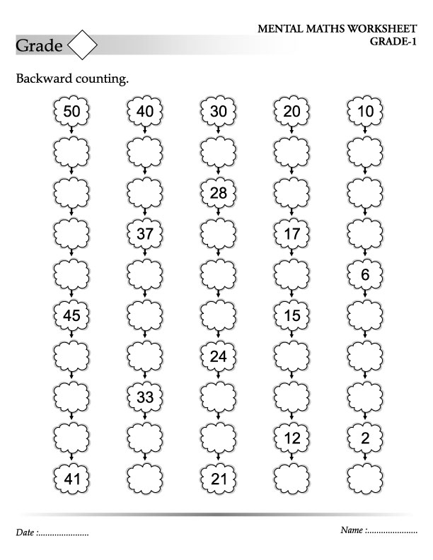
49
39
29
48
38
47
27
46
36
26
35
25
44
34
43
23
42
32
22
31

Slide 7
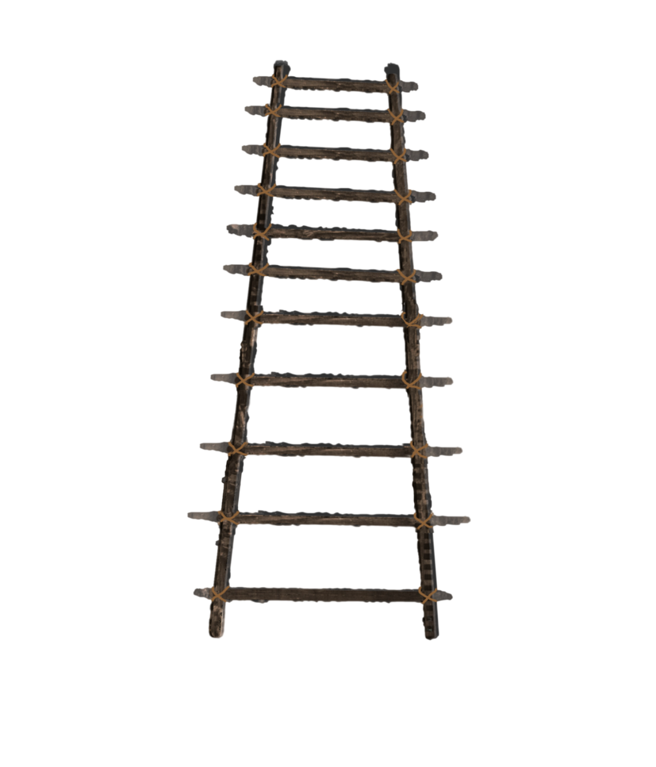



COUNT 5 STEPS FORWARD FOR THE LADDER AND 5 STEPS BACKWARD FOR THE SNAKE.
50
45
42
33
31
38
26
21
28
11
16
20
9
7
3
1

Slide 8
H.W
9.9.21
Count backward , write the missing numbers in your note book and colour as per the instruction given below-
10 – 1 in green
25 – 13 in red
28 -- 36 in yellow
48 – 40 in blue

Slide 9
1-Count backward and write the missing numbers-
50
45
42
32
38
28
24
11
16
20
7
3

Slide 10

THANKING YOU
ODM EDUCATIONAL GROUP

