Slide 1


Welcome to the Vertual Class
Social Science
SUBJECT : History CHAPTER NUMBER: 01
CHAPTER NAME : THE RISE OF IN
NATIONALISM IN EUROPE
PPT- 08

Slide 2


LEARNING OUTCOMES
Pupil will be able to:
Locate Britain on World Map.
Understand the process behind the unification of Britain.
Familiarize with the idea of Nation.
Identify the reasons for Balkan Crisis.
Analize how independent nation established their autonomy over other countries.

Slide 3
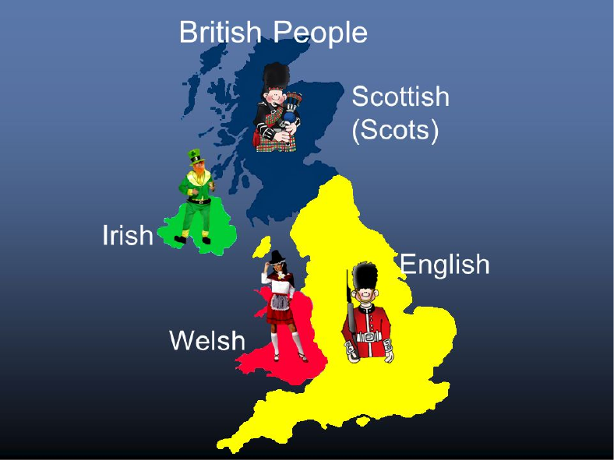
THE STRANGE CASE OF BRITAIN
Great Britain was the model of the nation and prior to the eighteenth century there was no British nation.
The nation became powerful as it steadily grew in wealth, importance and power.

Slide 4
Visualising a Nation
Artists in the 18th and 19th centuries found a way of personifying a nation. In other words they represented a country as if it were a person.
Nations were then portrayed as female figures. That is, the female figure became an allegory of the nation.
During the French Revolution artists used the female allegory to portray ideas such as liberty, Justice and the red cap, or the broken chain, while Justice is generally a blindfolded woman carrying a pair of weighing scales.

Slide 5

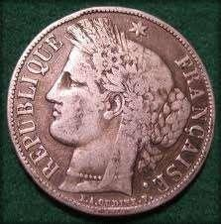
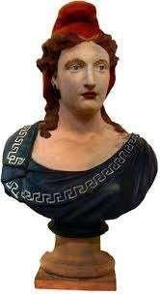
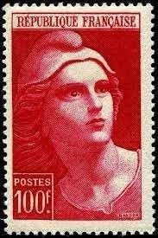
MARIANNE
Symbolizing the Republic of France

Slide 6

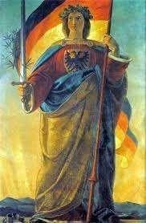

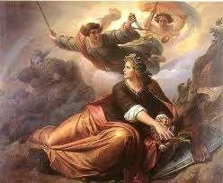
GERMANIA
Symbolizing the German nation

Slide 7
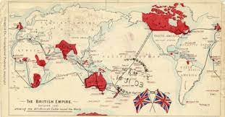
Beginning of Imperialism
Nationalism no longer retained its idealistic liberal-democratic sentiment.
During this period nationalist groups became increasingly intolerant of each other and ever ready to go to war.

Slide 8
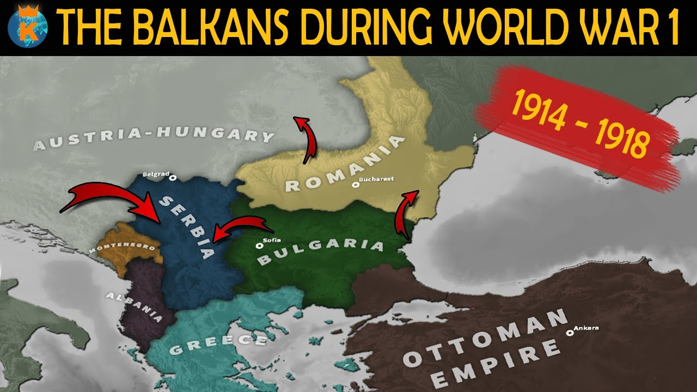
CONFLICTS OF THE BALKANS
Nationalist tension in Europe after 1871 was the area called the Balkans.
The Balkans was comprising modern day Romania, Bulgaria, Albania, Greece, Macedonia, Croatia, Bosnia- Herzegovina, Slovenia, Serbia and Montenegro whose inhabitants were broadly known as the Slavs.

Slide 9
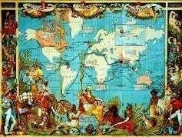
A MAP CELEBRATING THE BRITISH EMPIRE

Slide 10

HOME ASSIGNMENT
Worksheet Q. No: 07, 17, 19, 20

Slide 11
THANKING YOU
ODM EDUCATIONAL GROUP

