Slide 1

WELCOME TO ONLINE CLASS
CLASS-UKG
SUBJECT-GK
TOPIC-IMPORTANT PLACES
(revision)

Slide 2
Let us learn and revise about some places in our
neighborhood places.
Market
Hospital
Bank
Post Office
Police Station
Fire Station
Park
Places of Worship
School

Slide 3
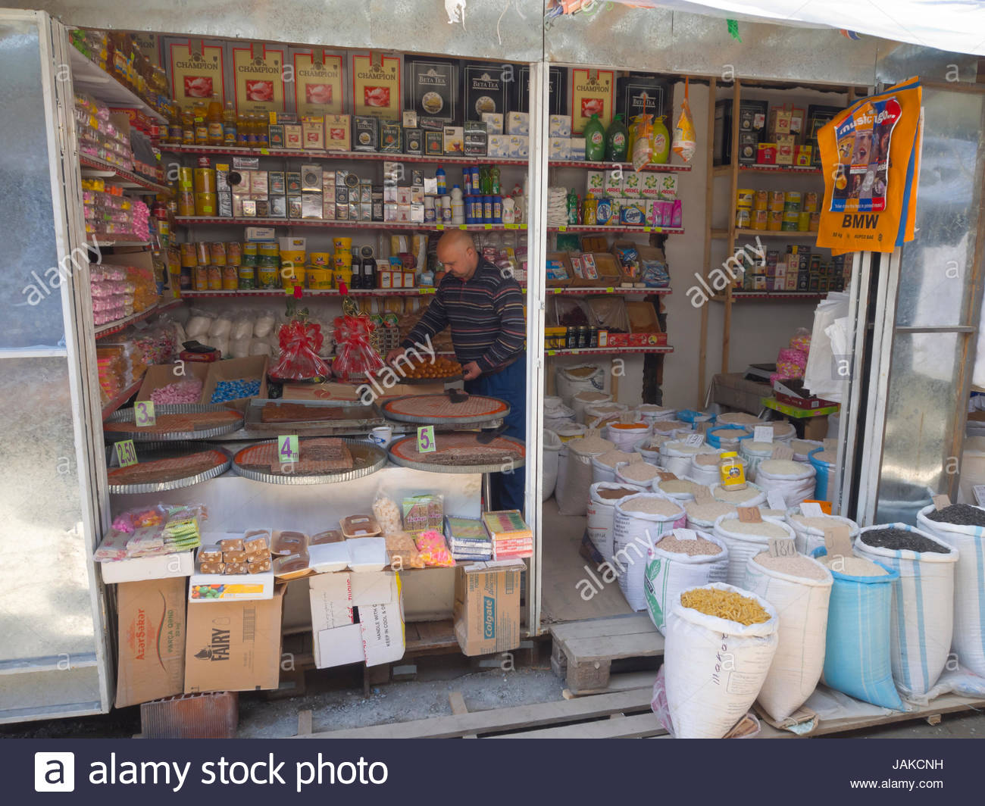
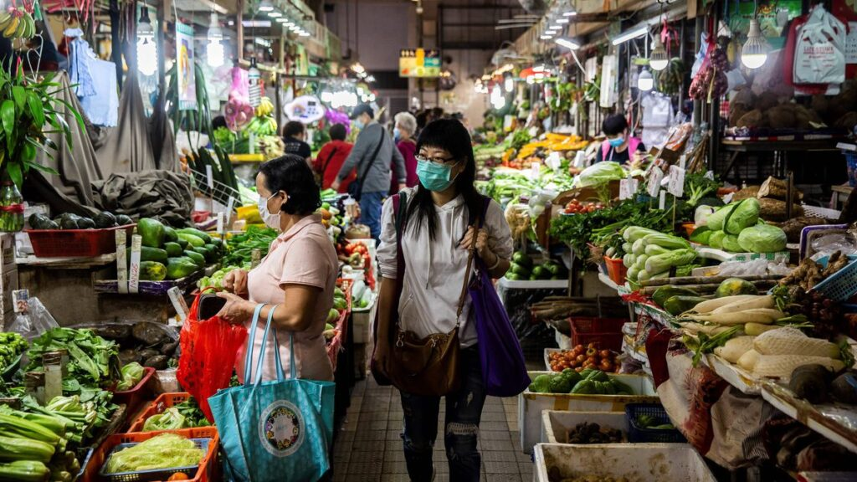
Market
A local market has many shops which sells different things of daily use-like vegetables,groceries etc

Slide 4
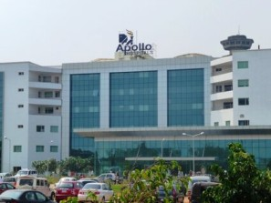
Hospital
Hospital
We go to the hospital when we are sick or injured. There are many doctors and nurses in a hospital. A doctor treats sick and injured people.

Slide 5
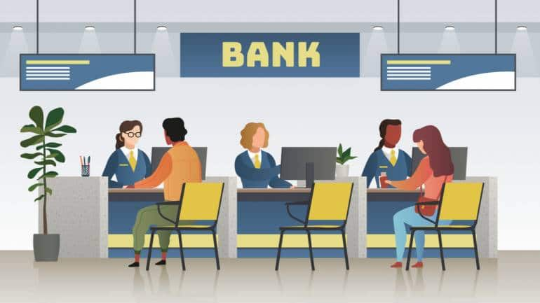
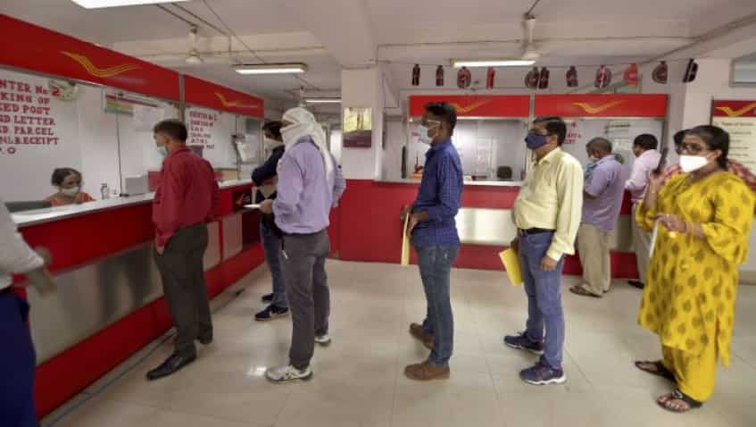
Bank
People deposit their money in a bank safely. They can also borrow money from the bank. This is called a loan.

Slide 6
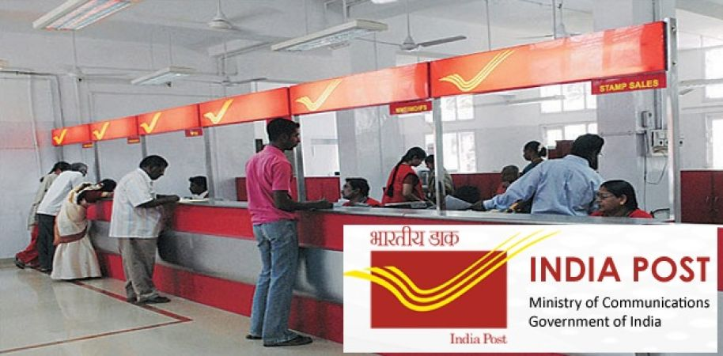
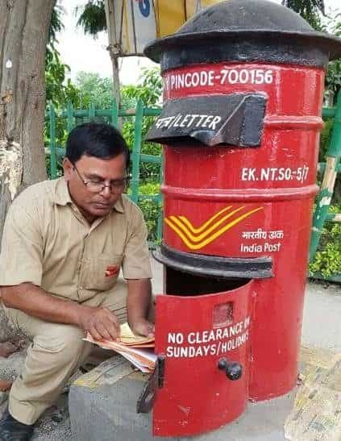
Post Office
We can send and receive letters and parcels through the post office. The postman brings letters from post office to our houses .

Slide 7
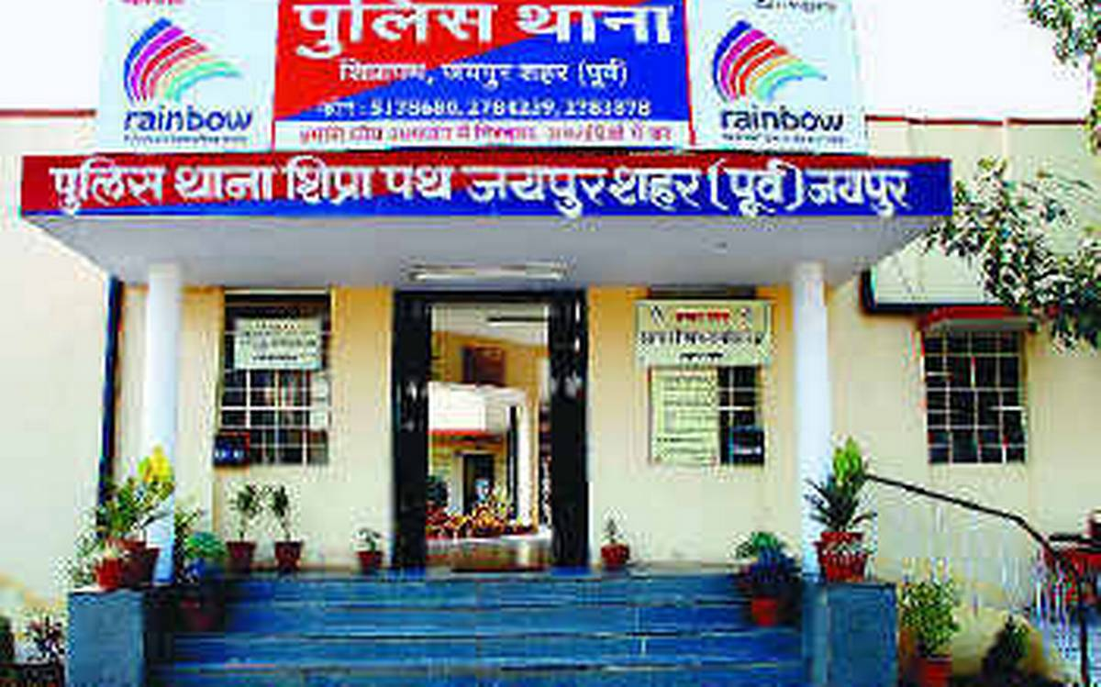
Police Station
A police station is a place where the police work. Policemen take care of our neighborhood. They catch thieves and robbers and put them in jail. They maintain law and order.

Slide 8
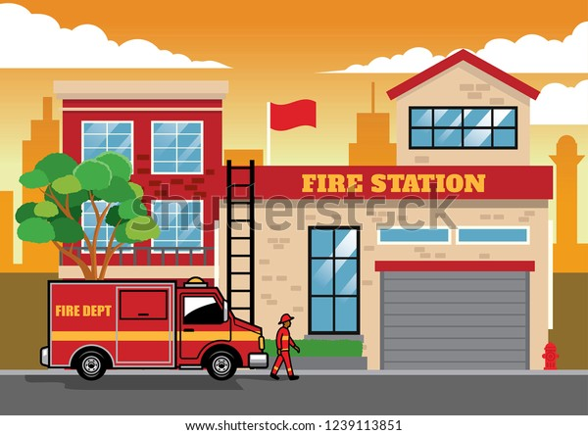
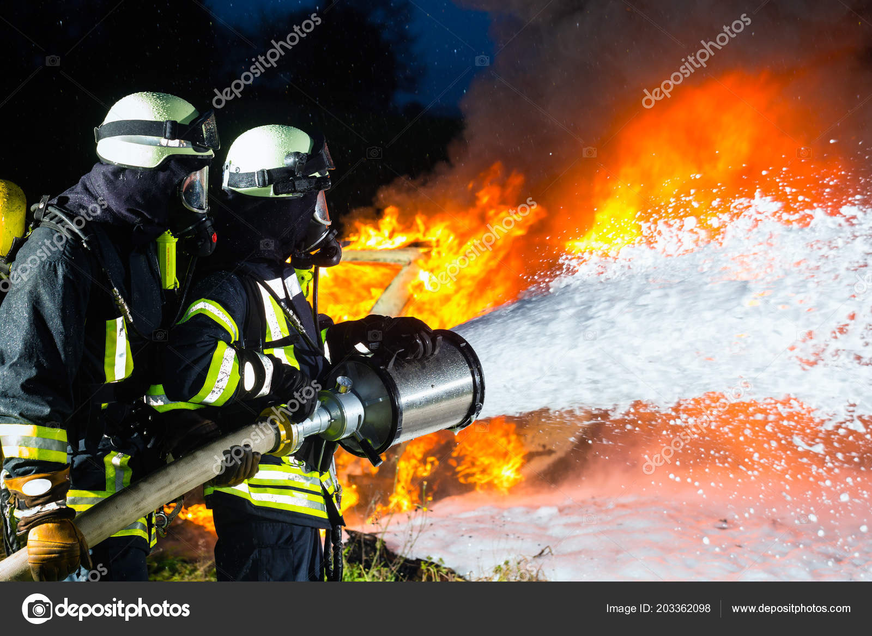
Fire Station
A fire station has a fire brigade. We call up the fire station when there is a fire. Fire fighters travel in red fire-engines to put out a fire .

Slide 9
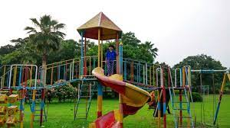
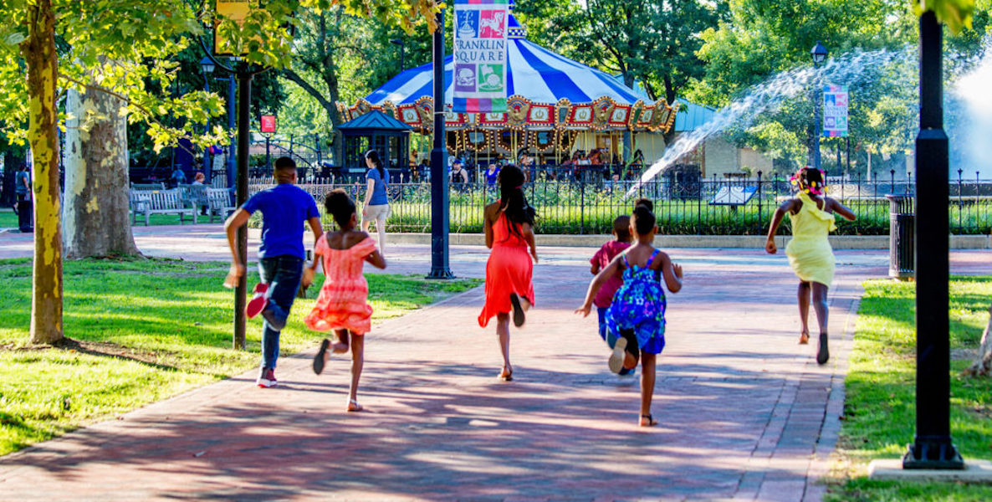
Park
A park has many plants and footpaths. It also has swings and see-saws for the enjoyment of children. Children go to park to play. Many people go there to walk.

Slide 10
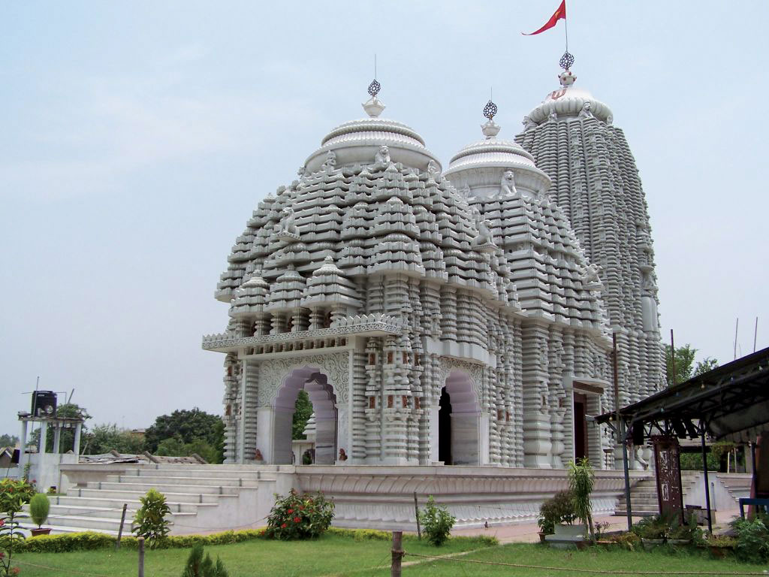
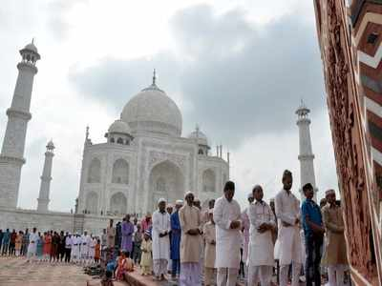
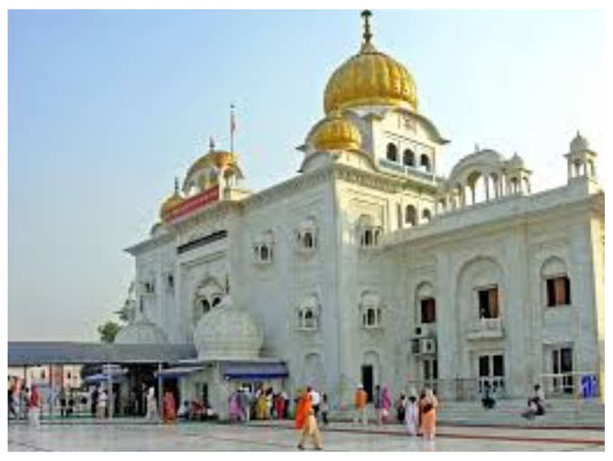
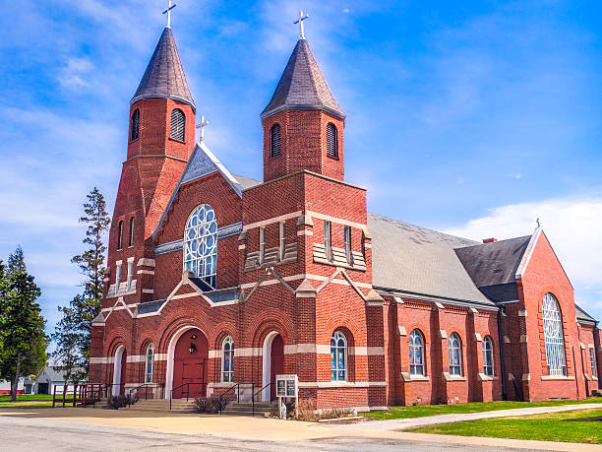
Places of Worship
Different people go to different places of worship to pray. for example – temples, mosques gurudwaras and churches.

Slide 11
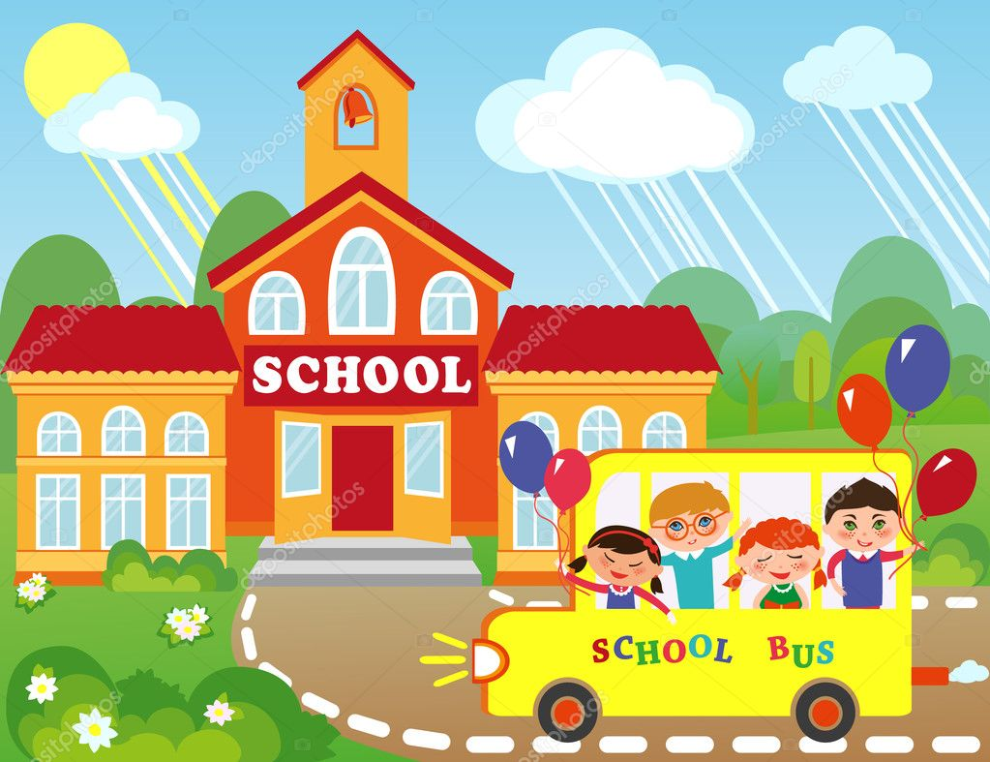
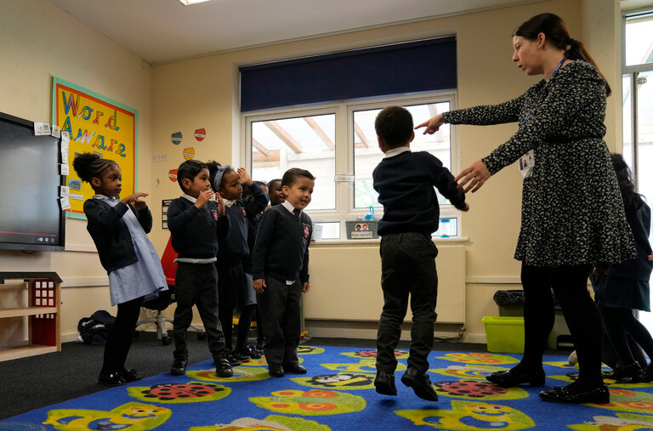
School
School is a very important service provider in our neighborhood. Children go to school to learn , read and write. They also learn many good habits.

Slide 12
So we see there are many important places in our neighborhood. We depend on these places to live our life comfortably. We should keep our neighborhood clean and safe.

Slide 13
Things to learn-some important places in our neighborhood -
Market
Hospital
Bank
Post Office
Police Station
Fire Station
Park
Places of Worship
School

Slide 14

Home assignment
Learn any five important places of your neighborhood and the person works there .

Slide 15
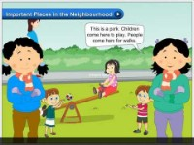

Slide 16

THANKING YOU
ODM EDUCATIONAL GROUP

